Slide 1

Your Daily Routine
Data-Driven. People-Led. Outcome-Focused.
Bone Health

Slide 2
Starter Activity
On the first page of your Workshop Guide, write down a list of common activities that you do on an average day
These can be any activity, such as
  tying your shoes
  doing laundry
  gardening

Slide 3
Agenda
1. Your Posture and Protecting Your Spine
2. Guidelines for Safe Movement
3. The Hip Hinge
4. The Do’s and Don’ts of Safe Movement
Data-Driven. People-Led. Outcome-Focused.

Slide 4
Learning Objectives
I will be able to…
Identify what good posture will look like and briefly explain why maintaining good posture is important for safe movement
Demonstrate, independently and while using good posture, how to implement proper body mechanics while executing different common daily activities to encourage active living
Identify a minimum of three Do’s and three Don’ts for Safe Movement
Demonstrate the hip hinge and identify specific activities of daily living (ADLs) that could be done with the hip hinge in mind

Slide 5
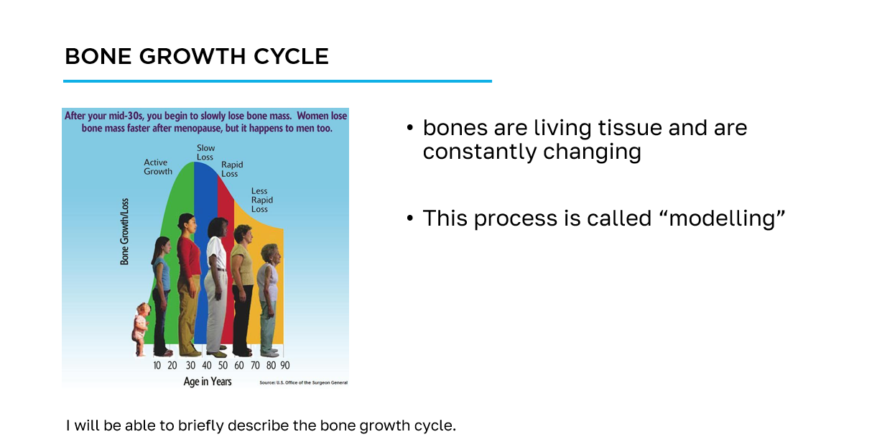
How to navigate the slides
slide title
key information
learning objective
slide image

Slide 6
Workshop Guide
As we progress through this workshop, please ensure to complete the appropriate sections of the Workshop Guide provided for you.
This will be your quick reference following this workshop to aid you on your bone health journey.

Slide 7
Section 1
Your Posture and
Protecting Your Spine

Slide 8
What is Proper Posture?
With the person next to you discuss what it means to have proper posture
  What does having proper posture look like to you?
  What are the benefits of having proper posture?
I will be able to identify what good posture will look like and briefly explain why maintaining good posture is important for safe movement.

Slide 9
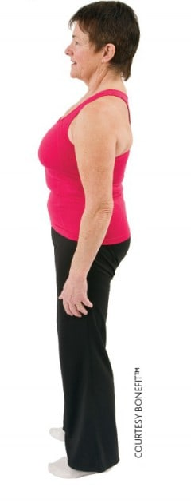
What is Proper Posture?
Having proper posture can be identified when your ear, shoulder and hip are in alignment
This alignment is called a neutral spine
  it is the strongest and safest position for the spine
I will be able to identify what good posture will look like and briefly explain why maintaining good posture is important for safe movement.
Notes:
Image Source: https://osteoporosis.ca/bone-health-osteoporosis/living-with-the-disease/after-the-fracture/self-help-guidelines-for-day-to-day-activities-after-a-spine-fracture/what-is-a-neutral-spine/

Slide 10
How to Maintain a Proper Posture
Video – Proper Posture
Video courtesy of Osteoporosis Canada
I will be able to identify what good posture will look like and briefly explain why maintaining good posture is important for safe movement.
Notes:
Video Source: https://osteoporosis.ca/bone-health-osteoporosis/living-with-the-disease/after-the-fracture/videos-on-how-to-safely-do-everyday-activities/

Slide 11
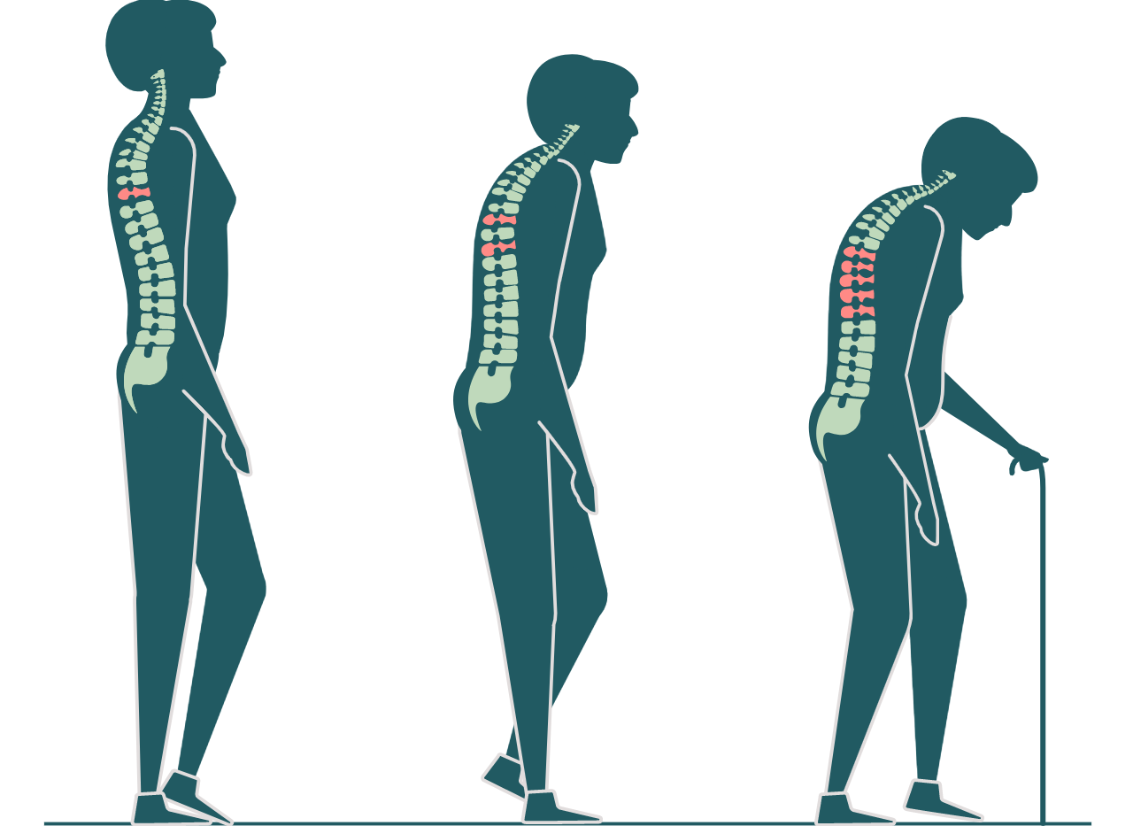
What if we do not protect our spine?
the neutral position is the best position to protect your spine
  by training your muscles you can prevent strain on your spine
hunching over or twisting your spine causes a lot of strain
  the more strain increases the risk of spinal fractures (also known as vertebral compression fractures)
  this is compounded in individuals with low bone density
As we get older...
I will be able to identify what good posture will look like and briefly explain why maintaining good posture is important for safe movement.

Slide 12
Section 2
Guidelines for Safe Movement

Slide 13
Standing and Sitting
Standing and walking puts less strain on the spine than sitting
When standing…
maintain your spine in the neutral position
keep your feet pointed straight with your knees lined up over your second toe
if standing in one place for a length of time, put one foot up on a stool or open cupboard
  switch feet periodically
I will be able to demonstrate, independently and using good posture, how to implement proper body mechanics while executing different common daily activities to encourage active living.

Slide 14
Standing and Sitting
When sitting…
maintain your spine in the neutral position
use a rolled towel or pillow to support your lower back
keep your head, hips and back in alignment
keep your hips higher than your knees - perch position
have your feet rest flat on the floor
  if they do not reach the floor, use a small footstool
if at a desk, prop up what you are working on so it slants towards you
I will be able to demonstrate, independently and using good posture, how to implement proper body mechanics while executing different common daily activities to encourage active living.

Slide 15
Moving between Standing and Sitting
Video – Standing to Sitting
Video courtesy of Osteoporosis Canada
I will be able to demonstrate, independently and using good posture, how to implement proper body mechanics while executing different common daily activities to encourage active living.
Notes:
Video Source: https://osteoporosis.ca/bone-health-osteoporosis/living-with-the-disease/after-the-fracture/videos-on-how-to-safely-do-everyday-activities/

Slide 16
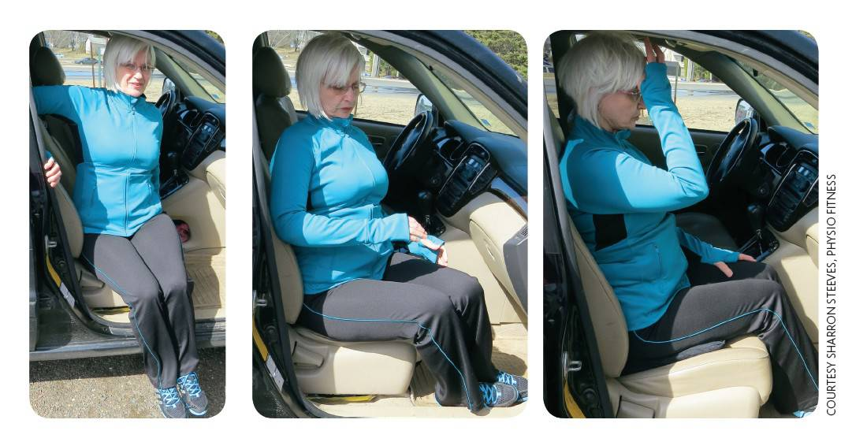
Getting In and Out of a Car
use the same method for getting on and off a chair
bring a small towel or pillow to keep your spine as upright as possible
  you may benefit from a wedge-shaped cushion (found in the automotive department of most retailers)
I will be able to demonstrate, independently and using good posture, how to implement proper body mechanics while executing different common daily activities to encourage active living.
Notes:
Image Source: https://osteoporosis.ca/bone-health-osteoporosis/living-with-the-disease/after-the-fracture/self-help-guidelines-for-day-to-day-activities-after-a-spine-fracture/sitting/

Slide 17
Walking
When walking…
maintain your spine in the neutral position
point your feet straight ahead
your knees should be lined up over your 2nd toe in your shoe
do not let your knees lock back as you bring your weight over your foot - keep them slightly bent
keep knees, hips and toes lined up when climbing stairs
I will be able to demonstrate, independently and using good posture, how to implement proper body mechanics while executing different common daily activities to encourage active living.

Slide 18
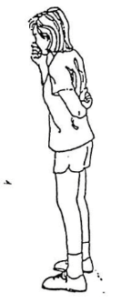
Coughing or Sneezing
When coughing or sneezing…
develop the habit of supporting your back with one hand whenever you cough or sneeze
  this protects the spine from damage caused by the sudden bend forward
I will be able to demonstrate, independently and using good posture, how to implement proper body mechanics while executing different common daily activities to encourage active living.
Notes:
Image Source: Alberta Health Services. (2013). Osteoporosis/Bone Health Education Program. (pp. 46).

Slide 19
STABLE Acronym
S - maintain your SPINE in a neutral position
T - avoid TRUNK twisting
A - keep your ARMS close to your body
B - maintain a wide BASE of support
L - use your LEGS
E - EVALUATE the load, environment, abilities and limitations
I will be able to identify a minimum of three Do’s and three Don’ts for Safe Movement.

Slide 20
Section 3
The Hip Hinge

Slide 21
Bending with a Neutral Spine
There are many daily activities that require us to bend over or lean forward - such as brushing our teeth or washing our face
a helpful movement to know is called the hip hinge, which significantly reduces the strain on the spine
I will be able to demonstrate the hip hinge and identify specific activities of daily living (ADLs) that could be done with the hip hinge in mind.

Slide 22
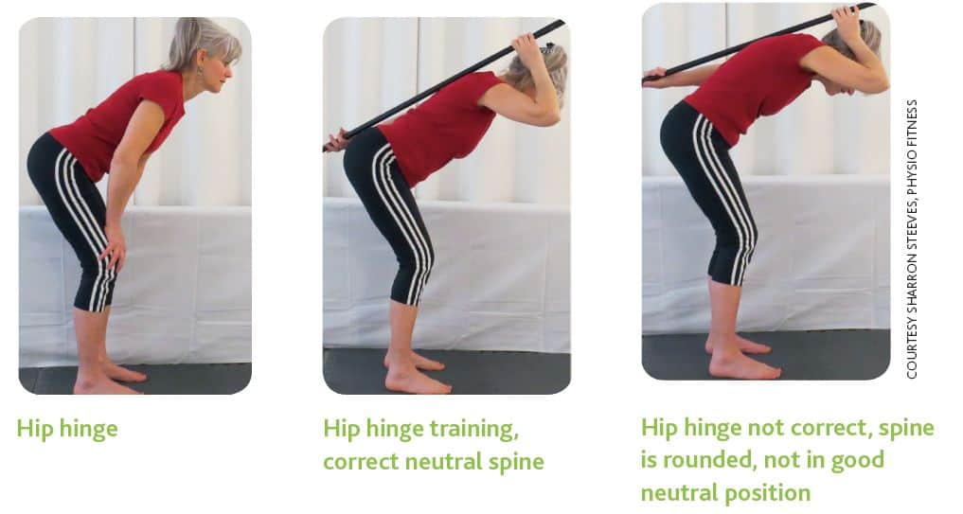
The Hip Hinge
bend your knees slightly while keeping your back straight from hip to shoulder
stick out your tailbone behind you to bend forward from the hips
I will be able to demonstrate the hip hinge and identify specific activities of daily living (ADLs) that could be done with the hip hinge in mind.
Notes:
Image Source: https://osteoporosis.ca/bone-health-osteoporosis/living-with-the-disease/after-the-fracture/self-help-guidelines-for-day-to-day-activities-after-a-spine-fracture/bending-with-a-neutral-spine/#hip_hinge

Slide 23
The Hip Hinge
Video – Hip Hinge
Video courtesy of Osteoporosis Canada
I will be able to demonstrate the hip hinge and identify specific activities of daily living (ADLs) that could be done with the hip hinge in mind.
Notes:
Video Source: https://osteoporosis.ca/bone-health-osteoporosis/living-with-the-disease/after-the-fracture/self-help-guidelines-for-day-to-day-activities-after-a-spine-fracture/bending-with-a-neutral-spine/#hip_hinge

Slide 24
Safe Lifting and Carrying
Video – Safe Lifting and Carrying
Video courtesy of Osteoporosis Canada
I will be able to demonstrate the hip hinge and identify specific activities of daily living (ADLs) that could be done with the hip hinge in mind.
Notes:
Video Source: https://osteoporosis.ca/bone-health-osteoporosis/living-with-the-disease/after-the-fracture/videos-on-how-to-safely-do-everyday-activities/

Slide 25
Safe Sweeping
Video – Safe Sweeping
Video courtesy of Osteoporosis Canada
I will be able to demonstrate the hip hinge and identify specific activities of daily living (ADLs) that could be done with the hip hinge in mind.
Notes:
Video Source: https://osteoporosis.ca/bone-health-osteoporosis/living-with-the-disease/after-the-fracture/videos-on-how-to-safely-do-everyday-activities/

Slide 26
Activities of Daily Living
Another great resource for other common daily activities can be found here (found in your Workshop Guide):
https://melioguide.com/health-guides/activities-of-daily-living/
Examples of activities listed:
raking leaves
shovelling and weeding in the garden
mowing your lawn
shovelling the snow

Slide 27
Section 4
The Do’s and Don’ts of Safe Movement

Slide 28
The Do’s of Safe Movement
Always pay attention to proper posture
  lift your breastbone
  keep your head erect and look forward
  keep your shoulders back and slightly “pinch” your shoulder blades
  tighten your abdominal muscles and buttocks
Whenever possible, walk or climb the stairs
  when walking the stairs, use the handrail
Always bend from the hips and knees, not from the waist
I will be able to identify a minimum of three Do’s and three Don’ts for Safe Movement.

Slide 29
The Don'ts of Safe Movement
Don’t…
walk or exercise on slippery surfaces
wear backless bedroom slippers or shoes with slippery soles
slouch when standing, walking or sitting at a desk
sit in a deep, cushioned chair or couch that causes you to sink into it
move too quickly
I will be able to identify a minimum of three Do’s and three Don’ts for Safe Movement.

Slide 30
The Don'ts of Safe Movement
Don’t…
engage in sports or activities that require twisting the spine or bending forward from the waist before talking to your healthcare provider
  for example: sit-ups, toe-touches or swinging a golf club
force yourself to complete a task or exercise if you feel short of breath, are in pain or are fatigued
take to your chair or bed for extended periods of time
  inactivity is one of the worst things for osteoporosis
I will be able to identify a minimum of three Do’s and three Don’ts for Safe Movement.

Slide 31
Cool-down Activity
Review your activity list from the starter activity at the beginning of the workshop
  Identify for which activities you are already practicing safe movement techniques and for which some modifications are required
With the person next to you, discuss what changes you can make to some of the more common activities to ensure that you are practicing safe movement

Slide 32
Additional Resources
Osteoporosis Canada
osteoporosis.ca
Dr. David Hanley Osteoporosis Centre
osteoporosiscalgary.com
National Osteoporosis Foundation
nof.org

Slide 33






SPONSORS

Slide 34
Bibliography
(n.d.) A Few Self-Help Guidelines for Day-to-Day Activities After A Spine Fracture. Retrieved from https://osteoporosis.ca/bone-health-osteoporosis/living-with-the-disease/after-the-fracture/table-of-contents/
(2020). Activities of Daily Living. Retrieved from https://melioguide.com/health-guides/activities-of-daily-living/
(2020). How to Do a Hip Hinge. Retrieved from https://www.verywellfit.com/how-to-do-a-hip-hinge-4685934
(2019). Osteoporosis Fracture Facts. Retrieved from https://www.fracturedtruths.com/osteoporosis-fracture-facts
Alberta Health Services. (2013). Osteoporosis/Bone Health Education Program. (pp. 40-48).

