Slide 1

Strengthening and Resistance Exercises
Data-Driven. People-Led. Outcome-Focused.
Bone Health

Slide 2
Starter Activity
Please, complete the Get Active Questionnaire handout.
We will return to this questionnaire at the end of the workshop.

Slide 3
Agenda
1. Exercise Guidelines
2. Lower Body Strength Exercise Routine
3. Upper Body and Upper Back Strength Exercise Routine
4. SMART Goal Setting
Data-Driven. People-Led. Outcome-Focused.

Slide 4
Learning Objectives
I will be able to…
Assess my personal activity level in relation to both the Canadian Physical Activity Guidelines and the Osteoporosis Canada recommendations for bone health
Identify what I am doing well and what I can improve on in terms of exercise for bone health
Briefly explain the significance of strength exercises in managing my bone health
Perform strengthening exercises safely and correctly
Create a personal exercise routine for bone health by setting a SMART goal for strength training

Slide 5
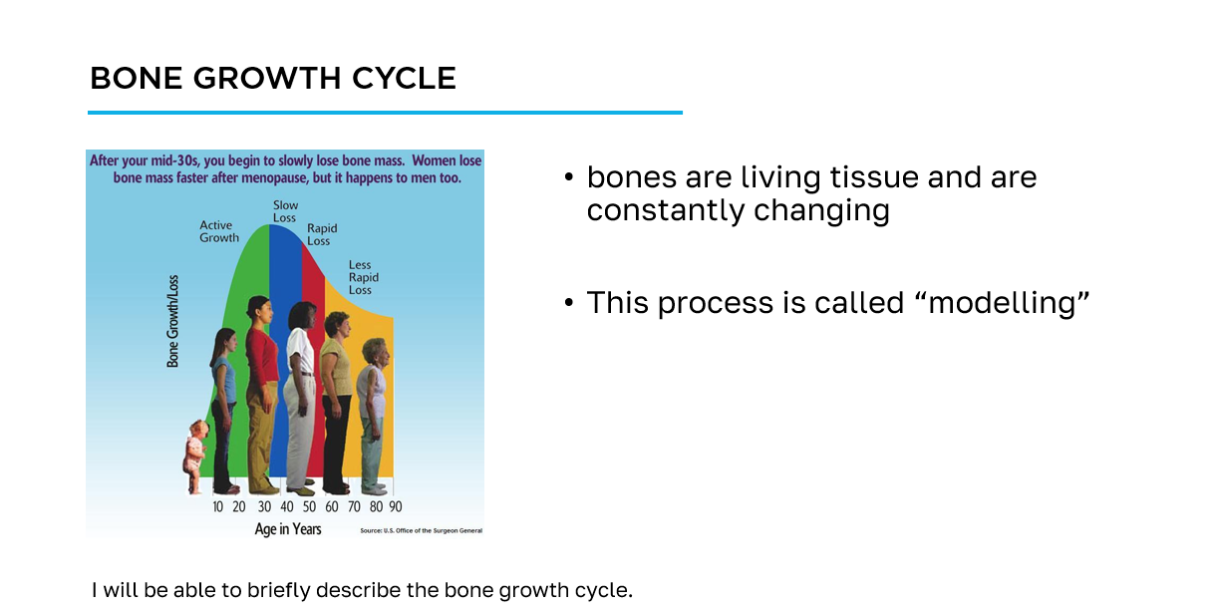
How to navigate the slides
slide title
key information
learning objective
slide image

Slide 6
Workshop Guide
As we progress through this workshop, please ensure to complete the appropriate sections of the Workshop Guide provided for you.
This will be your quick reference following this workshop to aid you on your bone health journey.

Slide 7
Section 1
Exercise Guidelines

Slide 8
Canadian Physical Activity Guidelines
To achieve health benefits, adults aged 18-64 should:
accumulate at least 150 minutes of moderate-to-vigorous intensity aerobic physical activity per week, in bouts of 10 minutes or more
perform muscle and bone strengthening activities using major muscle groups, at least 2 days per week
65 years and older:
as above + physical activities to enhance balance and prevent falls
I will be able to assess my personal activity level in relation to both the Canadian Physical Activity Guidelines and the Osteoporosis Canada recommendations for bone health.

Slide 9
Exercise for Bone Health
Osteoporosis Canada recommends:
at least 150 minutes of moderate-to-vigorous intensity aerobic physical activity per week, in bouts of 10 minutes or more - weight-bearing is better
muscle and bone strengthening activities using major muscle groups, at least 2 days per week
physical activities to enhance balance and prevent falls daily
practice spine sparing strategies and good posture daily
I will be able to assess my personal activity level in relation to both the Canadian Physical Activity Guidelines and the Osteoporosis Canada recommendations for bone health.

Slide 10
What is Strength Training?
With the person beside you, discuss what strength training means to you and what your experience has been with strength training.
Record your ideas in your Workshop Guide.
I will be able to briefly explain the significance of strength exercises in managing my bone health.

Slide 11
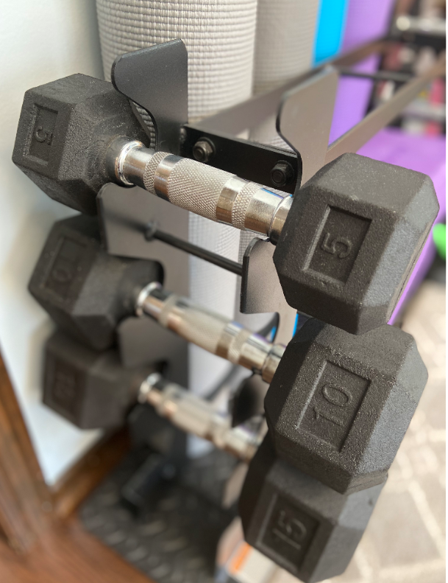
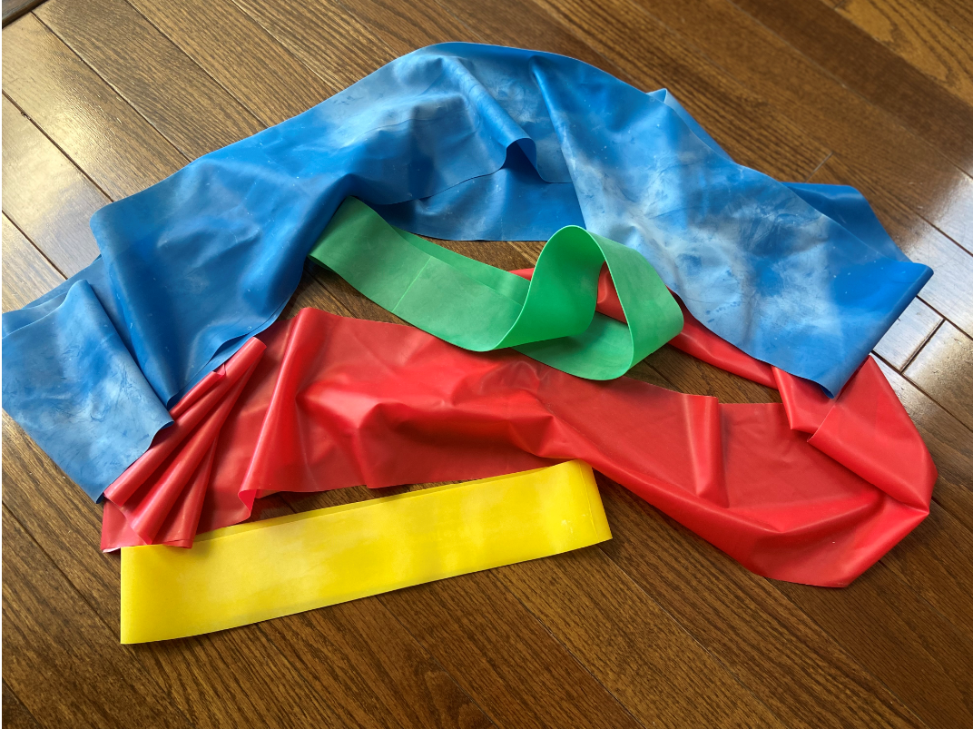
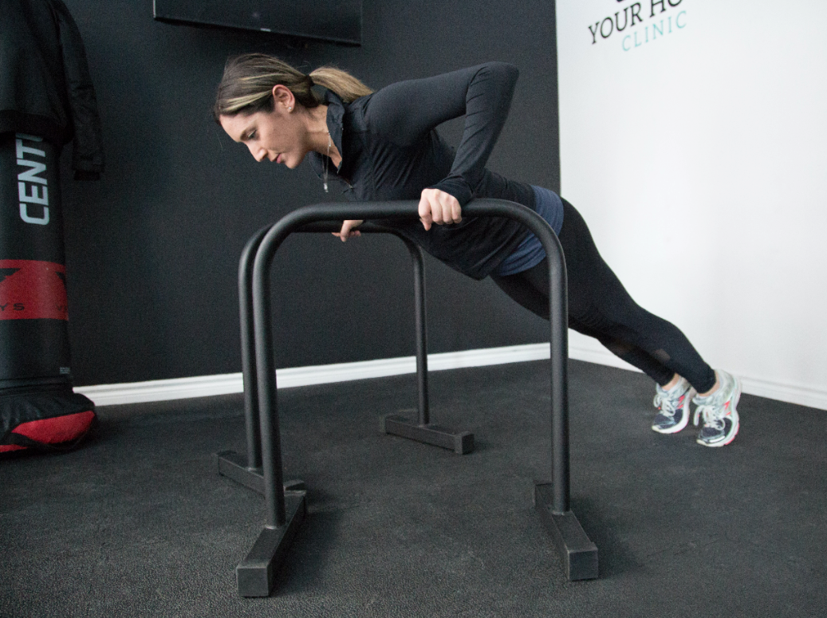
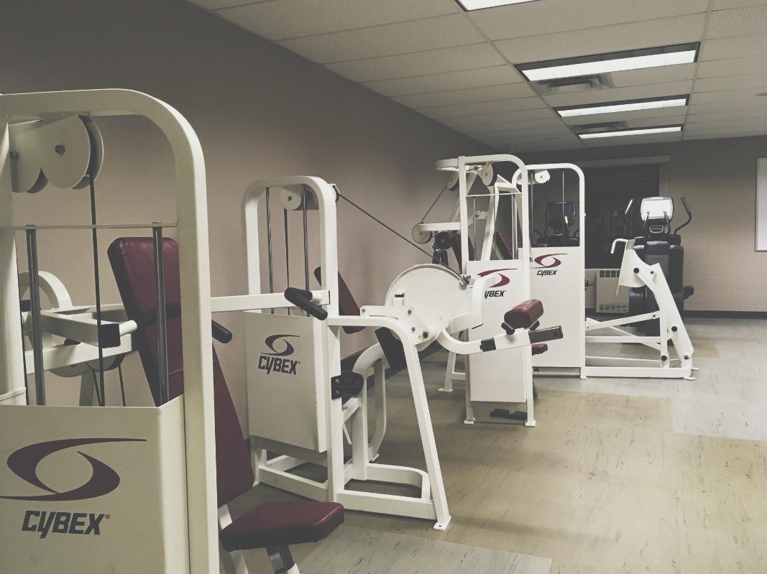
What is Strength Training?
Movements performed against resistance. You can use:
weights
gym equipment
exercise bands
lifting your body against gravity
I will be able to briefly explain the significance of strength exercises in managing my bone health.

Slide 12
Why Should I Strength Train?
Strength training will
build your muscle
make your muscles stronger
prevent falls
protect the spine
slow the rate of bone loss
I will be able to briefly explain the significance of strength exercises in managing my bone health.

Slide 13
General Rules of Strength Training
Strength exercises should
target
  shoulders and arms
  upper and lower legs
  upper back and chest
be performed at least 2 days per week
be challenging so that you can only do 8 to 12 repetitions in a row
make your muscles feel tired
I will be able to perform strengthening exercises safely and correctly.

Slide 14
Before You Start Exercising
For almost everyone the benefits of exercise far outweigh the risks!
complete a Get Active Questionnaire before you start a new exercise program and...
if you have any questions or concerns check with your doctor, a physiotherapist, a qualified exercise professional (Canadian Society for Exercise Physiology) or a BoneFitTM trained professional
I will be able to perform strengthening exercises safely and correctly.

Slide 15
Osteoporosis and Spine Fracture
If you have had a spine fracture:
focus on your posture and technique/alignment, rather than how hard you are exercising
speak with a physiotherapist, a qualified exercise professional (Canadian Society for Exercise Physiology) or a BoneFitTM trained professional
a tailored or supervised program is recommended
I will be able to perform strengthening exercises safely and correctly.

Slide 16
When Exercising
Remember to…
wear comfortable, supportive footwear
be aware that muscle soreness after exercise is normal
use a firm, stable chair for support
learn to perform the exercise with proper technique
control the speed of your movement
I will be able to perform strengthening exercises safely and correctly.

Slide 17
Section 2
Lower Body Strength Routine

Slide 18
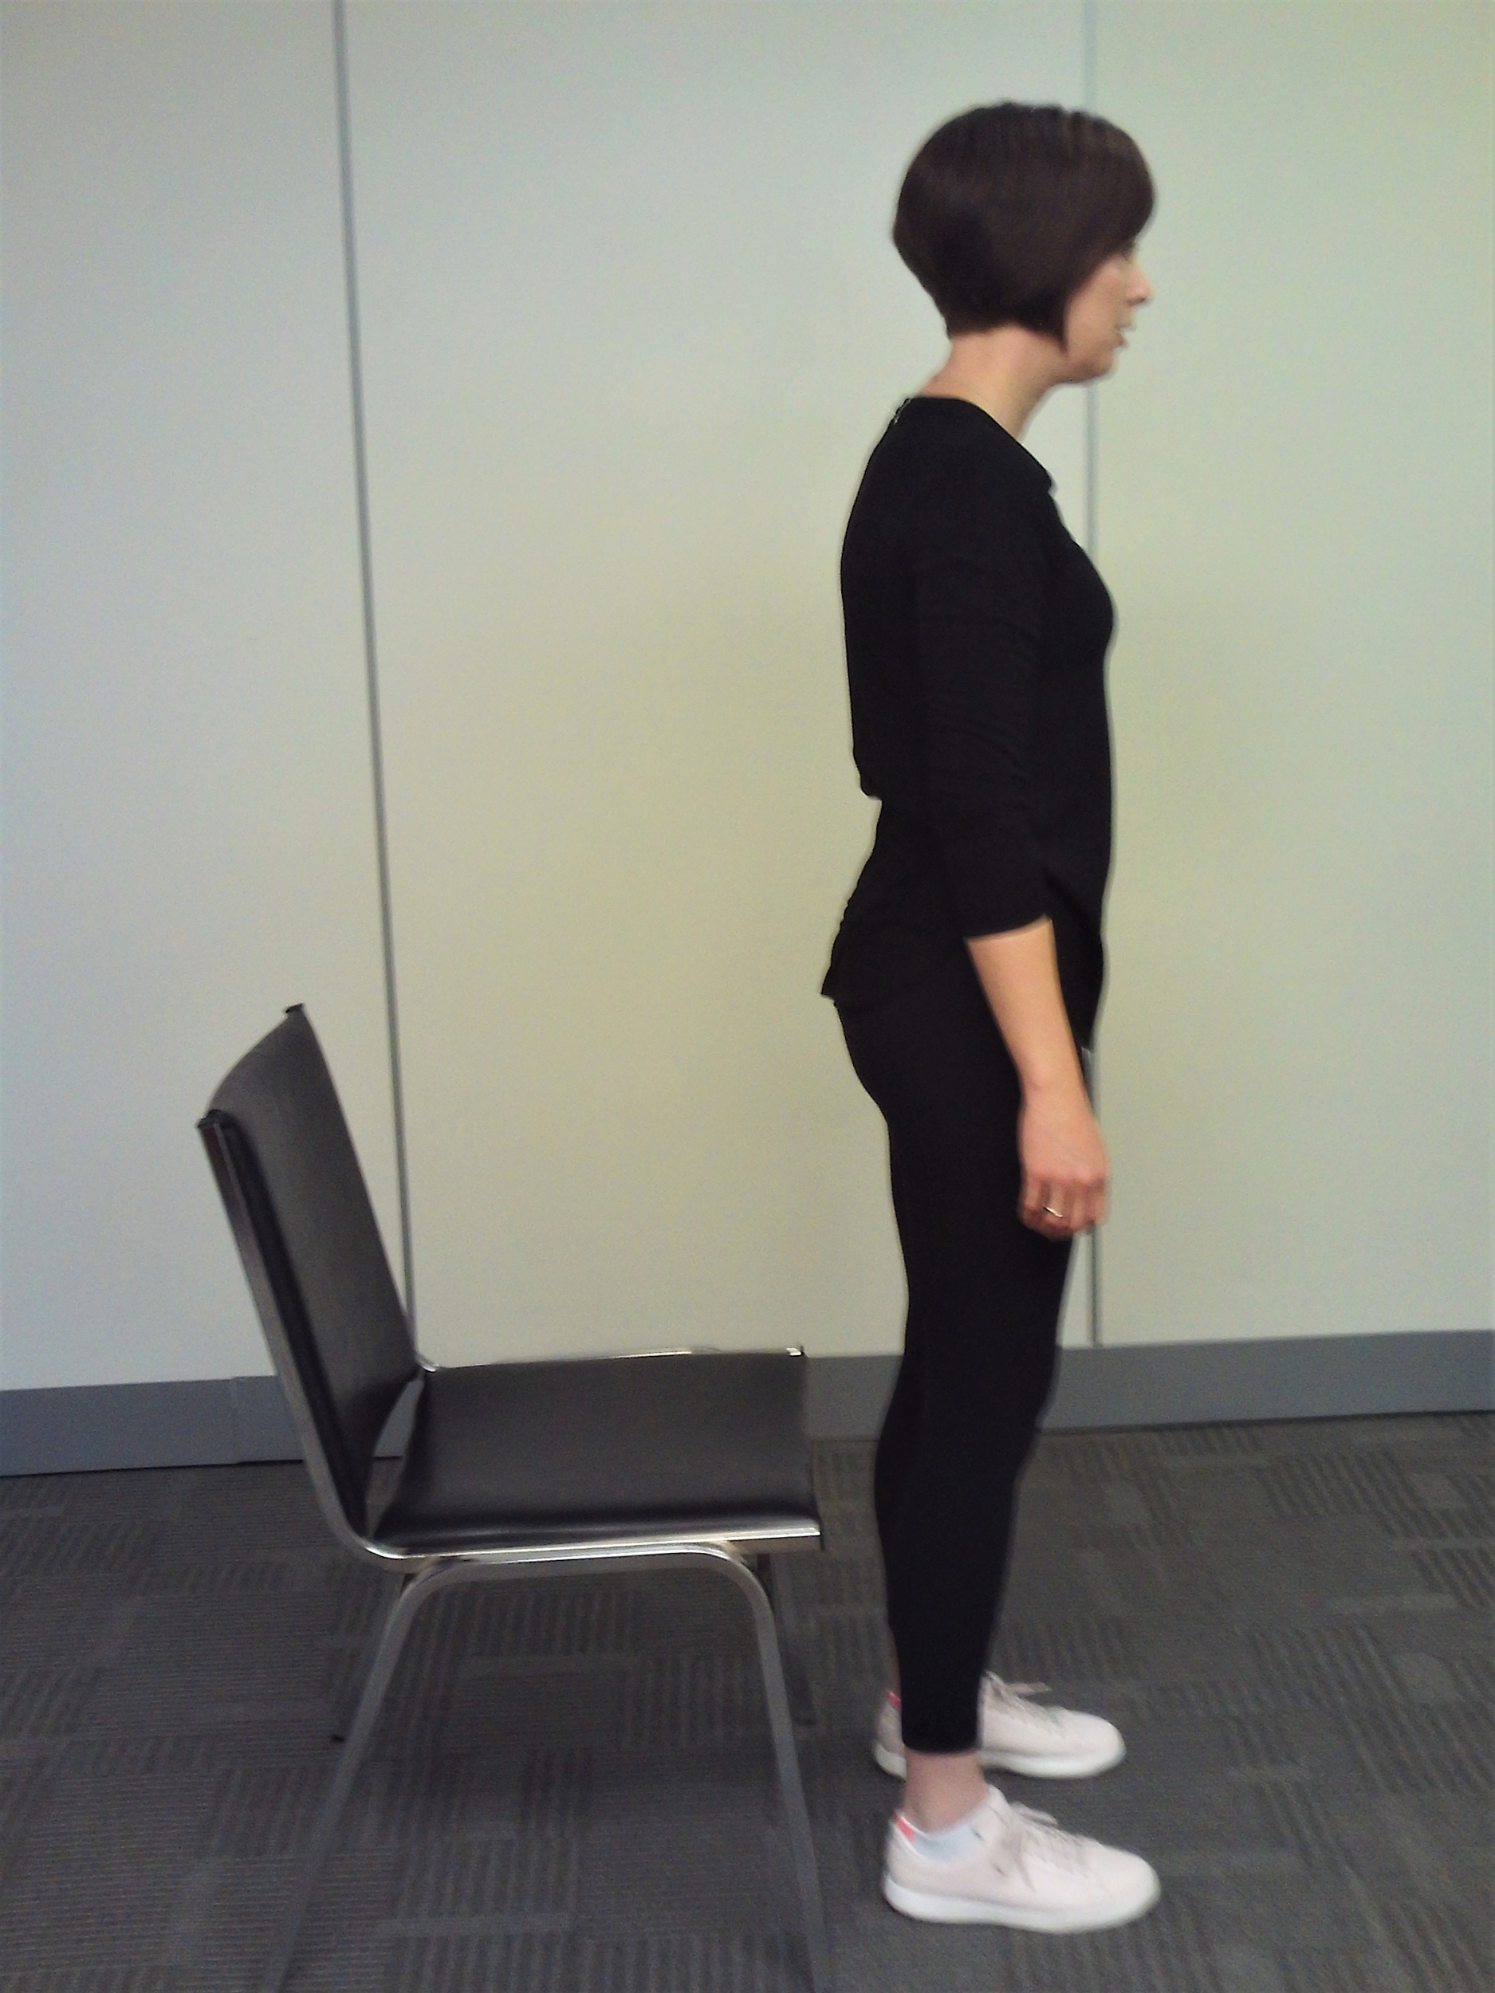
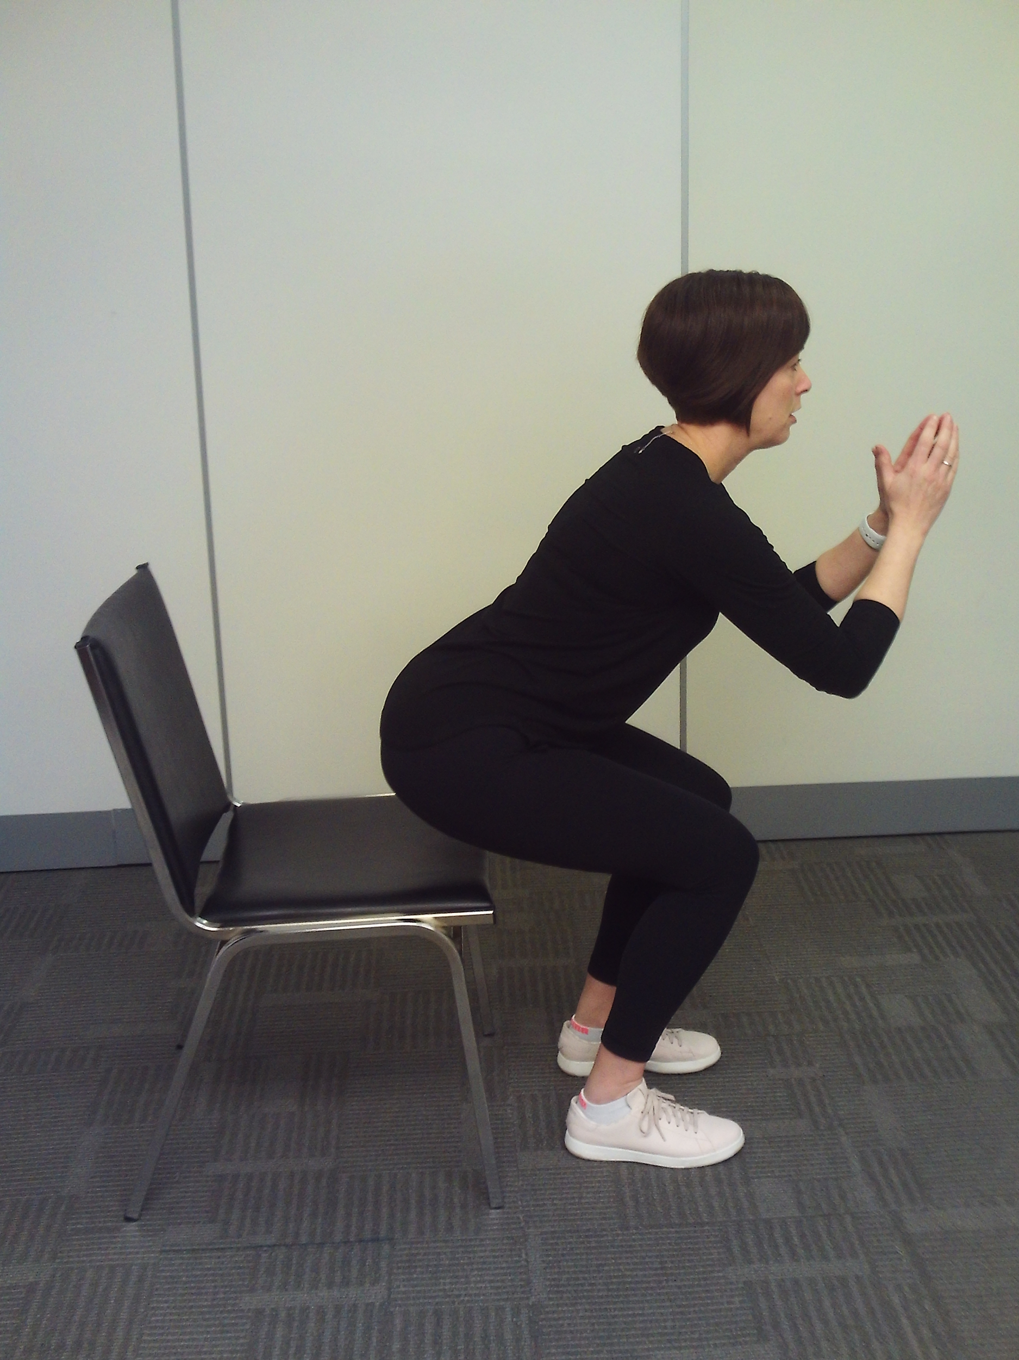
Squat
Repeat up to 15 times
Begin in a standing upright position in front of a chair.
Lower yourself into a squatting position, hinging at your hips and knees, until you lightly touch the chair.
Return to starting position and repeat.
I will be able to perform strengthening exercises safely and correctly.

Slide 19
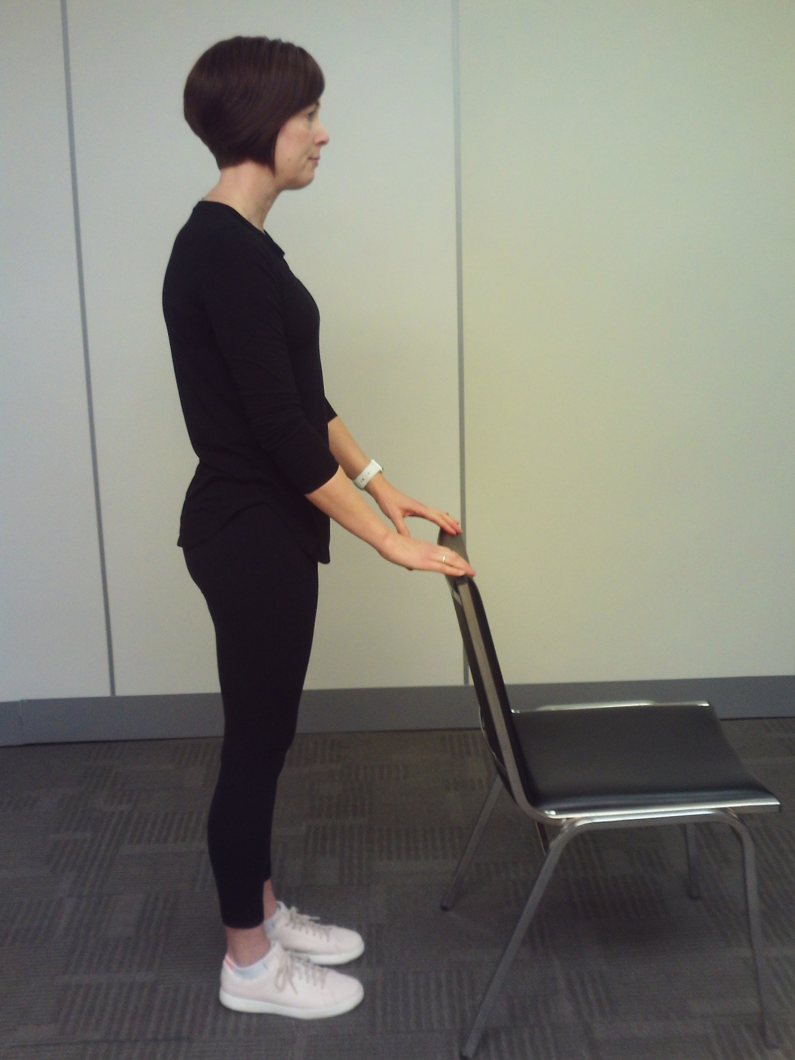
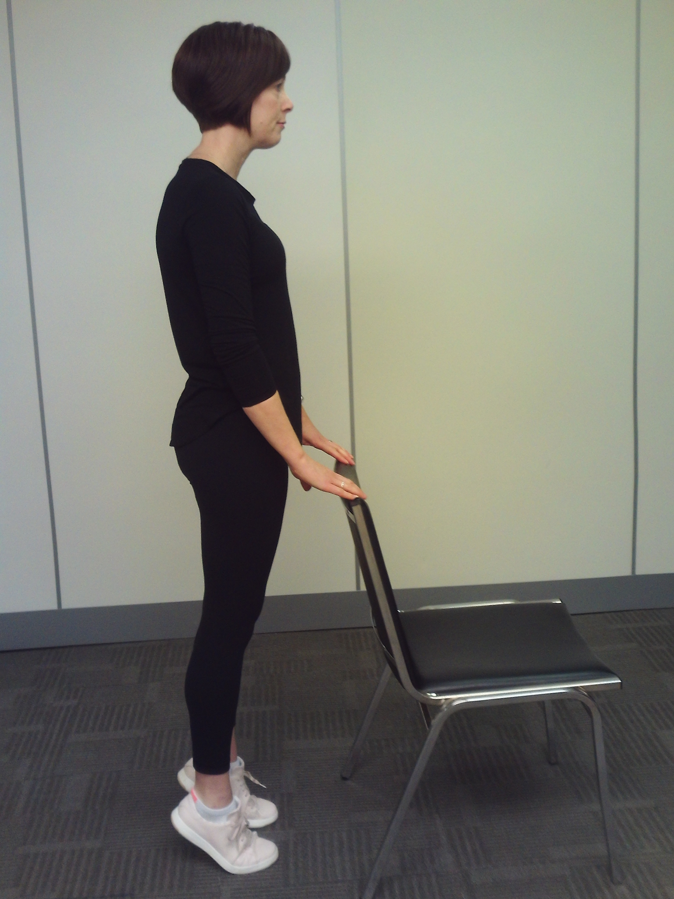
Heel Raise
Repeat on each leg up to 15 times
Begin in standing holding onto a chair for support
Slowly raise your heels off the ground
Lower back to the floor and repeat
I will be able to perform strengthening exercises safely and correctly.

Slide 20
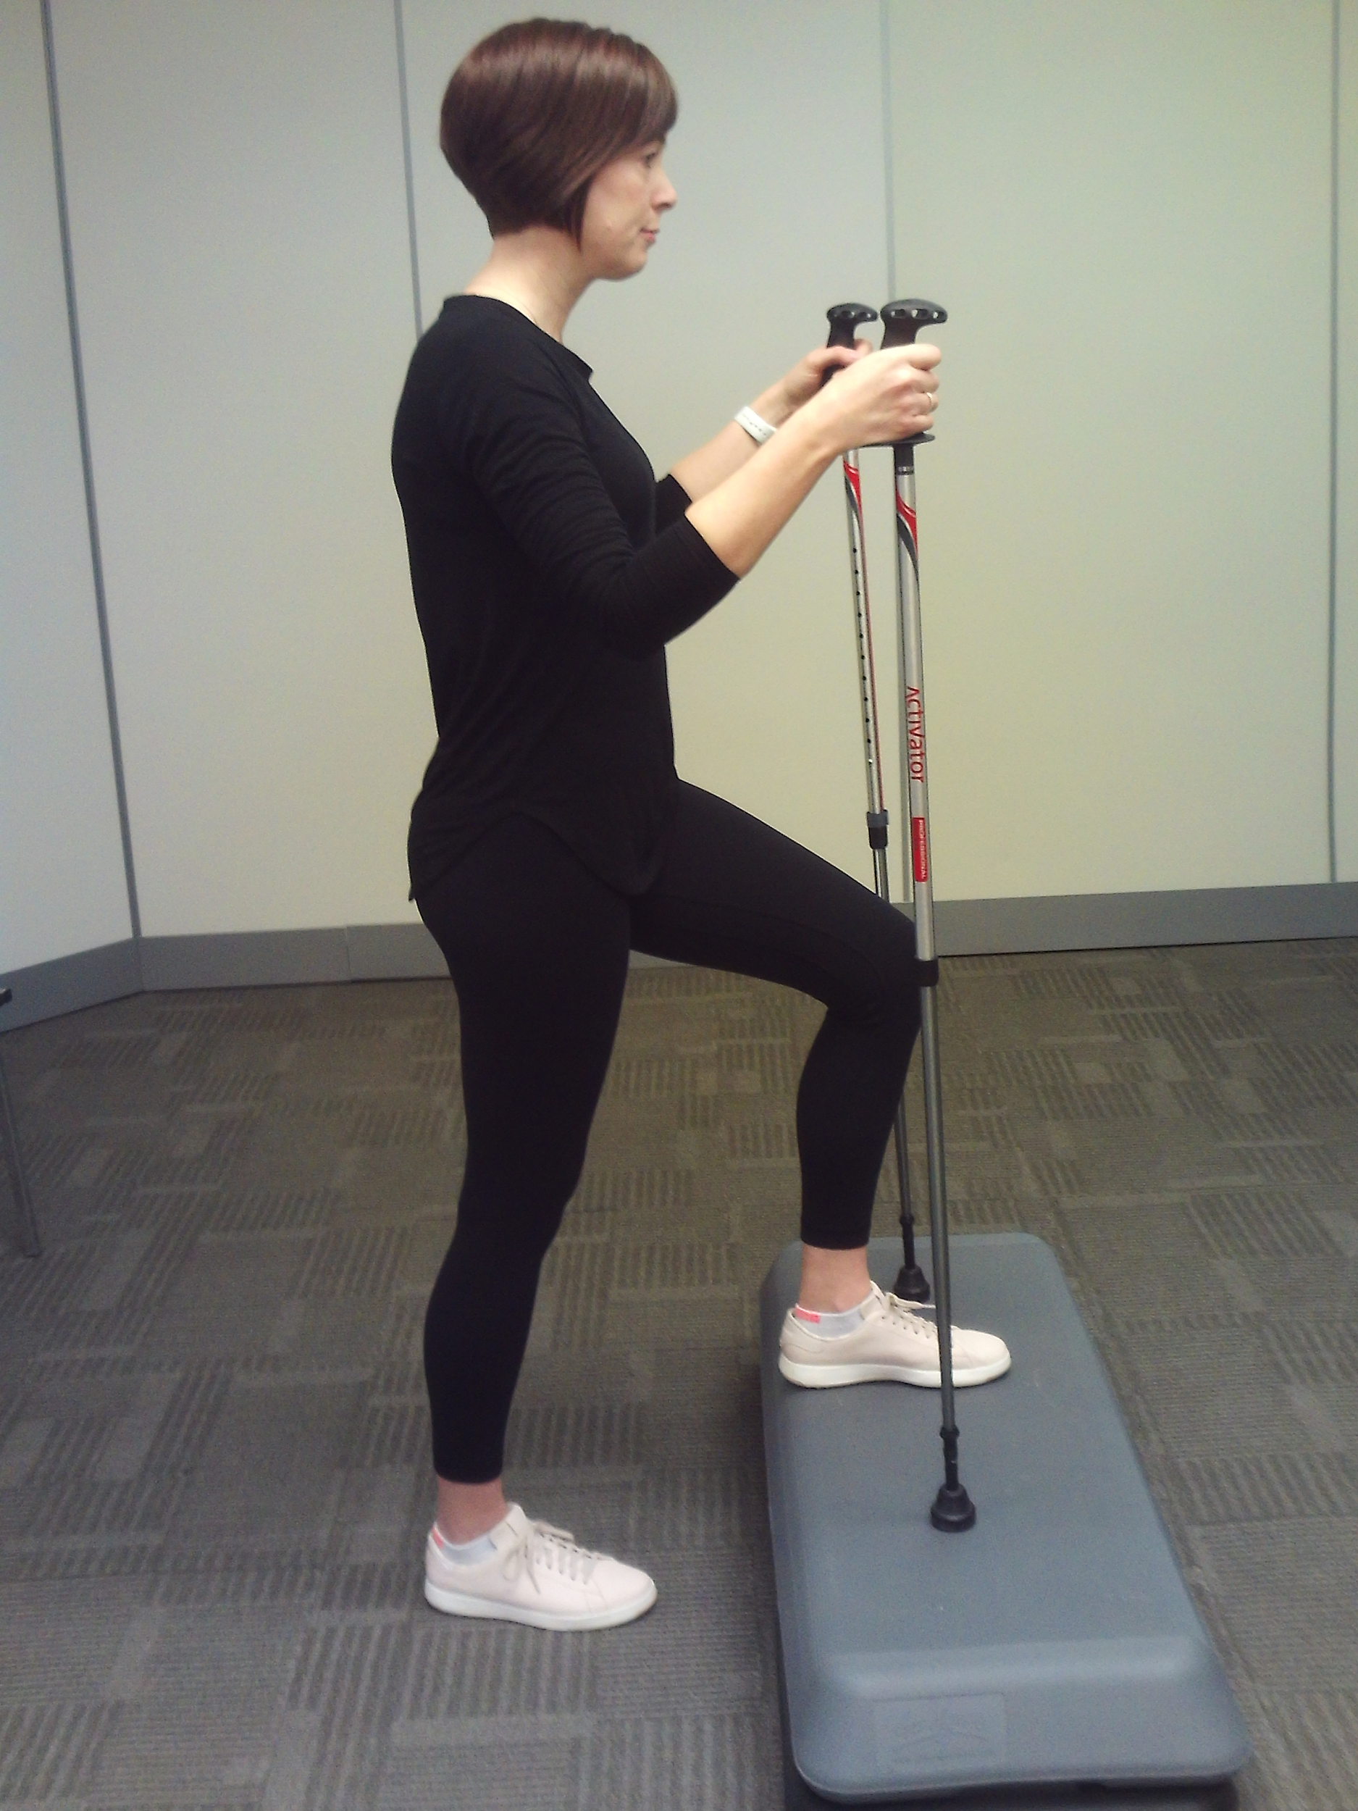
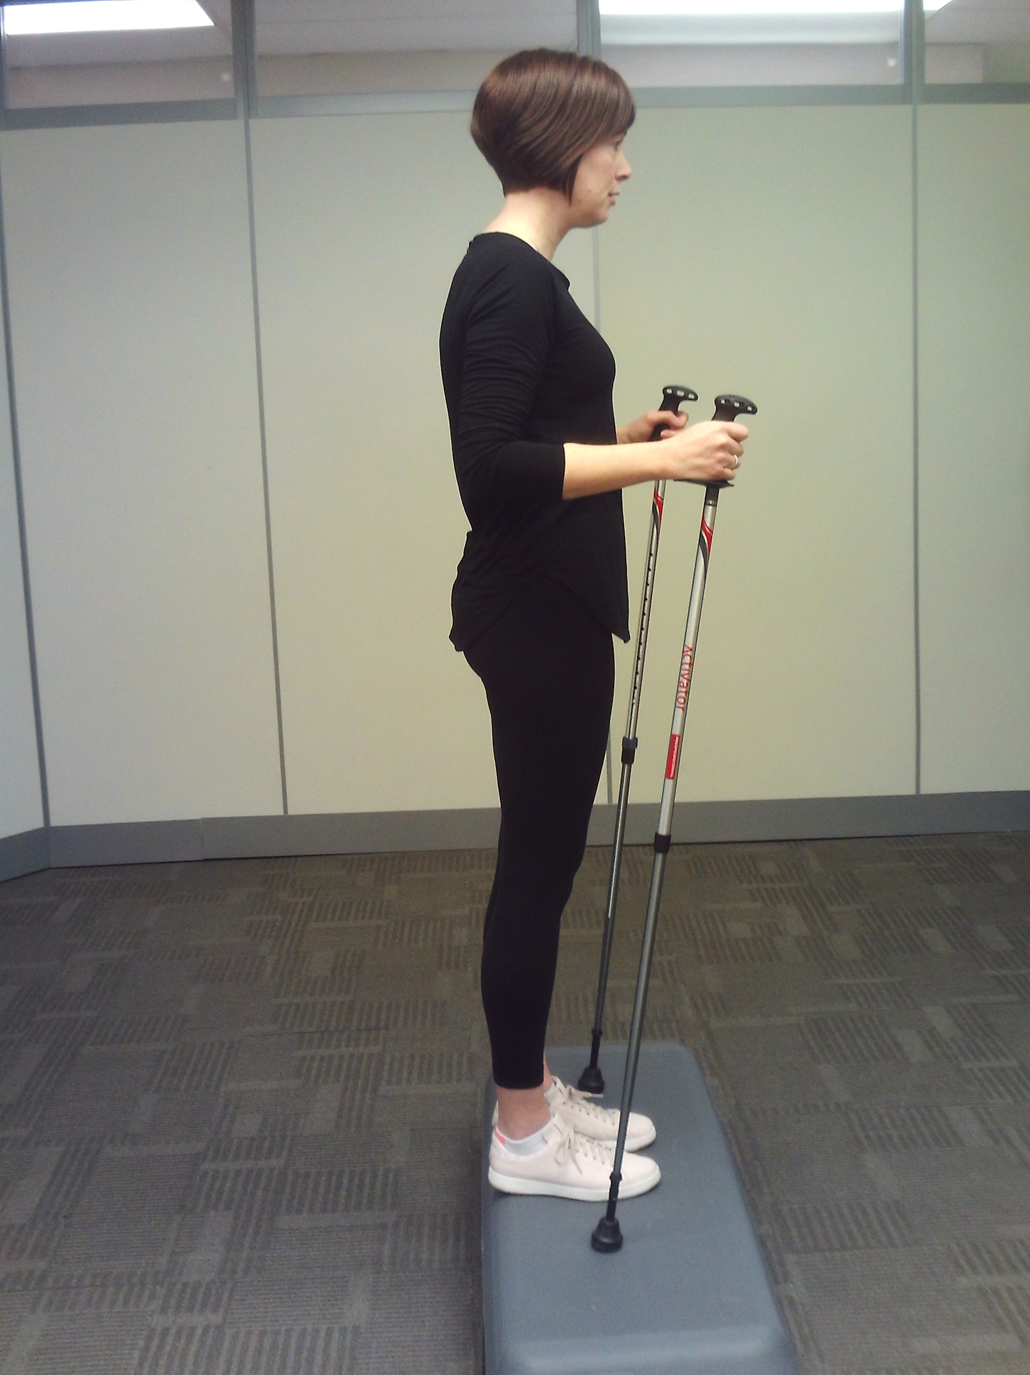
Step Up
Repeat on each leg up to 15 times
Begin in an upright standing position with a step in front of you, holding a chair or railing for support
Step forward onto the step with one foot, then step up with your other foot
Step back to the ground in reverse order and repeat
I will be able to perform strengthening exercises safely and correctly.

Slide 21
Section 3
Upper Body and Upper Back Strength Routine

Slide 22
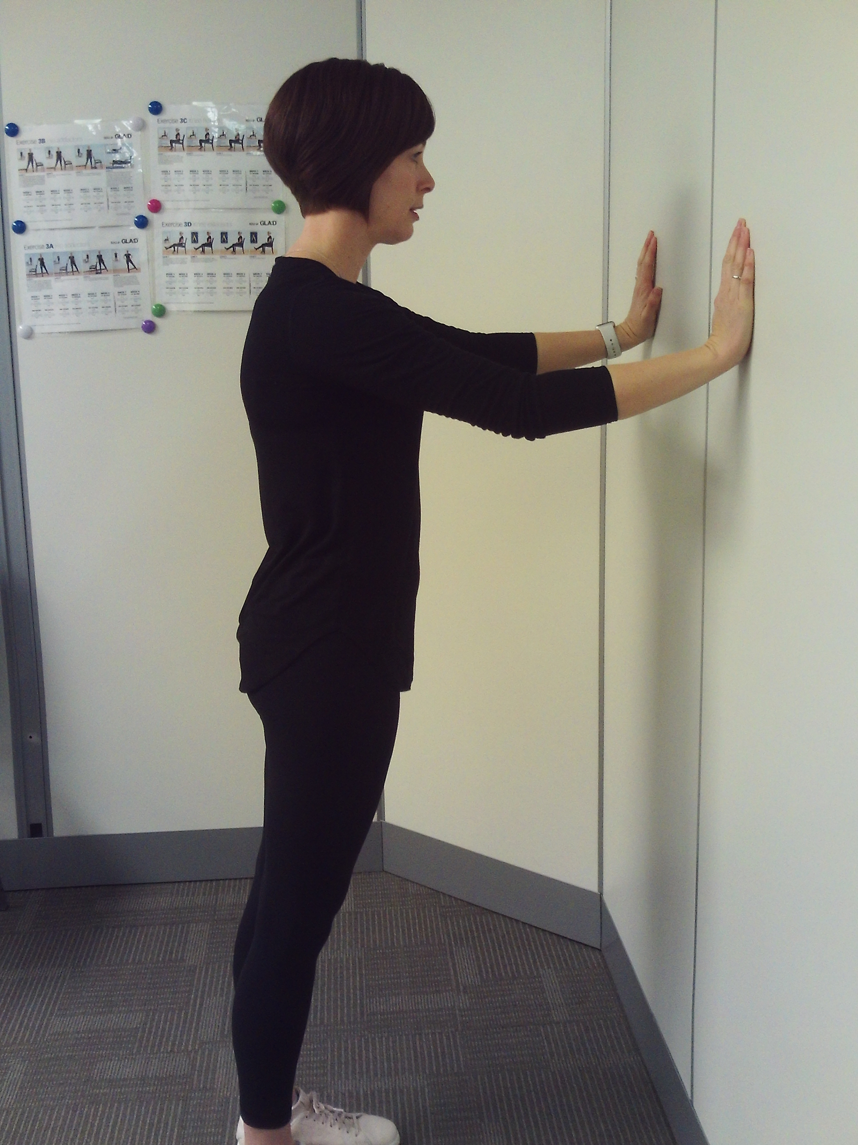
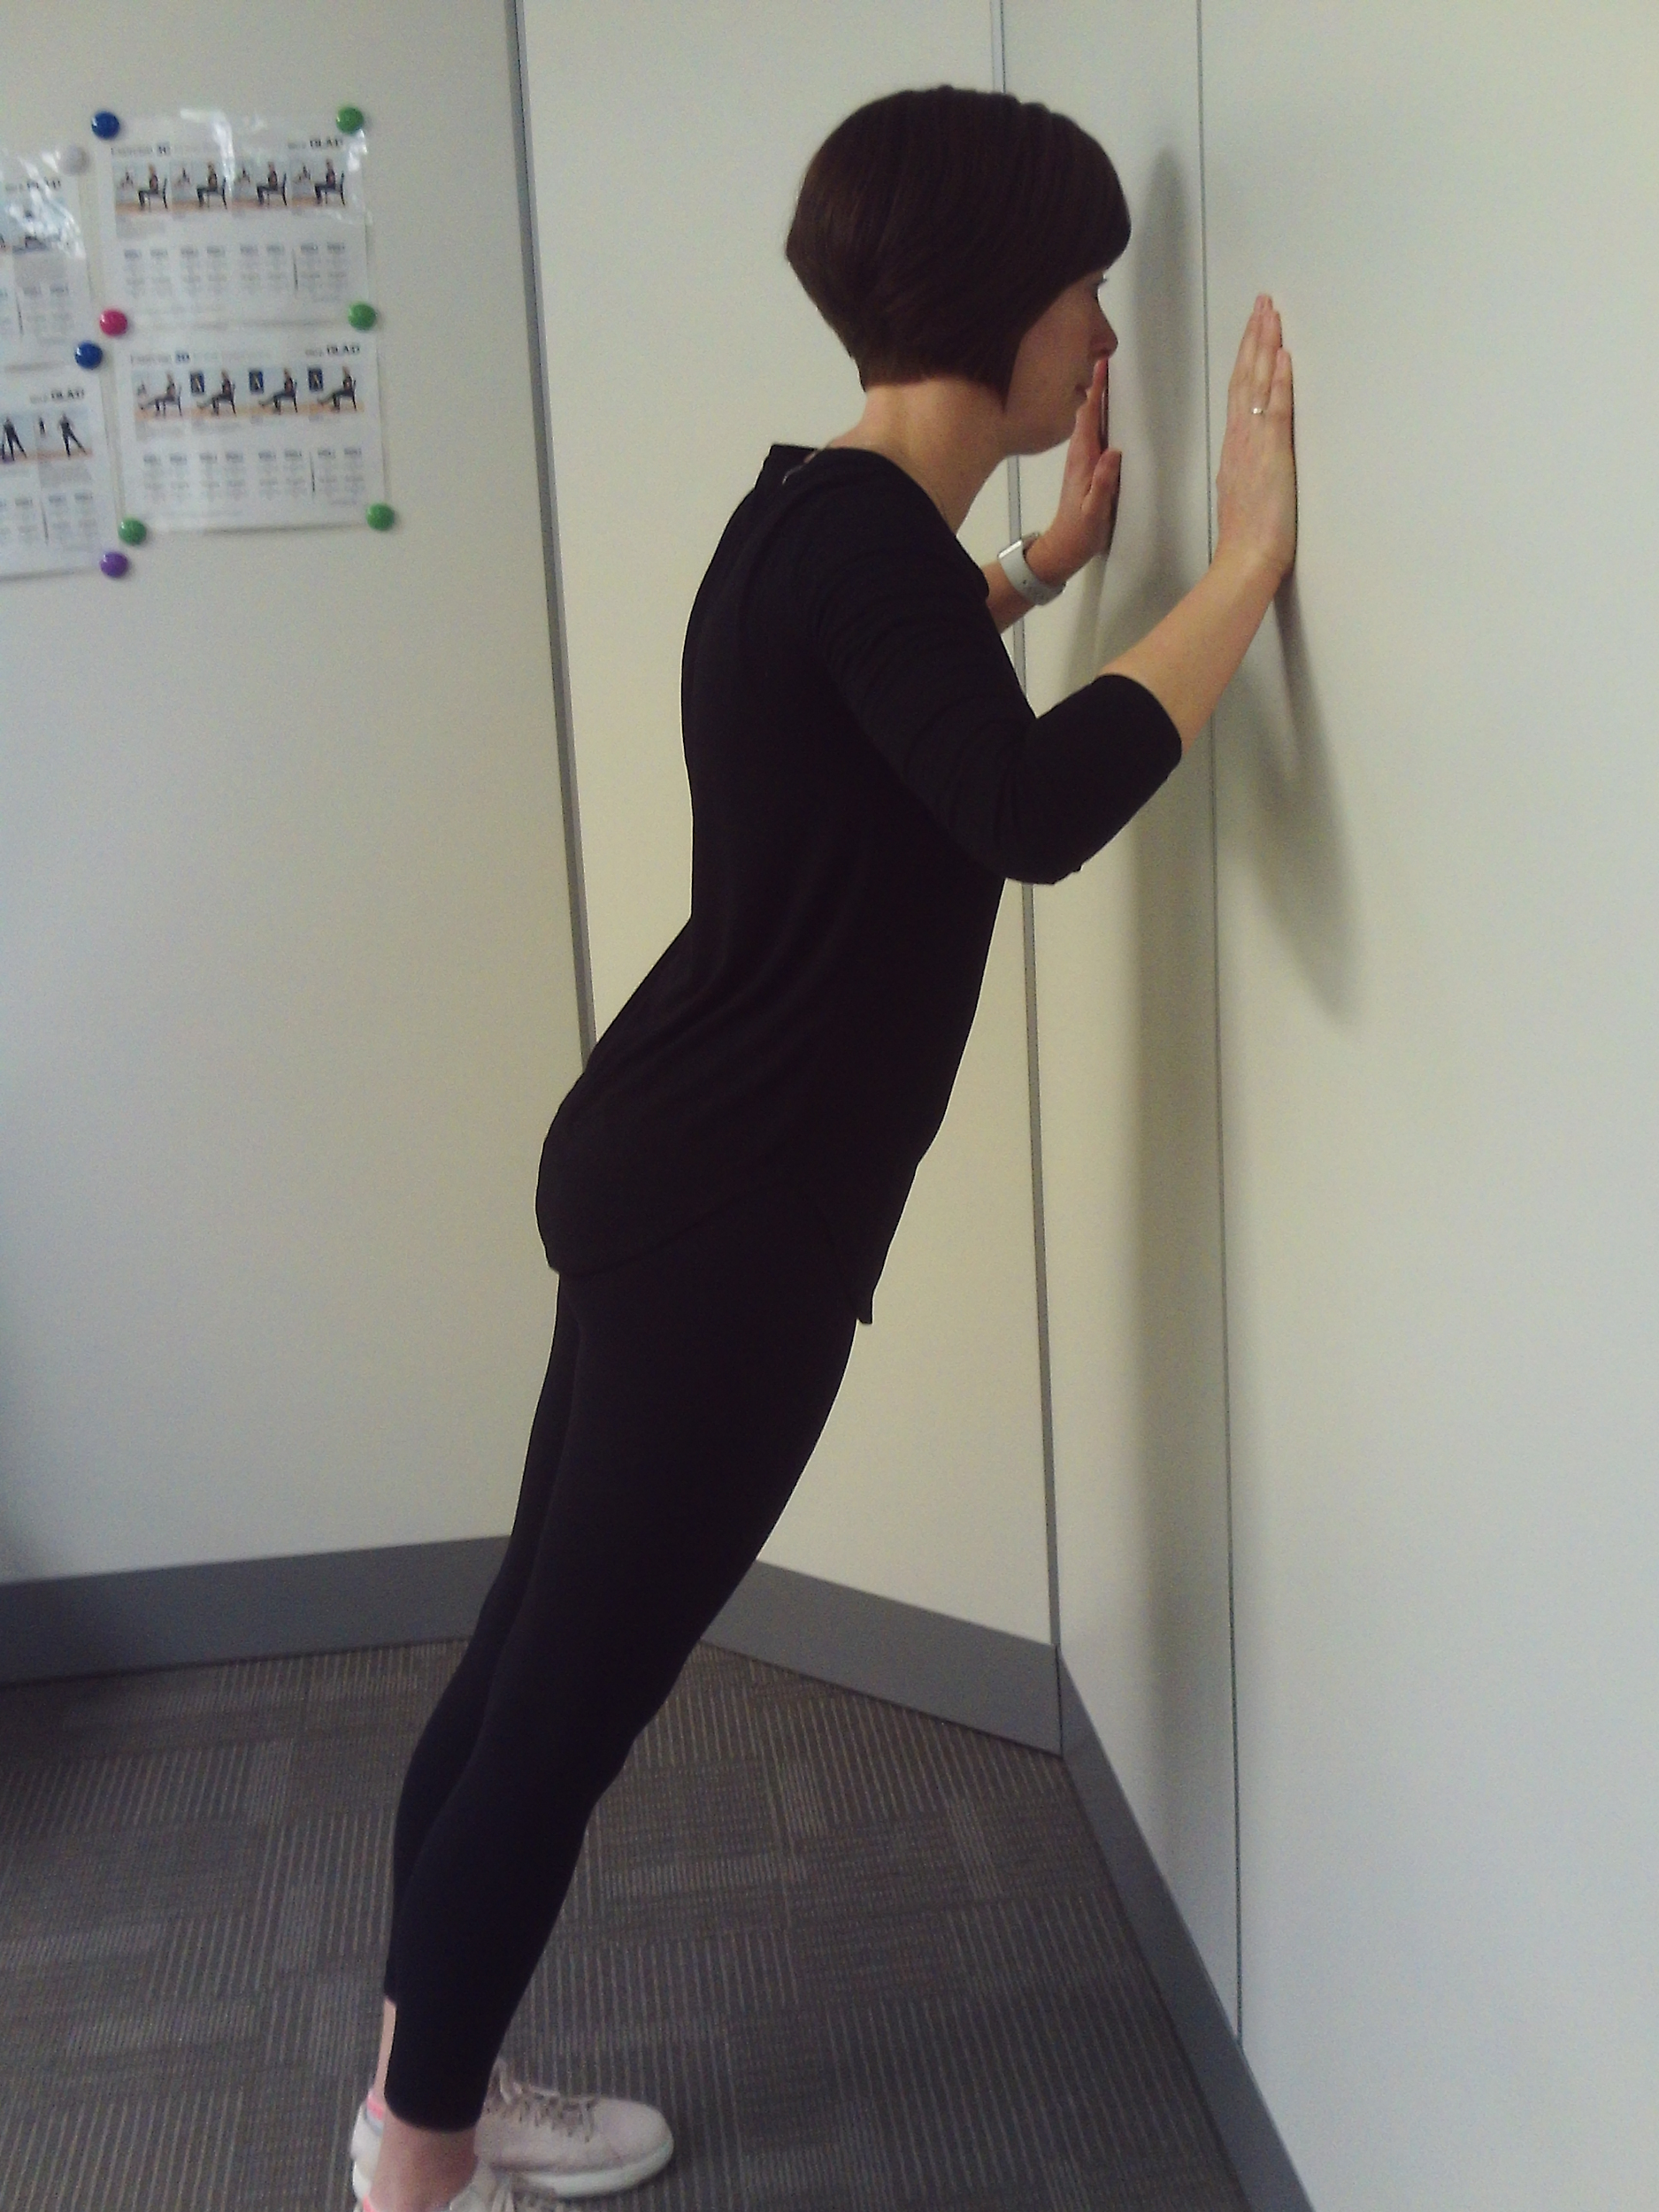
Wall Push Ups
Repeat up to 15 times
Begin in an upright standing position with your arms straight and hands resting on a wall at/just below shoulder height
Bend your elbows, leaning in towards the wall, then push back into the starting position and repeat
I will be able to perform strengthening exercises safely and correctly.

Slide 23
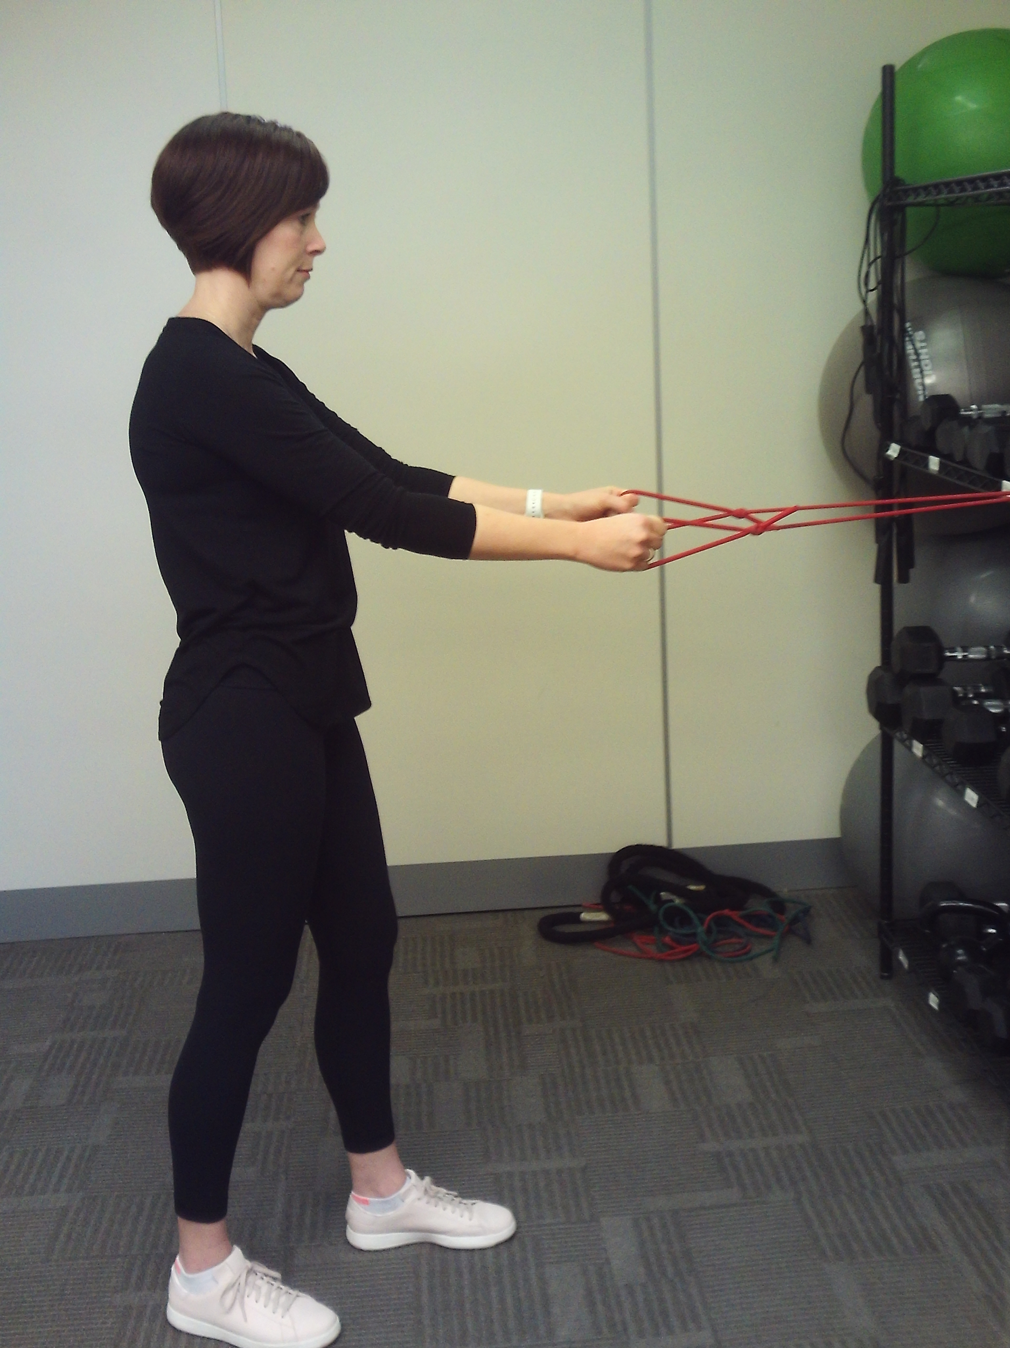
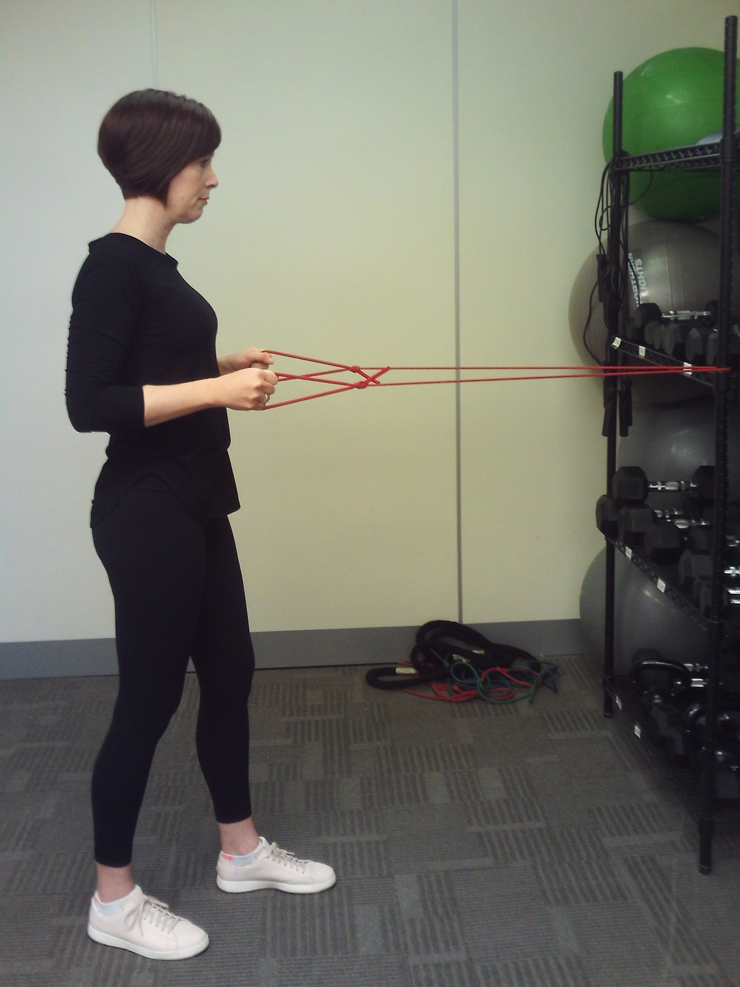
Standing Row
Repeat up to 15 times
Begin in a standing upright position holding both ends of a resistance band that is anchored in front of you at chest height
Pull back against the resistance, bending your elbows, squeeze your shoulder blades
Slowly return to the starting position and repeat
I will be able to perform strengthening exercises safely and correctly.

Slide 24
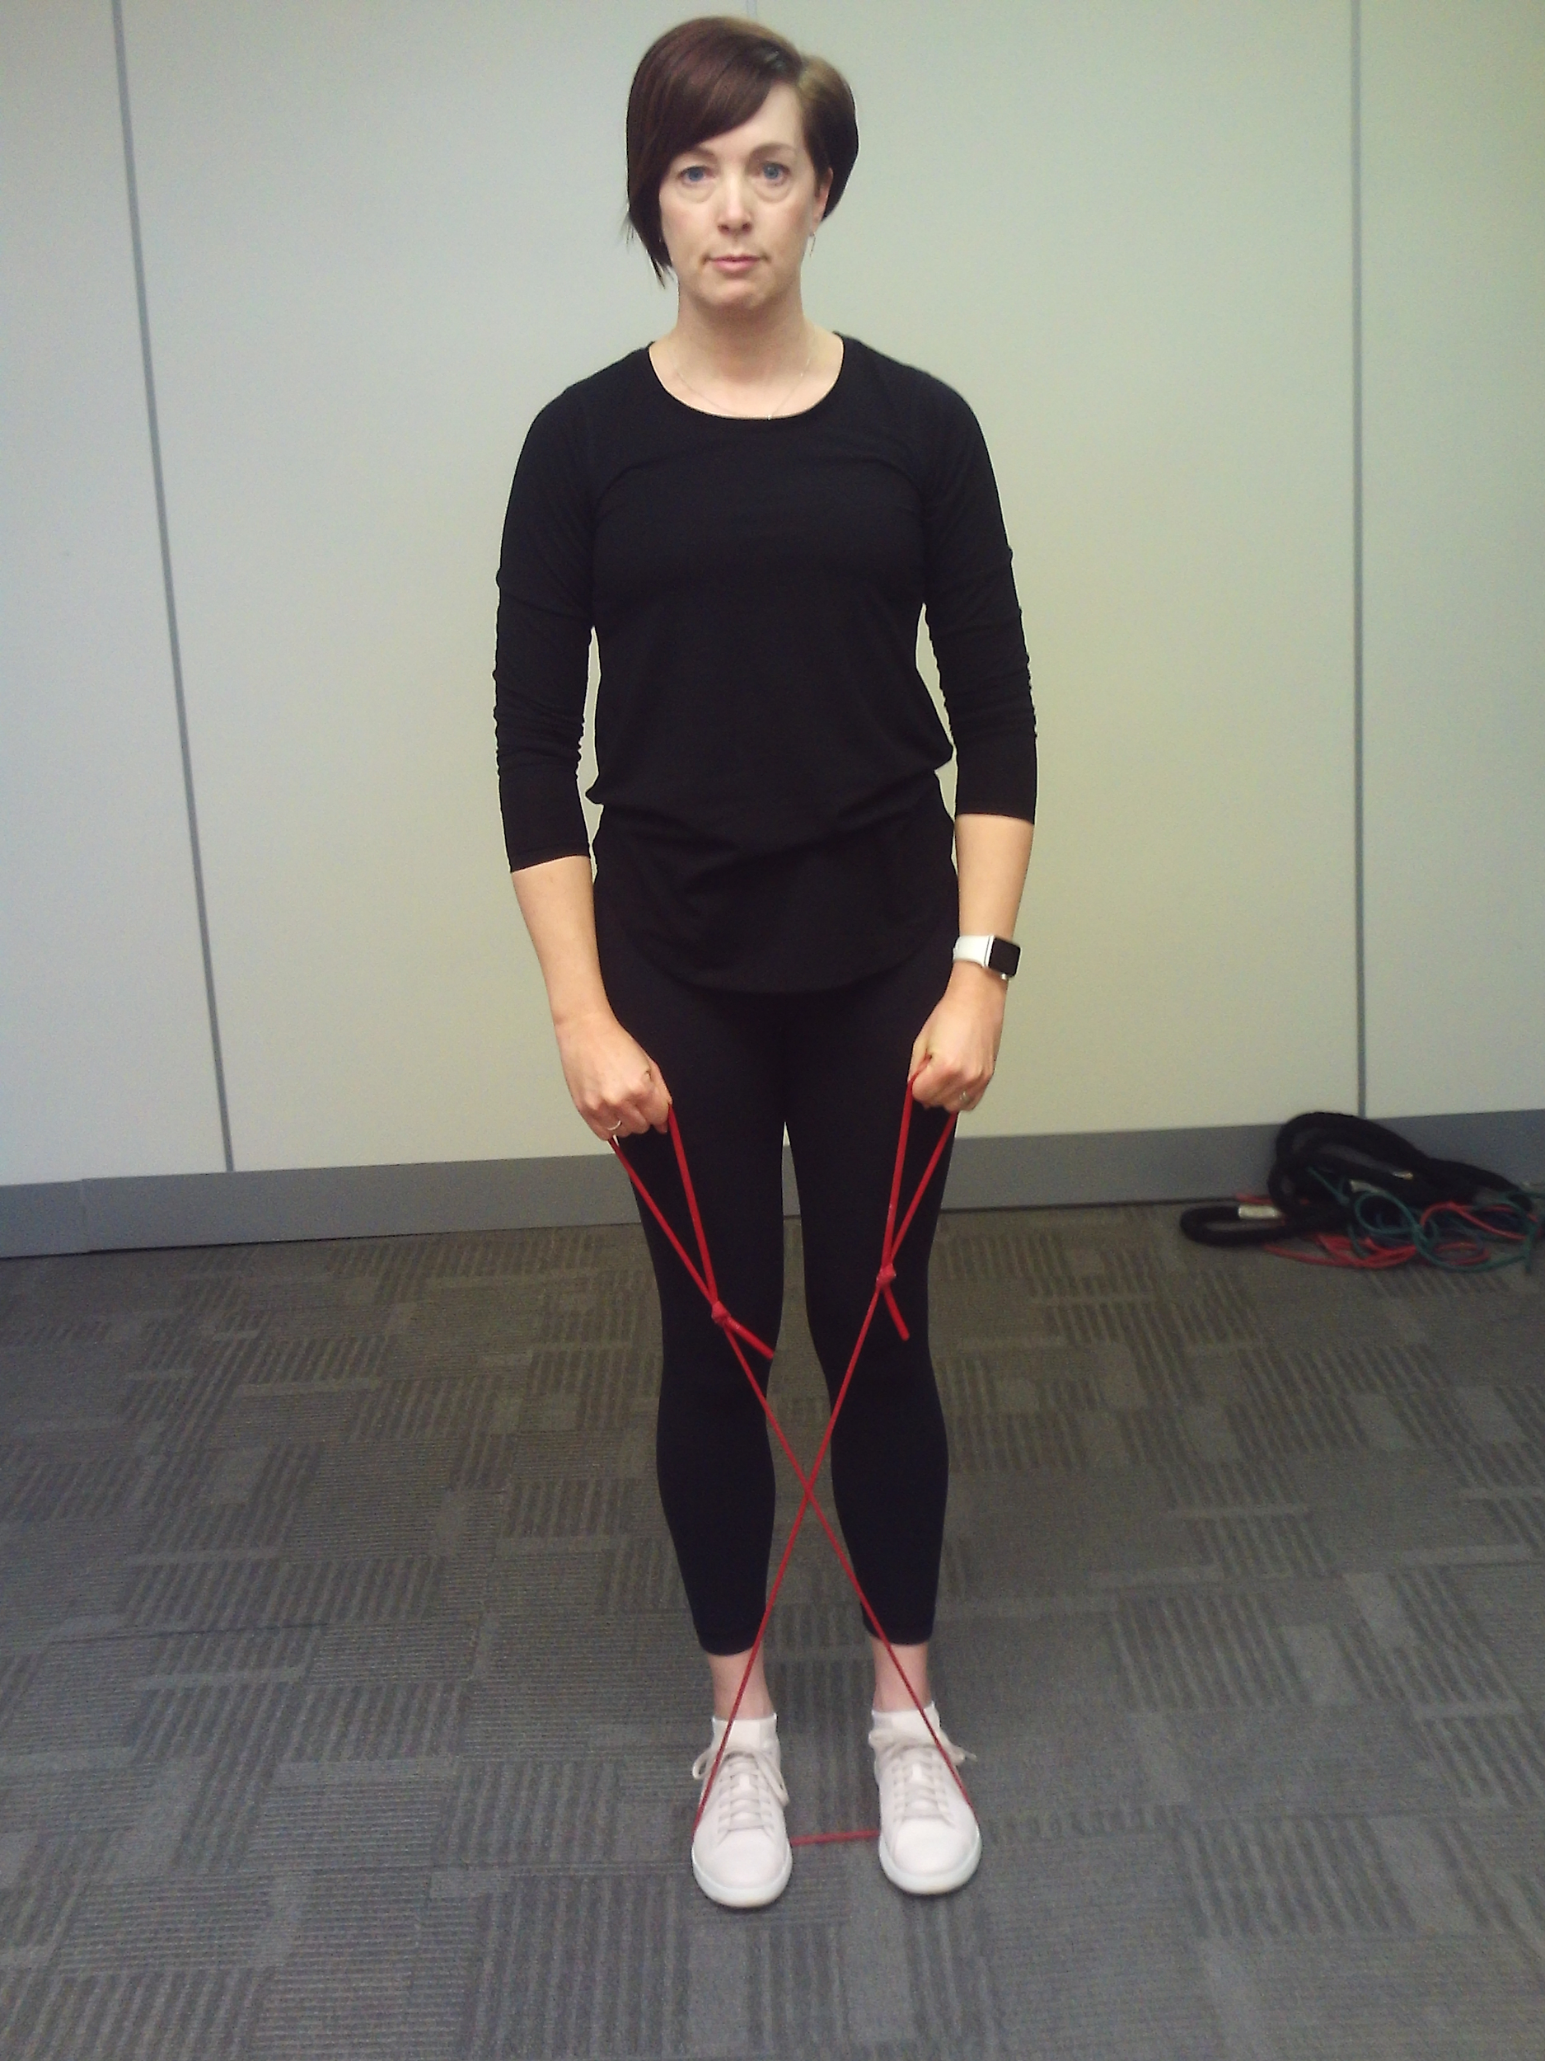
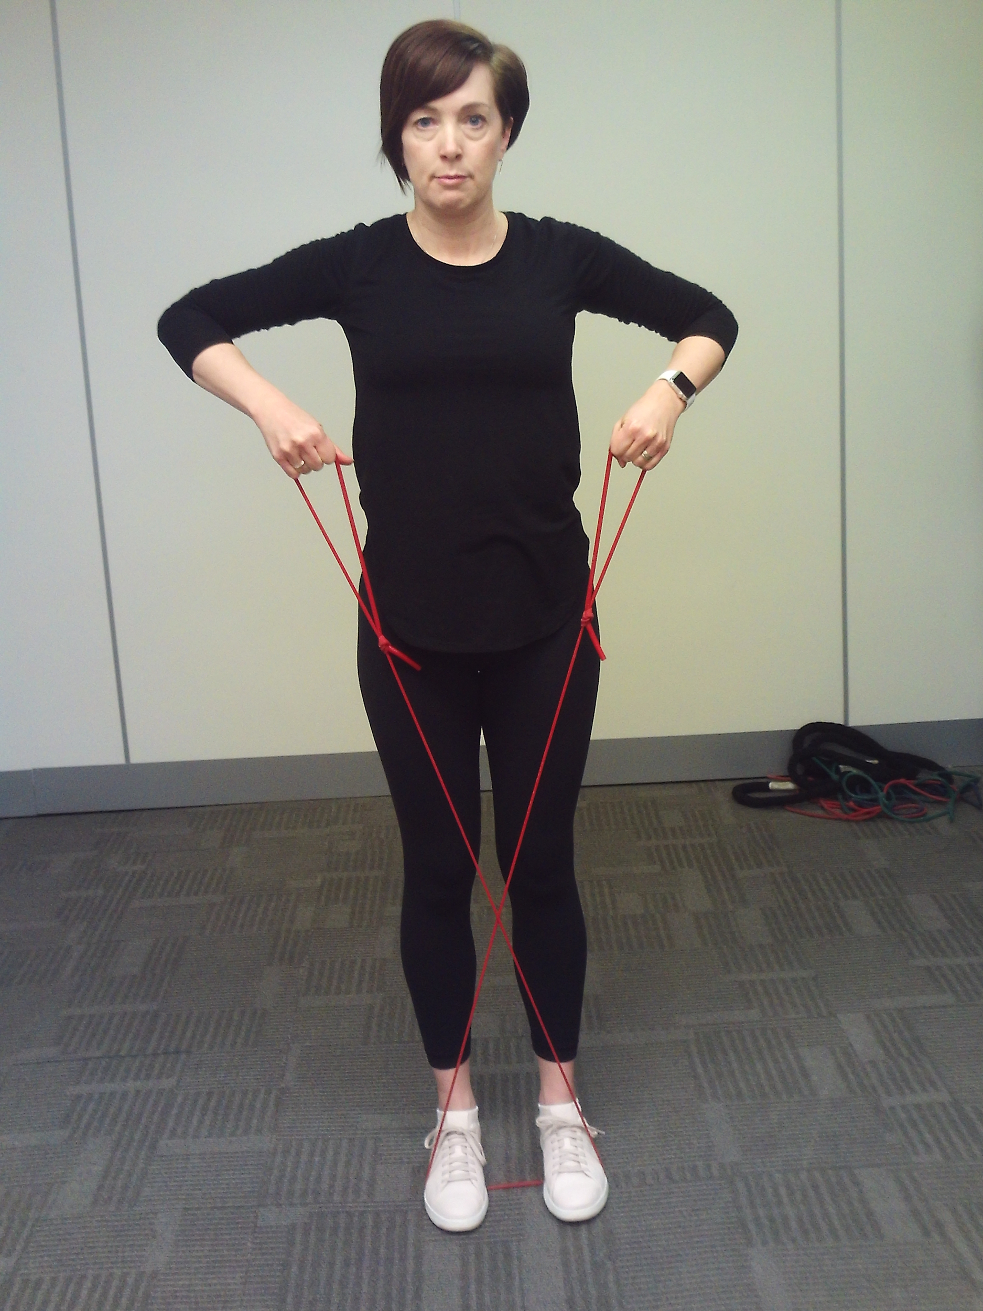
Upright Row
Repeat up to 15 times
Begin standing in an upright position holding both ends of a resistance band that is looped under your feet
Pull up on the band, keeping your hands close to your body, bending your elbows until your hands at chest height
Lower hands back to starting position and repeat
I will be able to perform strengthening exercises safely and correctly.

Slide 25
Section 4
SMART Goal Setting

Slide 26
Planning and Goal Setting
In your Strengthening and Resistance - Workshop Guide, consider the following:
This week…
decide how you want to continue with safe movement and bone health exercise
identify how you will take action to benefit from the information you have learned
identify goals that will help you stay motivated
I will be able to create a personal exercise routine for bone health by setting a SMART goal for strength training.

Slide 27
How do I set goals?
Setting SMART goals helps you make clear, successful changes
Specific How will I do it? What, how much, when, how often?
Measurable How will I measure it? What will it look like to achieve my goal?
Achievable Can I do it? Can I keep doing it? Start small and build momentum.
Realistic Is it within reach? Does my goal fit into your everyday life?
Time-oriented When will I meet my goal?
I will be able to create a personal exercise routine for bone health by setting a SMART goal for strength training.

Slide 28
Hints to Stay Motivated
schedule exercise into your week
use the words “I will”, not “ I will try…”
choose a goal that is meaningful to you
big goals need to be broken down into smaller steps
  but always keep your big goals in mind
reach out for support - recruit a “cheer team”
I will be able to create a personal exercise routine for bone health by setting a SMART goal for strength training.

Slide 29
Cool-down Activity
Review your Get Active Questionnaire from the Starter Activity. In your Workshop Guide, consider
  what changes do you need to make to your daily routine?
  how can you make these changes?
  which areas should you focus on first?
Create a SMART goal for improving your exercise routine that you can work towards over the next week
I will be able to identify what I am doing well and what I can improve on in terms of exercise for bone health.

Slide 30
Additional Resources
Osteoporosis Canada
osteoporosis.ca
Dr. David Hanley Osteoporosis Centre
osteoporosiscalgary.com
National Osteoporosis Foundation
nof.org

Slide 31






SPONSORS

Slide 32
Bibliography
Osteoporosis Canada. (2018). Too Fit to Fracture: Managing Osteoporosis through Exercise.
Alberta Health Services. (2013). Osteoporosis/Bone Health Education Program. (pp. 51).
Alberta Health Services. (2012). Better Bones 4 Life: Learning to Exercise and Move with Osteopenia or Osteoporosis. (pp. 36-45)
Osteoporosis Australia. (2011). Australia Strengthening for Bone Health.

