Slide 1

Posture and Balance Exercises
Data-Driven. People-Led. Outcome-Focused.
Bone Health

Slide 2
Starter Activity
Please, complete the “Test Your Balance!” activity on the first page of your Workshop Guide
What is your current exercise routine to improve your balance?
  record your routine in your Workshop Guide

Slide 3
Agenda
1. Exercise Guidelines
2. Posture Exercises
3. Static Balance Exercises
4. Dynamic Balance Exercises
5. SMART Goal Setting
Data-Driven. People-Led. Outcome-Focused.

Slide 4
Learning Objectives
I will be able to…
Assess my personal activity level in relation to the Canadian Exercise guidelines/Canadian Physical Activities Guidelines, and the Osteoporosis Canada guidelines
Describe what good posture looks like
Identify cues that help me maintain or improve my posture
Demonstrate the ability to safely perform a daily routine of balance training exercises
Create an activity plan by setting SMART goals for a personal exercise routine

Slide 5
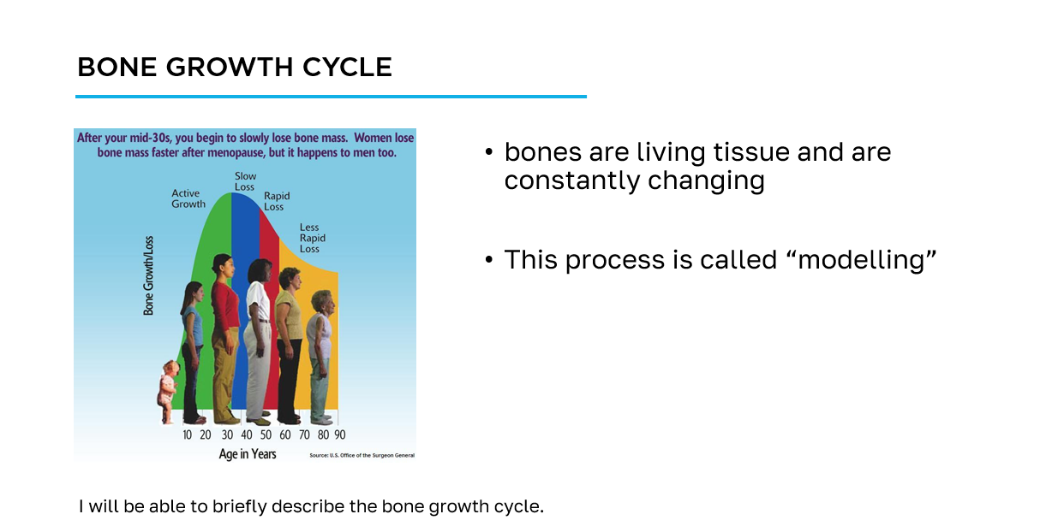
How to navigate the slides
slide title
key information
learning objective
slide image

Slide 6
Workshop Guide
As we progress through this workshop, please ensure to complete the appropriate sections of the Workshop Guide provided for you.
This will be your quick reference following this workshop to aid you on your bone health journey.

Slide 7
Section 1
Exercise Guidelines

Slide 8
Canadian Physical Activity Guidelines
To achieve health benefits, adults aged 18-64 should:
accumulate at least 150 minutes of moderate-to-vigorous intensity aerobic physical activity per week, in bouts of 10 minutes or more
perform muscle and bone strengthening activities using major muscle groups, at least 2 days per week
65 years and older:
as above + physical activities to enhance balance and prevent falls
I will be able to assess my personal activity level in relation to both the Canadian Physical Activity Guidelines and the Osteoporosis Canada recommendations for bone health.

Slide 9
Exercise for Bone Health
Osteoporosis Canada recommends:
at least 150 minutes of moderate-to-vigorous intensity aerobic physical activity per week, in bouts of 10 minutes or more - weight-bearing is better
muscle and bone strengthening activities using major muscle groups, at least 2 days per week
physical activities to enhance balance and prevent falls daily
practice spine sparing strategies and good posture daily
I will be able to assess my personal activity level in relation to both the Canadian Physical Activity Guidelines and the Osteoporosis Canada recommendations for bone health.

Slide 10
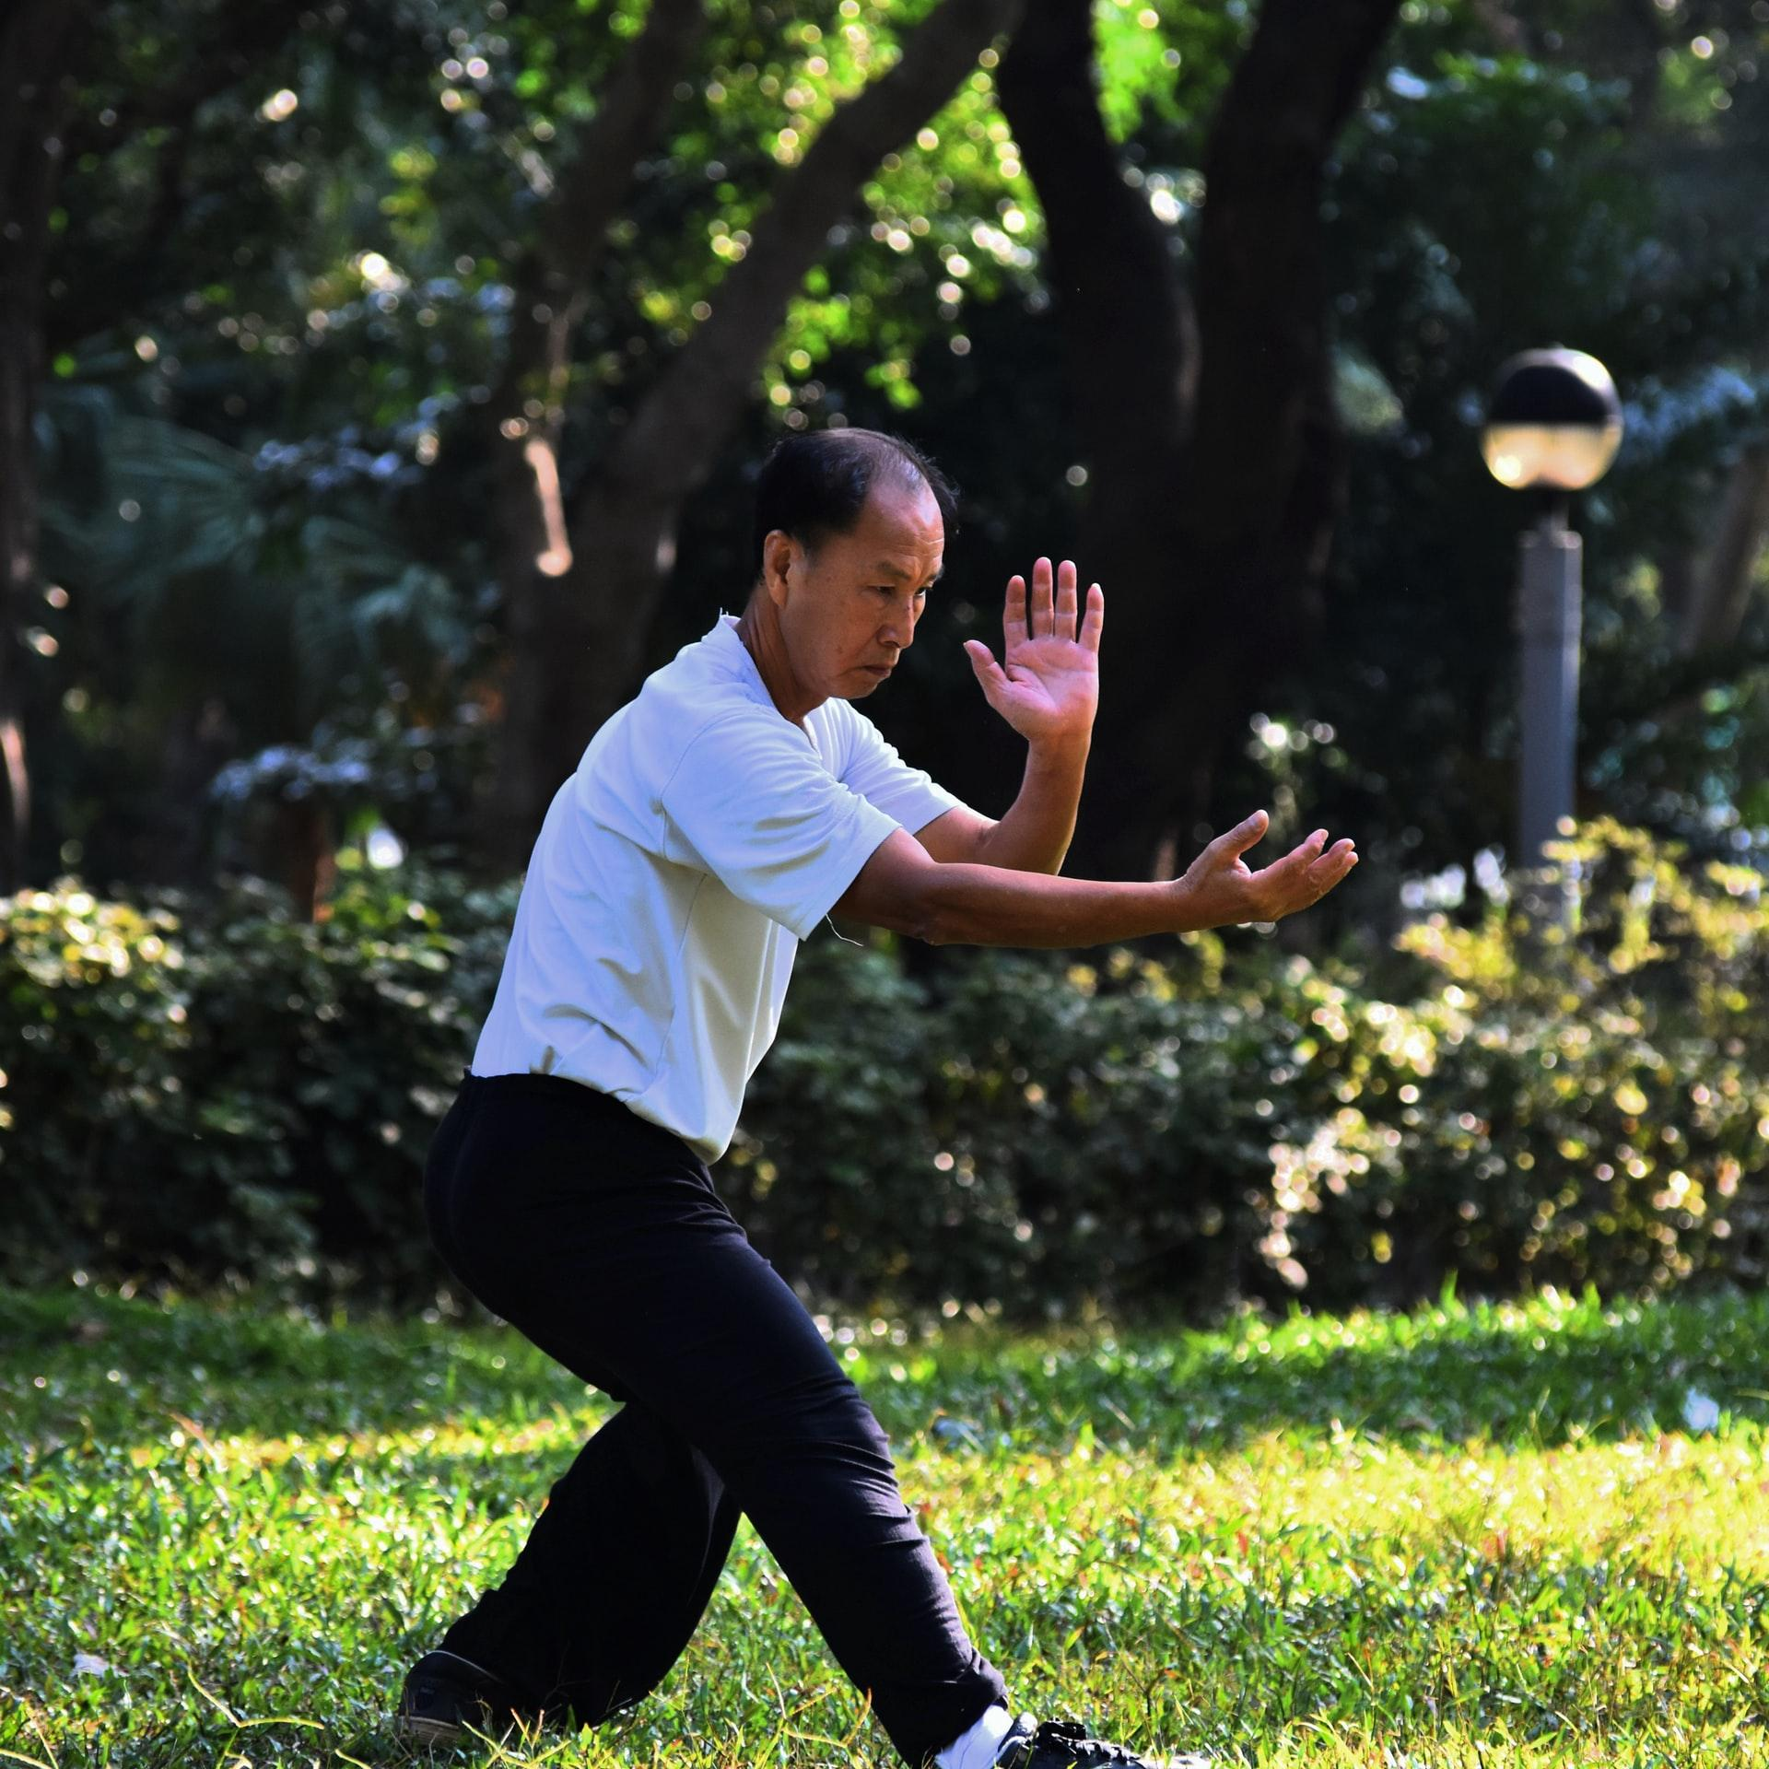
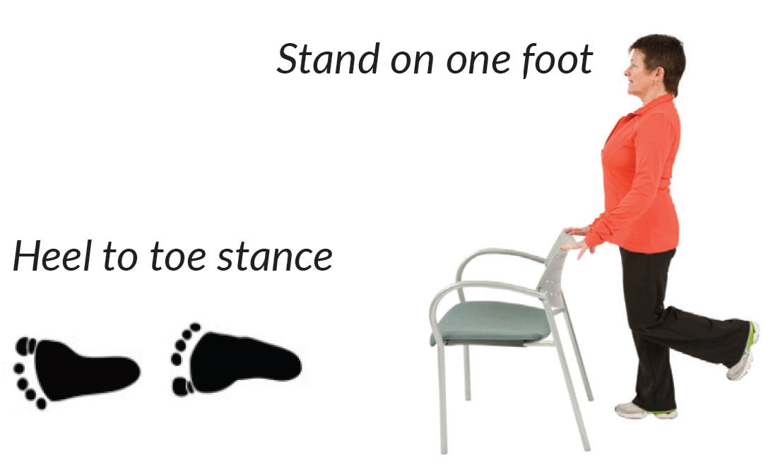
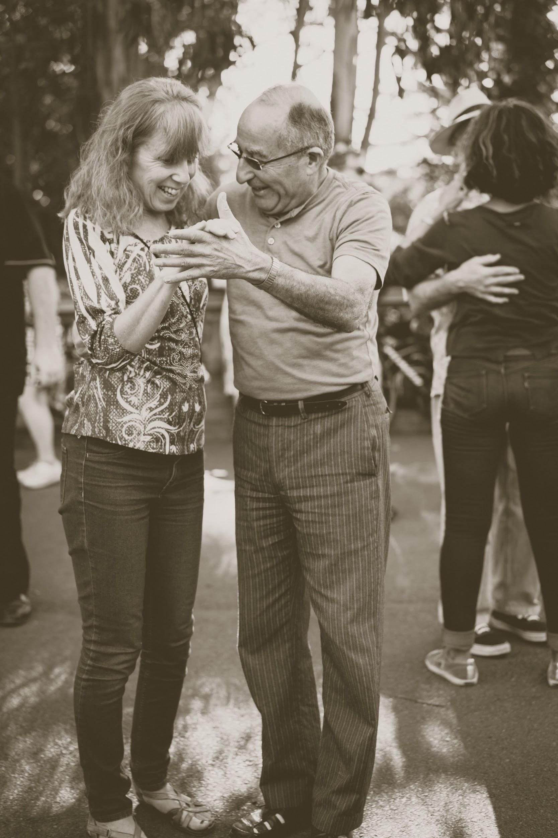
What is Balance Training?
Movements that challenge your ability to react when you become unstable.
Dancing
Tai Chi
I will be able to demonstrate the ability to safely perform a daily routine of balance training exercises.
Notes:
Photo by Mark Hang Fung So on Unsplash
Photo by John Moeses Bauan on Unsplash

Slide 11
Why Should I Do Balance Exercises?
Balance training will
help prevent falls
help you keep your balance while you do your day to day activities
improve your stability when you step or reach
allow you to practice reactions when your balance becomes upset
I will be able to demonstrate the ability to safely perform a daily routine of balance training exercises.

Slide 12
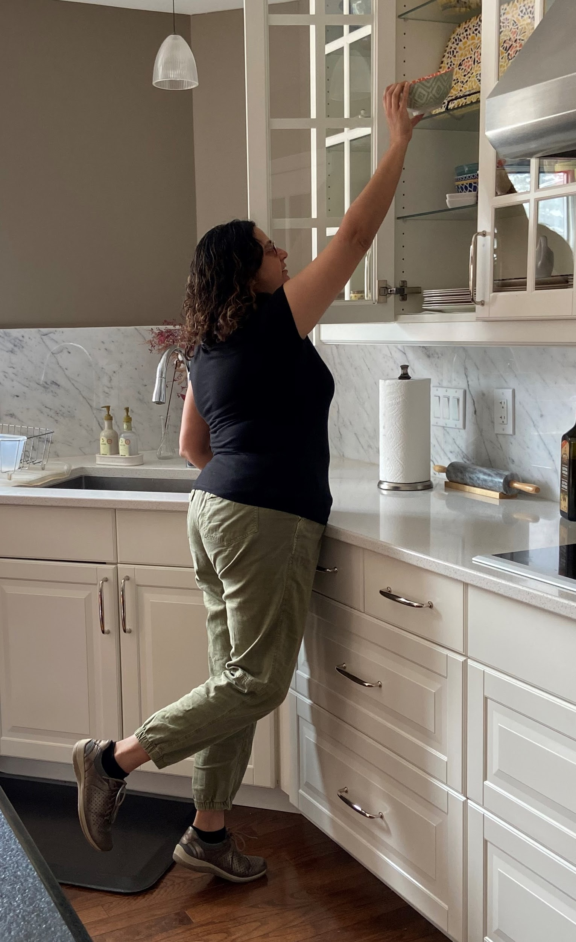
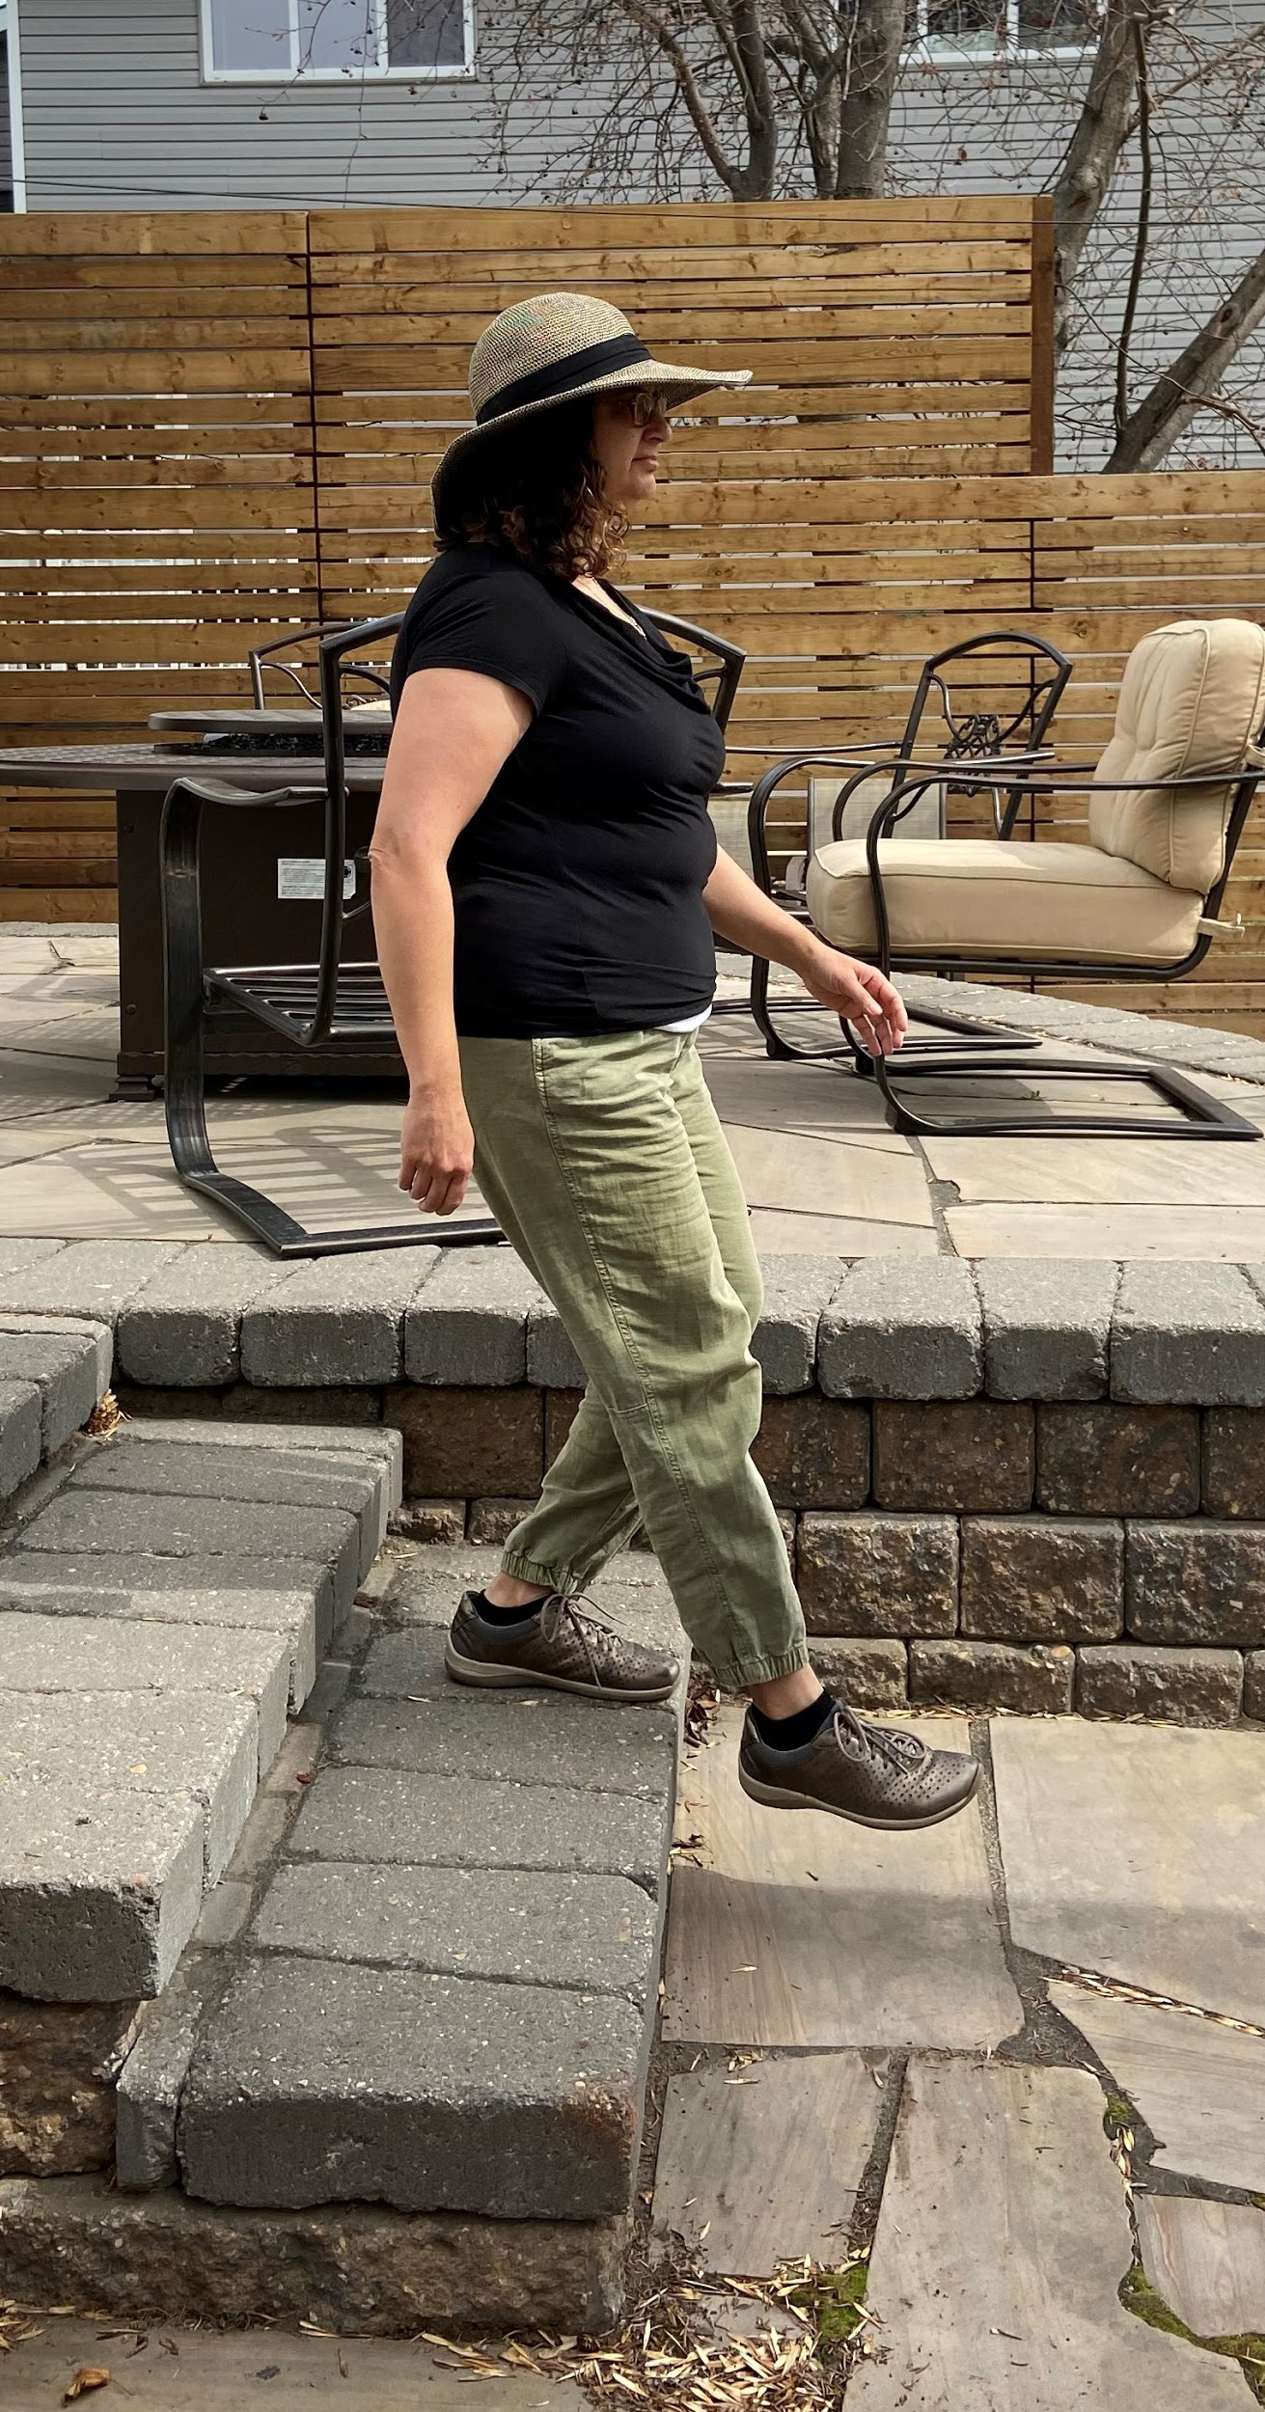
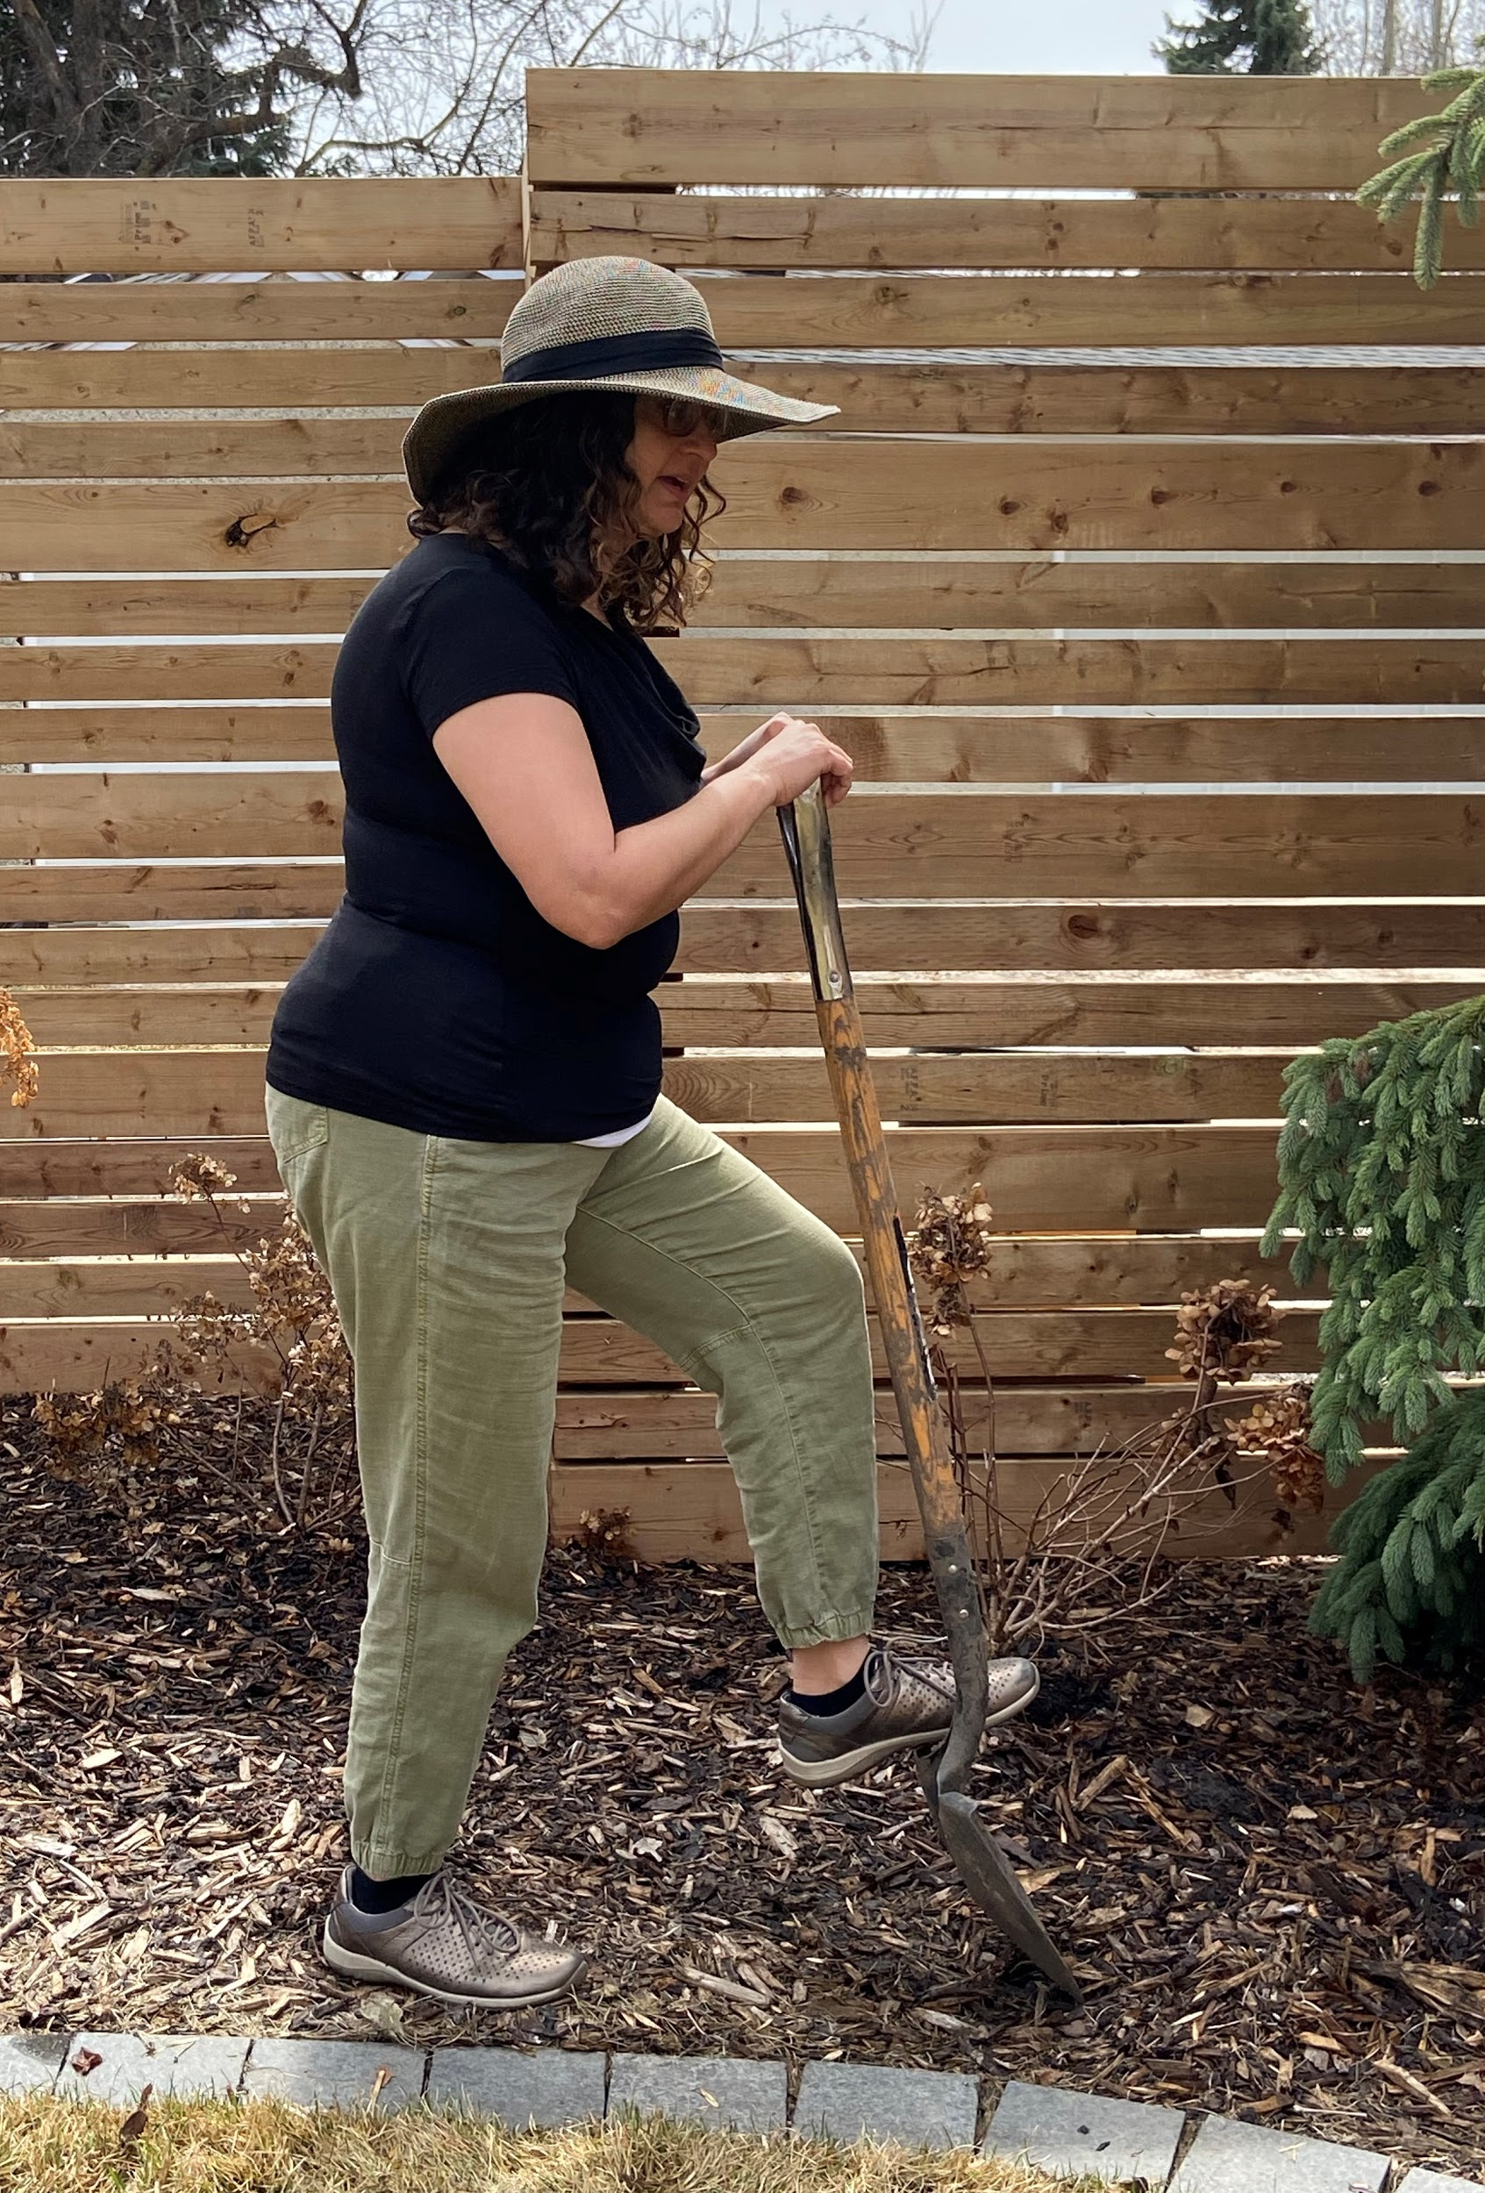
Activities that Require Good Balance
Reaching
Stepping
Uneven Ground

Slide 13
General Rules for Balance Training
Always have a support nearby to help you
  sturdy chair
  countertop or table
  wall
Balance exercises should be challenging enough that you need to focus on your balance
  You may need to start by holding on for support
  Over time reduce how much you hold on
Be careful not to fall
Perform daily
I will be able to demonstrate the ability to safely perform a daily routine of balance training exercises.

Slide 14
Before You Start Exercising
For almost everyone the benefits of exercise far outweigh the risks!
complete a Get Active Questionnaire before you start a new exercise program and...
if you have any questions or concerns check with your doctor, a physiotherapist, a qualified exercise professional (Canadian Society for Exercise Physiology) or a BoneFitTM trained professional

Slide 15
Osteoporosis and Falls
If you have had a fall, a near fall or are afraid of falling:
speak with a physiotherapist, a qualified exercise professional (Canadian Society for Exercise Physiology) or a BoneFitTM trained professional
a tailored or supervised program is recommended

Slide 16
When Exercising
Remember to…
wear comfortable, supportive footwear
be aware that muscle soreness after exercise is normal
use a firm, stable chair for support
learn to perform the exercise with proper technique
control the speed of your movement
I will be able to demonstrate the ability to safely perform a daily routine of balance training exercises.

Slide 17
Section 2
Posture Exercises

Slide 18
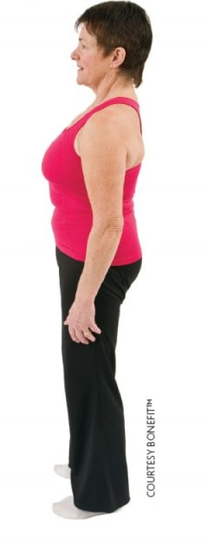
What does good posture look like?
from the side - ear, shoulder, hip and foot are in alignment
how?
  imagine that you are 2 inches taller
  imagine your collar bones are wings - spread your wings
  find the top of your pelvis and your lower ribs - lengthen the space between them
I will be able to describe what good posture looks like.

Slide 19
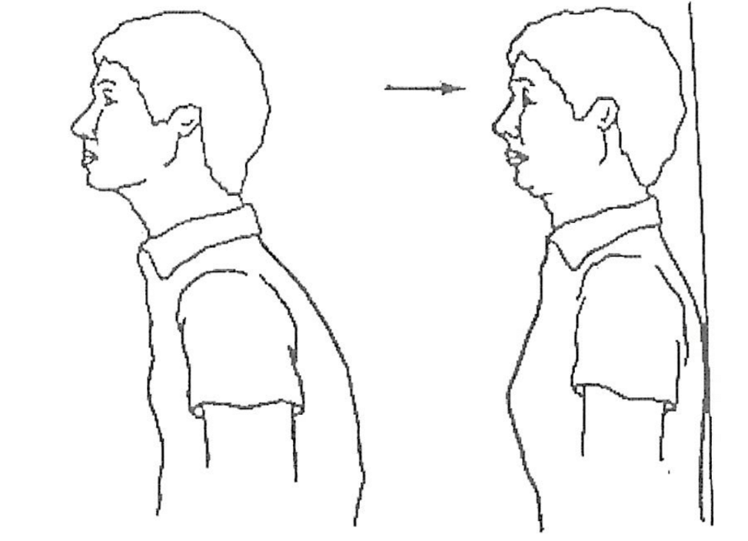
Chin Tuck
This exercise can be done standing with your back against a wall or sitting using a head rest
Tuck your chin slightly toward your chest
Feel the back of your neck lengthening
Keep your jaw and eyes level
Hold for 5 seconds and then relax
3 reps, hold for 5 seconds, daily
I will be able to identify cues that help me maintain or improve my posture.

Slide 20
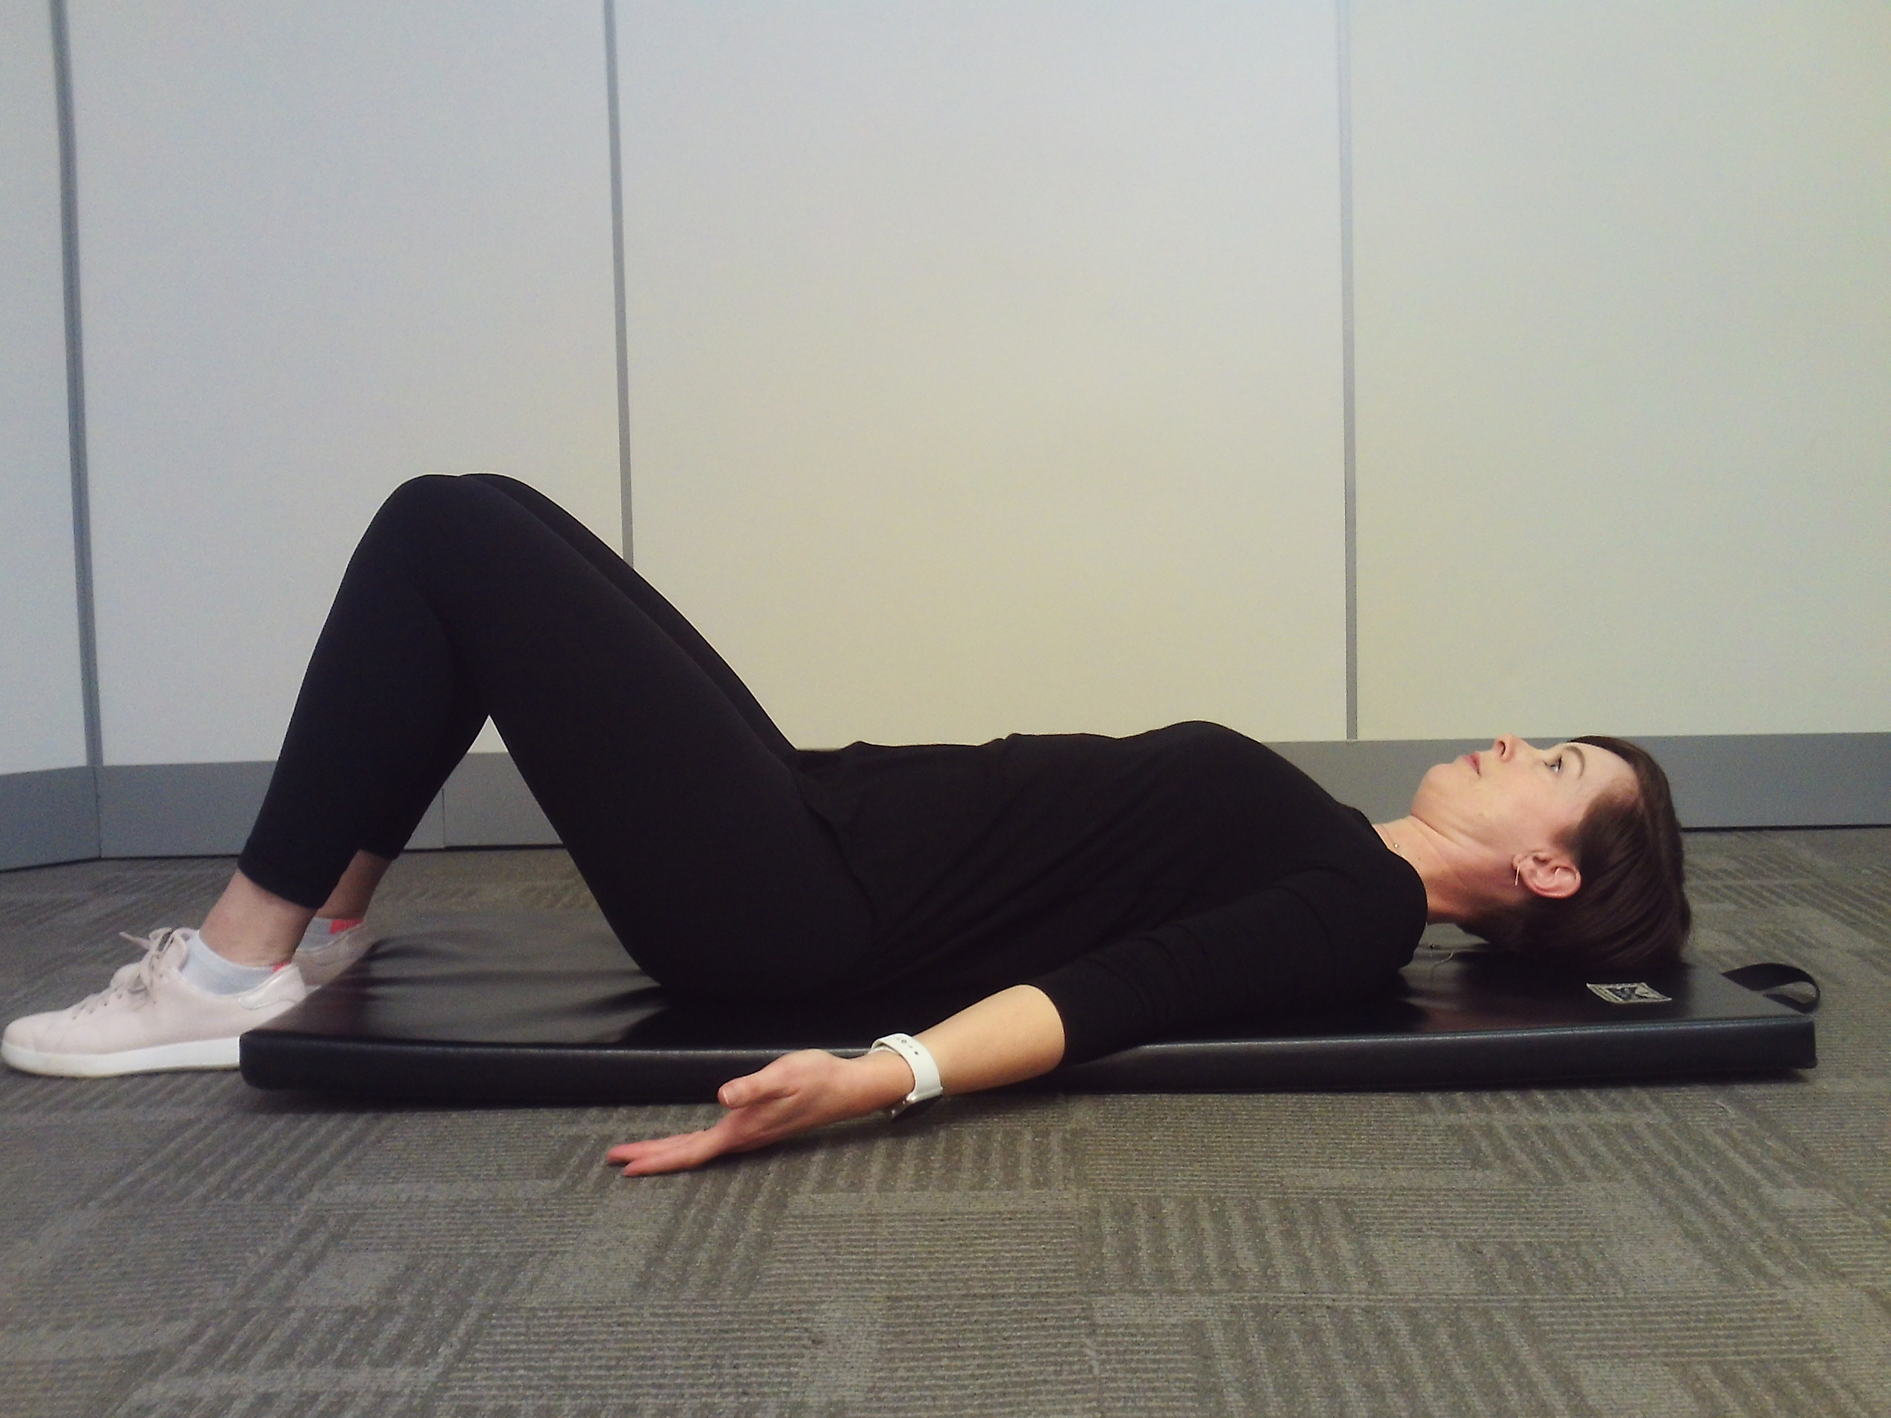
Improving Your Posture - unloading
lie on the floor without a pillow or towel under your head if you can comfortably
if you need to tip your head back for it to reach the floor then place a folded towel or small pillow under your head
lie with your arms, palms up, away from your body
imagine your collar bones are wings - spread your wings without pulling your shoulders back
5-10 minutes/day
I will be able to identify cues that help me maintain or improve my posture.

Slide 21
Section 3
Static Balance Exercises

Slide 22
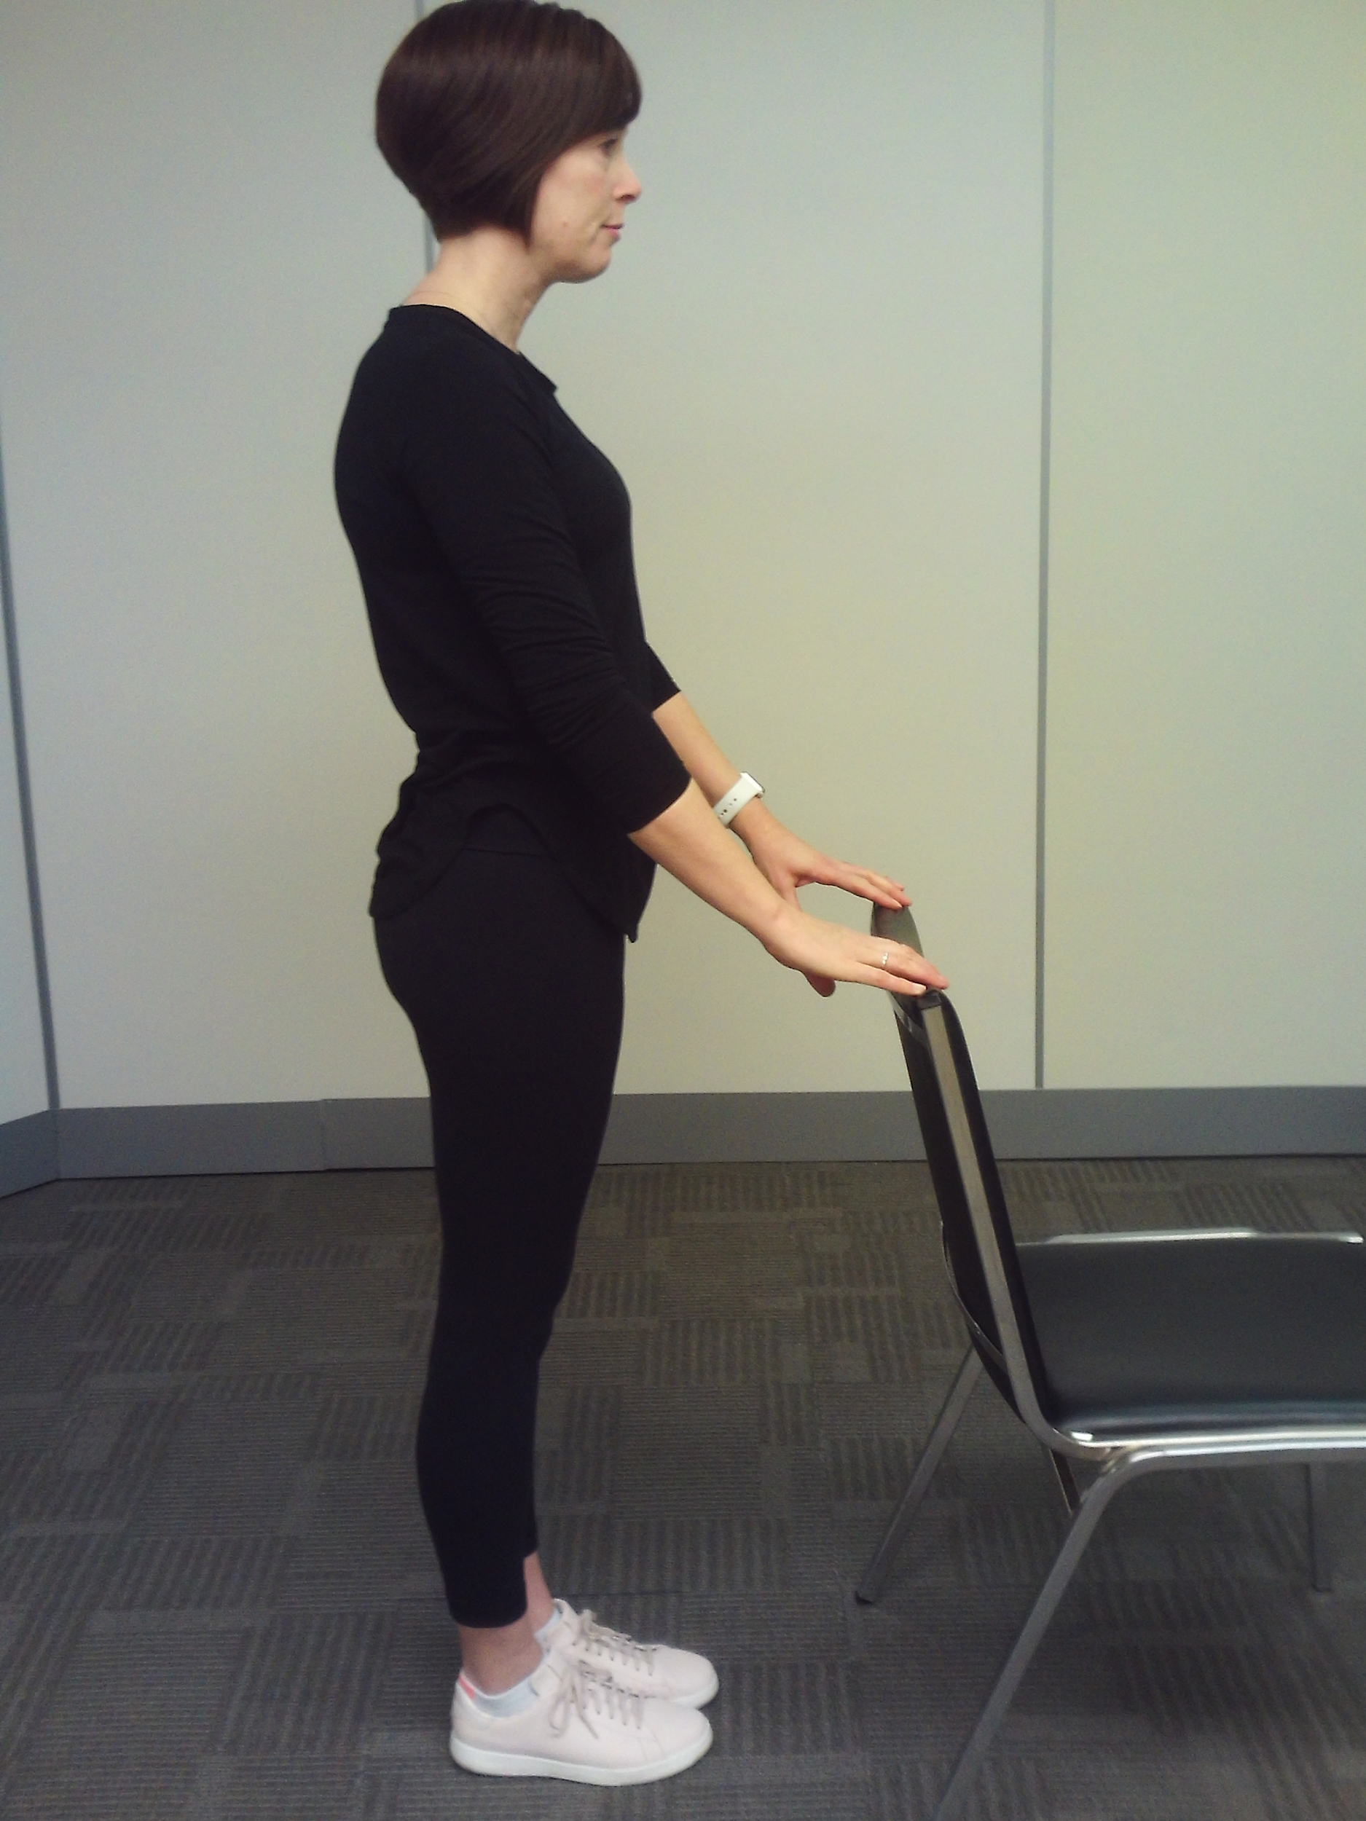
Balance Training - Static Stance
stand upright, holding a chair for support if needed
adjust so that 50% of your weight is on each foot
then try:
  shifting your weight between your heels and toes
  shifting your weight from side to side
  close your eyes
  challenge your brain by counting backwards from 100 by 7s
I will be able to demonstrate the ability to safely perform a daily routine of balance training exercises.

Slide 23
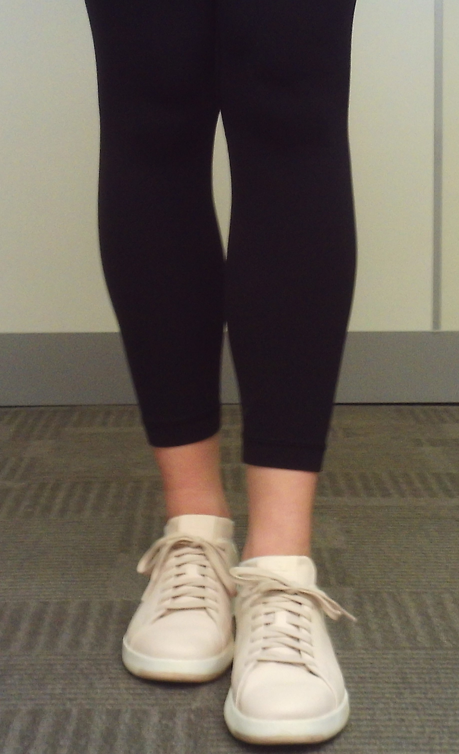
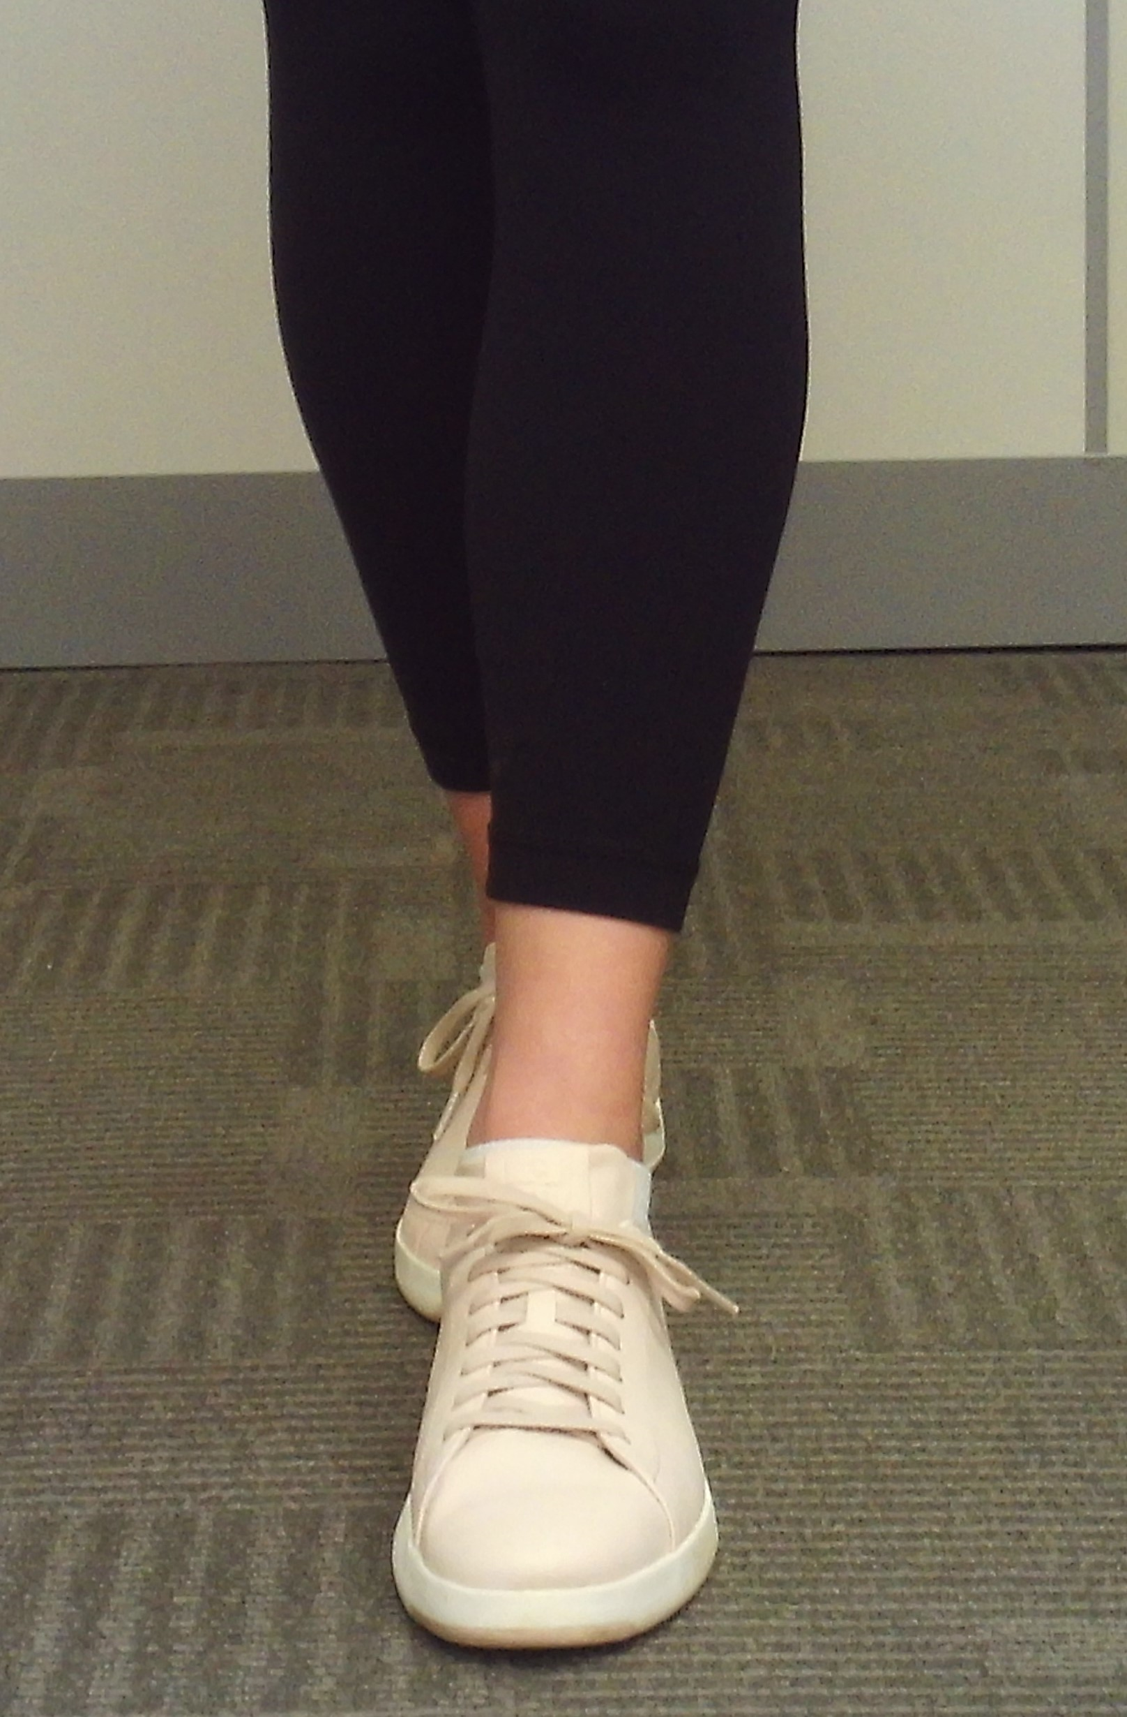
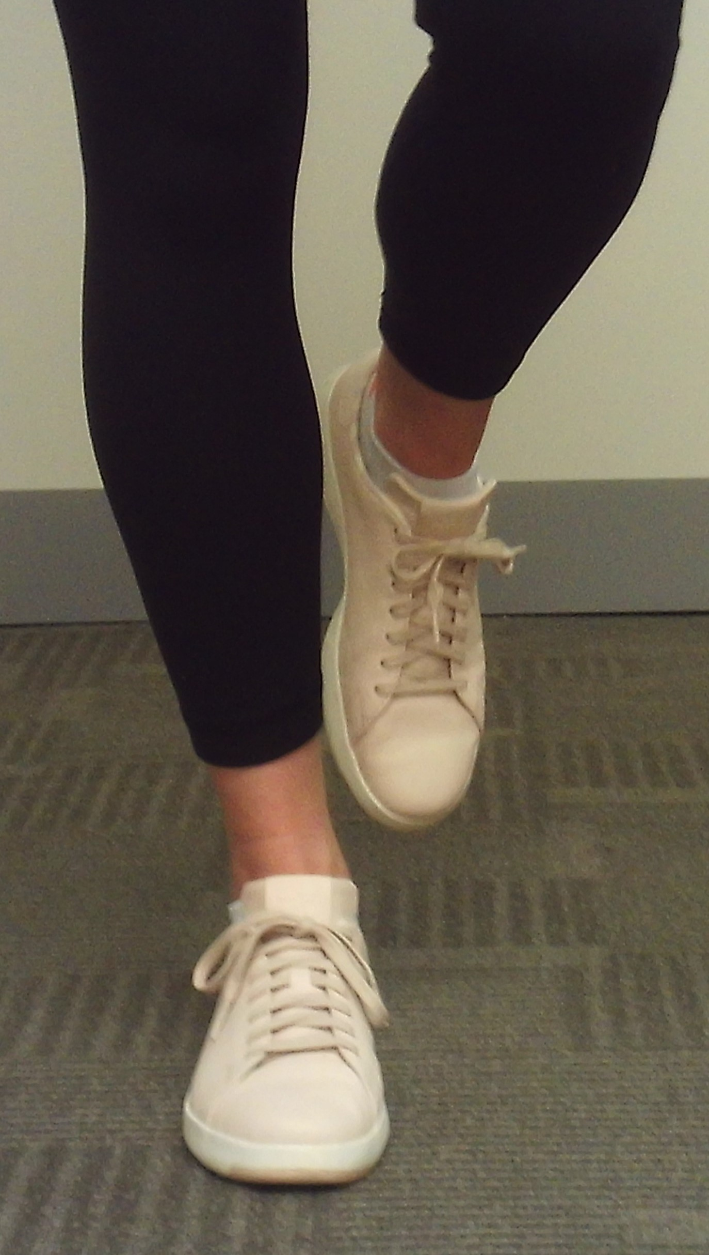
Static Stance Progressions
A
stand upright, holding a chair for support if needed
  semi-tandem - toes of one foot beside the heel of the other foot
  tandem - toes of one foot directly behind the heel of the other foot
  single-leg
B
C
I will be able to demonstrate the ability to safely perform a daily routine of balance training exercises.

Slide 24
Section 4
Dynamic Balance Exercises

Slide 25
Dynamic Balance Exercises
walk on toes
walk on heels
walk heel-to-toe
figure 8s
walk backwards
3-dimensional movement - dancing, Tai Chi
Video – Dynamic Balance Exercises
I will be able to demonstrate the ability to safely perform a daily routine of balance training exercises.

Slide 26
Progressions for Balance Training
There is no end to how you can challenge your balance. Here are some ideas:
move from more support to less support - holding a chair to not a holding chair
from a wide base of support to a narrow base - 2 feet to 1 foot
from a stable to an unstable surface - floor to foam/mat/pillow
reduce feedback - close eyes
multi-task - hold/carry a glass of water
challenge your brain - count backwards by 7s from 100
I will be able to demonstrate the ability to safely perform a daily routine of balance training exercises.

Slide 27
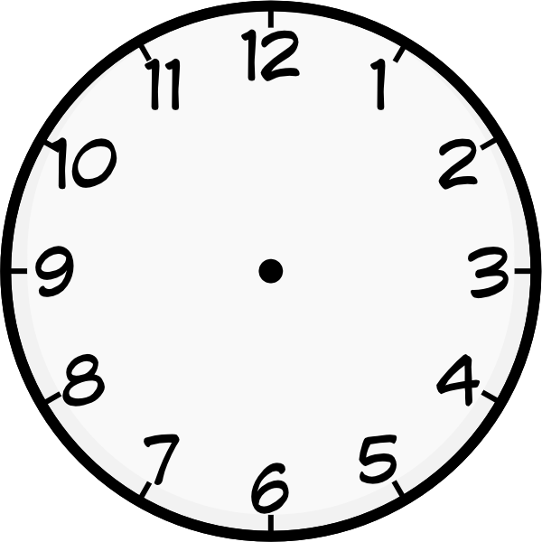
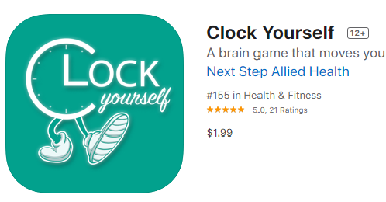

Reaction Time Training
Train yourself to think more quickly on your feet and react quickly
Clock Stepping Exercise
Imagine a clock on the floor and you are standing in the middle of it
Take a step in the direction of each number of the clock.
you can move:
  clockwise
  counterclockwise
  mix up the numbers
I will be able to demonstrate the ability to safely perform a daily routine of balance training exercises.

Slide 28
Reaction Time Training
Train yourself to think more quickly on your feet and react quickly
Clock Stepping Exercise
Imagine a clock on the floor and you are standing in the middle of it
Take a step in the direction of each number of the clock.
you can move:
  clockwise
  counterclockwise
  mix up the numbers
Video – Clock Stepping Exercise

Slide 29
Section 5
SMART Goal Setting

Slide 30
Planning and Goal Setting
In your Exercise and You - Workshop Guide, consider the following:
This week…
decide how you want to continue with safe movement and bone health exercise
identify how you will take action to benefit from the information you have learned
identify goals that will help you stay motivated
I will be able to create an activity plan by setting SMART goals for a personal exercise routine.

Slide 31
How do I set goals?
Setting SMART goals helps you make clear, successful changes
Specific How will I do it? What, how much, when, how often?
Measurable How will I measure it? What will it look like to achieve my goal?
Achievable Can I do it? Can I keep doing it? Start small and build momentum.
Realistic Is it within reach? Does my goal fit into your everyday life?
Time-oriented When will I meet my goal?
I will be able to create an activity plan by setting SMART goals for a personal exercise routine.

Slide 32
Hints to Stay Motivated
schedule exercise into your week
use the words “I will”, not “ I will try…”
choose a goal that is meaningful to you
big goals need to be broken down into smaller steps
  but always keep your big goals in mind
reach out for support - recruit a “cheer team”
I will be able to create an activity plan by setting SMART goals for a personal exercise routine.

Slide 33
Cool-down Activity
Review your current exercise routine for improving balance from the Starter Activity. In your Workshop Guide, consider
  what changes do you need to make to your daily routine?
  how can you make these changes?
  which areas should you focus on first?
Create a SMART goal for improving your exercise routine that you can work towards over the next week
I will be able to create an activity plan by setting SMART goals for a personal exercise routine.

Slide 34
Additional Resources
Osteoporosis Canada
osteoporosis.ca
Dr. David Hanley Osteoporosis Centre
osteoporosiscalgary.com
National Osteoporosis Foundation
nof.org

Slide 35






SPONSORS

Slide 36
Bibliography
Mielke, H. (2015). Bone Strong Dynamic Balance Exercises. Primary Care Network, Lloydminster.
Mielke, H. (2015). Bone Strong Static Balance Exercises. Primary Care Network, Lloydminster.
Alberta Health Services. (2013). Osteoporosis/Bone Health Education Program. (pp. 51).

