Slide 1

My Everyday Nutrition
Data-Driven. People-Led. Outcome-Focused.
Bone Health

Slide 2
Starter Activity
In your Workshop Guide, record everything you ate yesterday, including any supplements you might have taken
Using the resource tables in your Workshop Guide, calculate the amount of calcium and vitamin D intake for everything you consumed
You will return to this information later in the workshop

Slide 3
Agenda
1. Calcium and your Diet
2. Why should I care about Vitamin D?
3. Lifestyle Factors
Data-Driven. People-Led. Outcome-Focused.

Slide 4
Learning Objectives
I will be able to…
Briefly describe the role calcium plays in my bone health.
State the daily recommended calcium intake for adults.
Discuss why we should aim for food sources of calcium.
Identify a minimum of 2 ways to increase my calcium intake.
Calculate how much calcium I intake every day.
Determine if a calcium supplement might be needed.

Slide 5
Learning Objectives
I will be able to…
Briefly describe the role Vitamin D plays in my bone health.
State the daily recommended Vitamin D intake for adults.
Identify a minimum of 2 ways to increase my Vitamin D intake.
Briefly describe the role protein plays in my bone health.
Identify a minimum of 3 factors that can harm my bone health.
Discuss how they can reduce the risk associated with factors that can harm my bone health.

Slide 6
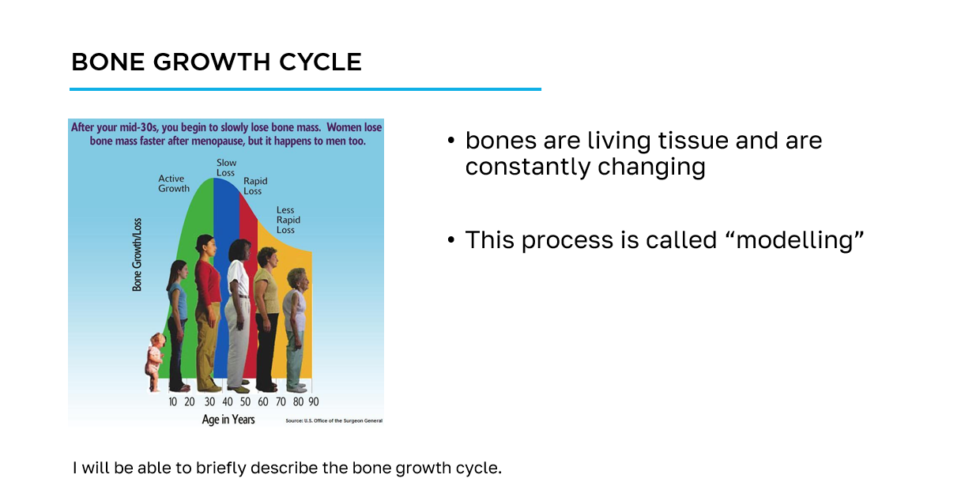
How to navigate the slides
slide title
key information
learning objective
slide image

Slide 7
Workshop Guide
As we progress through this workshop, please ensure to complete the appropriate sections of the Workshop Guide provided for you.
This will be your quick reference following this workshop to aid you on your bone health journey.

Slide 8
Section 1
Calcium and Your Diet

Slide 9
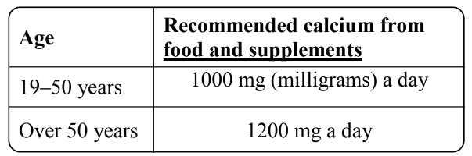
Why is Calcium Important?
Helps balance the renewing and repairing processes of bones
Reduces the risk of breaking a bone
Recommended daily calcium intake
I will be able to briefly describe the role calcium plays in their bone health.
I will be able to state the daily recommended calcium intake for adults.

Slide 10

How to Increase Your Calcium Intake
In groups of 3-4, brainstorm your ideas about the following question and record your ideas in your Workshop Guide
What are some ways to increase your daily intake of calcium?
You will have TWO MINUTES to record your ideas in your Workshop Guide
I will be able to identify a minimum of 2 ways to increase my calcium intake.

Slide 11
How to Increase Your Calcium Intake
Include dairy products in your diet every day.
Eat more leafy vegetables
Add skim milk powder to foods and drinks.
Have cheese as a snack or in a meal.
Eat more canned fish like salmon and sardines, with the bones
Read labels - choose foods with 15% or more Daily Value for calcium
I will be able to identify a minimum of 2 ways to increase my calcium intake.

Slide 12
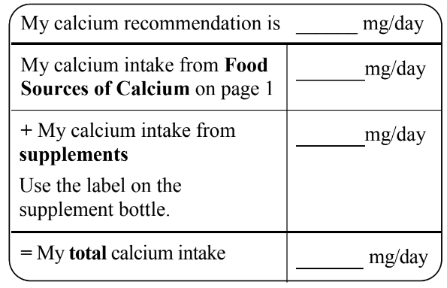
Calcium Intake Calculator
Using your daily intake of calcium from the starter activity, how does it compare to your recommended daily intake of calcium?
I will be able to calculate how much calcium I intake every day.

Slide 13
Calcium Intake Calculator
What changes could you make to your diet to ensure that you are meeting the daily calcium intake recommendation?
How else can you improve your diet?
I will be able to calculate how much calcium I intake every day.

Slide 14
Calcium from Food Sources
Try to get as much calcium from food as you can, before considering supplements
  food sources have other essential bone nutrients whereas a calcium supplement just provides calcium
Excess calcium from food sources is not harmful
I will be able to discuss why we should aim for natural sources of calcium.

Slide 15
Calcium Supplements
How do you know if you need a calcium supplement?
I will be able to determine if a calcium supplement might be needed.

Slide 16
Calcium Supplements
You may need a calcium supplement if
  you do not get enough calcium from food every day
  you do not include any dairy in your diet
  your healthcare provider recommends that you take a calcium supplement
I will be able to determine if a calcium supplement might be needed.

Slide 17
Calcium Supplements
If choosing a supplement, you will need to consider the amount of ‘elemental’ calcium in your total amount of calcium not just what you see on the front of the bottle
The body can only absorb a certain amount of calcium at one time (about 500 mg of elemental calcium)
Talk to your healthcare provider if you think you need a calcium supplement
I will be able to determine if a calcium supplement might be needed.

Slide 18
Section 2
Why Should I Care about Vitamin D?

Slide 19
Why is Vitamin D so important?
Helps your body absorb and use calcium from your diet and/or supplements
Increases bone strength which reduces the risk of breaking a bone
Increases muscle strength which may reduce the risk of falling
I will be able to briefly describe the role Vitamin D plays in their bone health.

Slide 20
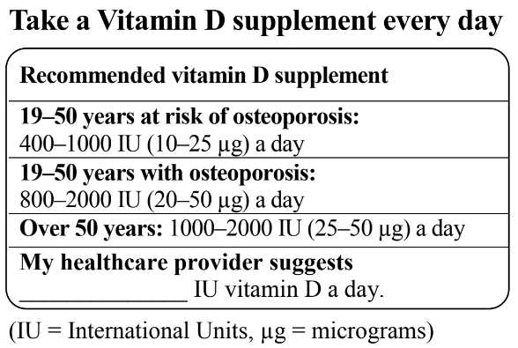
Recommended Daily Vitamin D Intake
Check the label of your supplement bottle for the type of vitamin D it contains
  vitamin D₃ is the best for most people and is more effective than D₂
  choose vitamin D₂ supplement for a vegan option
do not exceed more than 2000 IU of vitamin D each day from supplements unless your healthcare provider tells you to take more
I will be able to briefly describe the role Vitamin D plays in their bone health.

Slide 21
Recommended Daily Vitamin D Intake
Using your daily intake of vitamin D from the starter activity, how does it compare to your recommended daily intake of vitamin D?
I will be able to briefly describe the role Vitamin D plays in their bone health.

Slide 22
Vitamin D Sources
Choose foods with vitamin D such as milk, fortified soy beverage, halibut, salmon, sardines, trout, eggs and margarine
Our skin makes vitamin D from sunlight
  Albertans make little to no vitamin D from October to March!
Key Message:
Food and sunshine are NOT a reliable source of vitamin D
a daily vitamin D supplement is recommended for all ages
I will be able to identify a minimum of 2 ways to increase their Vitamin D intake.

Slide 23
Section 3
Lifestyle Factors

Slide 24

Lifestyle Factors that affect Your Bones
With a partner, come up with a list of 4 possible dietary and lifestyle factors that can have adverse effects on your bone health.
You will have ONE MINUTE to write down your ideas into your Workshop Guide.
I will be able to identify a minimum of 3 factors that can harm their bone health.
I will be able to discuss how I can reduce the risk associated with factors that can harm their bone health.

Slide 25
Lifestyle Factors Harmful to Your Bones
limit caffeine to 400 mg or less each day
      one cup (250 mL/8 oz) contains 100-150 mg of caffeine, also found in coffee-based drinks, colas, teas, energy drinks and dark chocolate
      colas and dark soft drinks also have phosphates that bind calcium, which has evidence that it can increase the risk for fracture
limit alcohol intake to NO MORE THAN 1-2 drinks each day
      one drink is 12 oz (355 mL) of beer, 5 oz (150 mL) of wine, 1.5 oz (45 mL) of liquor
I will be able to identify a minimum of 3 factors that can harm their bone health.
I will be able to discuss how I can reduce the risk associated with factors that can harm their bone health.

Slide 26
Lifestyle Factors Harmful to Your Bones
limit salt (sodium) intake to less than 2300 mg per day
      eat less processed and packaged foods, read labels to find options lower in sodium, choose fresh foods and foods with no salt added
      restaurant food is also high in sodium
smoking is a risk factor for osteoporosis
      Talk to your healthcare provider to discuss supports that can help you quit smoking
I will be able to identify a minimum of 3 factors that can harm their bone health.
I will be able to discuss how I can reduce the risk associated with factors that can harm their bone health.

Slide 27
Ensuring a Balanced Diet
Protein helps you maintain muscle mass and weight, which are important for bone health
If you lose weight without trying or have a poor appetite, talk to your healthcare provider about ways to add calories and protein to your diet
Eat a variety of healthy foods every day, including vegetables and fruits and make sure to include some protein at each meal and/or snack
I will be able to briefly describe the role protein plays in their bone health.

Slide 28
Cool-down Activity
Complete the My Action Plan for My Bone Health activity in your Workshop Guide

Slide 29
Additional Resources
Osteoporosis Canada
osteoporosis.ca
Dr. David Hanley Osteoporosis Centre
osteoporosiscalgary.com
National Osteoporosis Foundation
nof.org

Slide 30






SPONSORS

Slide 31
Bibliography
(n.d.). Calcium. Retrieved from https://osteoporosis.ca/bone-health-osteoporosis/calcium-and-vitamin-d/.
Alberta Health Services. (2018). Eating Well to Prevent and Treat Osteoporosis.
Alberta Health Services. (2018). Extra Hints for Calcium.
Alberta Health Services. (2018). Healthy Bones.
Alberta Health Services. (2012). Adding Calories and Protein to Your Diet.

