Slide 1

My Bones and Me
Data-Driven. People-Led. Outcome-Focused.
Bone Health

Slide 2
Starter Activity
On the first page of your Workshop Guide, write down the risk factors for bone loss and osteoporosis that you are familiar with
Discuss these factors with someone near you
We will review these factors later in the workshop

Slide 3
Agenda
1. Bone Mineral Density (BMD)
2. Understanding Fracture Risk
3. Low Bone Mass
4. What Men and Women need to know!
Data-Driven. People-Led. Outcome-Focused.

Slide 4
Learning Objectives
I will be able to…
Briefly explain the significance of low bone mass
Discuss at least one approach for treating low bone mass
Describe how bone mineral density is measured and what it is measuring
List a minimum of two reasons for a bone density test to be performed
Describe how BMD tests are interpreted
Identify the difference between my BMD and my fracture risk
Identify a minimum of two gender-based facts about osteoporosis or low bone density

Slide 5
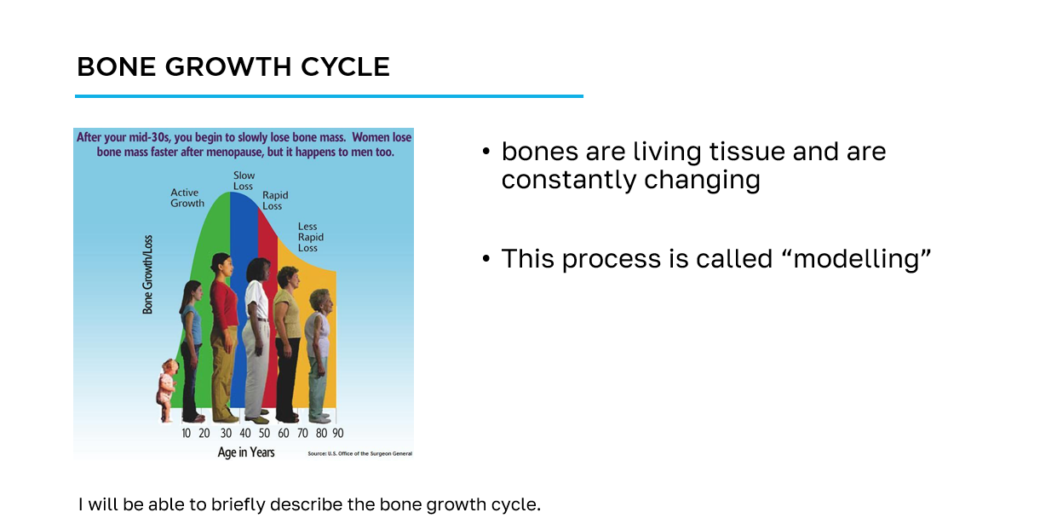
How to navigate the slides
slide title
key information
learning objective
slide image

Slide 6
Workshop Guide
As we progress through this workshop, please ensure to complete the appropriate sections of the Workshop Guide provided for you.
This will be your quick reference following this workshop to aid you on your bone health journey.

Slide 7
Section 1
Bone Mineral Density (BMD)

Slide 8
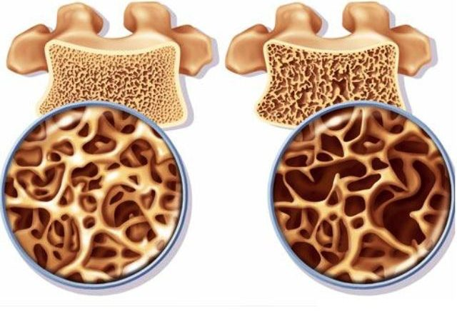
BMD
Bone Mineral Density only measures bone quantity and not quality
I will be able to describe how bone mineral density is measured and what it is measuring.
Notes:
Image Sources: http://salimdjelouat.com/2017/11/14/diabetes-and-bone-mineral-density-bmd/

Slide 9
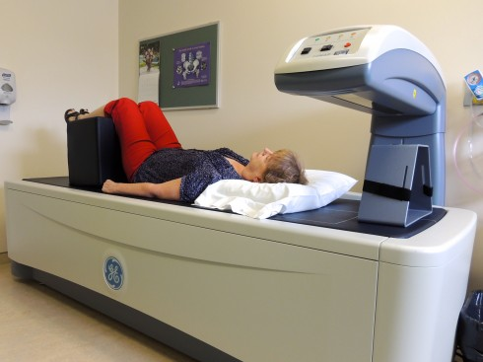
BMD Test
Measures the density of minerals, like calcium, in your bone
Takes less than 15 minutes and it is relatively painless
I will be able to describe how bone mineral density is measured and what it is measuring.
Notes:
Image Source: https://www.kdh.on.ca/our-services/diagnostic-imaging/bone-mineral-density-bmd-testing/

Slide 10
Why do we use the BMD Test
Helps to predict the risk of future bone fractures
Helps to diagnose bone loss and osteoporosis
Can help your doctor with their assessment of your osteoporosis therapy
Used as a part of your bone health assessment in addition to identifying other risk factors
I will be able to list a minimum of 2 reasons for a bone density test to be performed.

Slide 11
Understanding the BMD Test
Your T-Score is a comparison of your BMD Test results to the ideal or peak mineral density of a healthy 30-year-old adult (peak bone density)
  healthy bone density is a range, not a single number
  the lower the T-score, the lower your bone mass is compared to a 30-year-old
  some fractures, especially hip and spine, are almost always due to osteoporosis regardless of the T-score
I will be able to describe how BMD tests are interpreted.

Slide 12
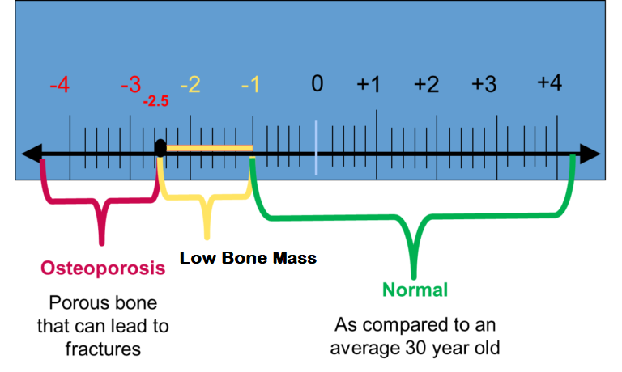
Understanding the BMD Test
Interpreting your T-Score
  T-score greater than -1.0 = Normal
  T-score between -1 and -2.5 = Low Bone Mass
  T-score of less than -2.5 = Osteoporosis
I will be able to describe how BMD tests are interpreted.
Notes:
Image Source: https://americanbonehealth.org/bone-density/understanding-the-bone-density-t-score-and-z-score/

Slide 13
Section 2
Understanding Fracture Risk

Slide 14

Fracture Risk for Men and Women
You should get a BMD Test, if you are…
65+
a postmenopausal woman or man (aged 50-64) with risk factors for fracture
under 50 with a disease or condition associated with low bone mass or bone loss
Video courtesy of the National Osteoporosis Foundation
I will be able to Identify the difference between my BMD and my fracture risk.

Slide 15
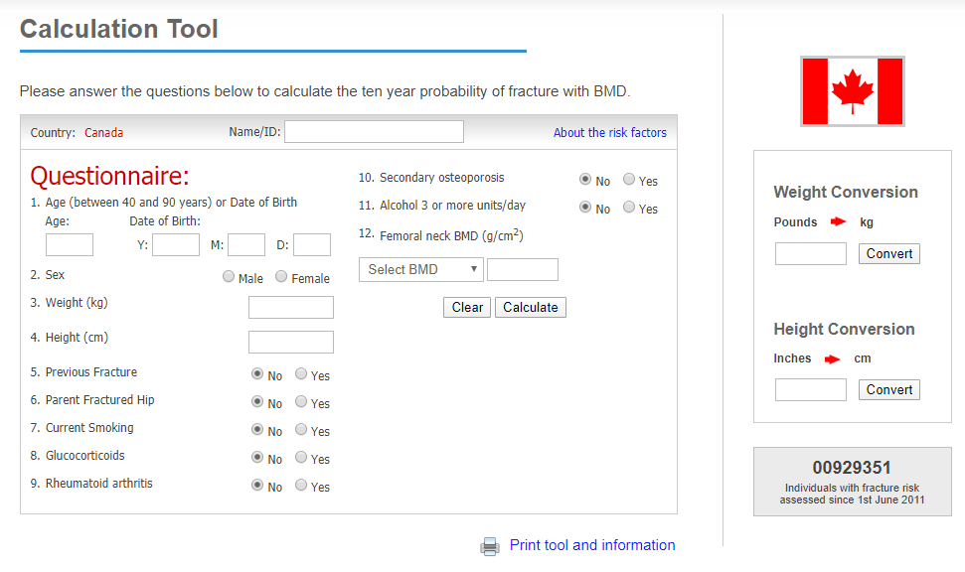
Fracture Risk for Men and Women
FRAX - Fracture Risk Assessment Tool
  can be calculated without a BMD test
  looks at your other risks to help predict overall fracture risk
  used for people over the age of 50 who are not on treatment
I will be able to identify the difference between my BMD and my fracture risk.
Notes:
Image Source: https://www.sheffield.ac.uk/FRAX/tool.aspx?country=19

Slide 16
Fracture Risk for Men and Women
FRAX
Risk for Major Osteoporotic Fracture
<10% - low risk
10-20% - moderate risk
>20% - high risk
I will be able to identify the difference between my BMD and my fracture risk.
Notes:
Image Source: https://www.sheffield.ac.uk/FRAX/tool.aspx?country=19

Slide 17
Fracture Risk for Men and Women
FRAX
Risk for Hip Fracture
<1% - low risk
1-3% - moderate risk
>3% - high risk
I will be able to identify the difference between my BMD and my fracture risk.
Notes:
Image Source: https://www.sheffield.ac.uk/FRAX/tool.aspx?country=19

Slide 18
BMD vs. Fracture Risk
In your groups, discuss the following questions and record your responses in the appropriate sections of the Workshop Guide provided for you.
Why is it important to know your BMD and your fracture risk?
What are the differences?

Slide 19
Section 3
Low Bone Mass

Slide 20
Low Bone Mass
When your bone density is lower than normal, but not low enough to be considered osteoporosis
  T-score between -1 and -2.5 = Low Bone Mass
I will be able to briefly explain the significance of low bone mass.

Slide 21
What is the Significance of Low Bone Mass?
In your table groups, brainstorm what would it mean to you if you had low bone mass
I will be able to briefly explain the significance of low bone mass.

Slide 22
Significance of Low Bone Mass
Does not always mean you will get osteoporosis, but it is a risk
  As we age, we lose more bone than we replace
there are no physical symptoms, like with osteoporosis
more likely to break a bone than someone with normal bone density
I will be able to briefly explain the significance of low bone mass.

Slide 23
Treating Low Bone Mass
Low Bone Mass can progress to osteoporosis
  ensuring you intake sufficient vitamin D and calcium and engage in an appropriate exercise routine
  Your doctor will evaluate you to see if you need medication
I will be able to discuss at least one approach for treating low bone mass.

Slide 24
Section 4
What Men and Women need to know!

Slide 25
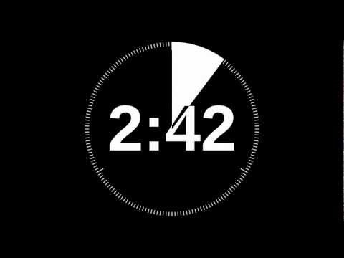
What Men and Women need to know!
In groups of 3-4, share and compare risk factors for bone loss and osteoporosis
Compile a list of factors for men and women that can lead to bone loss and/or osteoporosis
You will have THREE MINUTES to record your ideas in your Workshop Guide
I will be able to briefly describe the bone growth cycle.

Slide 26
Bone Loss and Ageing
After the age of about 65, both men and women lose bone at about the same rate
Before this, however, there are some other factors that you need to be aware of!
Video courtesy of the National Osteoporosis Foundation
I will be able to identify a minimum of two gender-based facts about osteoporosis or low bone density.

Slide 27
Bone Loss Factors for Women
low estrogen levels lead to bone loss
  estrogen helps protect bone
  menopause leads to lower estrogen levels which will cause bone loss
women’s bones are generally thinner than men’s bones
osteoporosis starts earlier and gets worse faster in women because of midlife hormonal shifts
  can lose up to 20% of bone density in the first 5-7 years after menopause
I will be able to identify a minimum of two gender-based facts about osteoporosis or low bone density.

Slide 28
Bone Loss Factors for Men
Associated with some male-only conditions
  abnormally low testosterone (hypogonadism)
      low testosterone levels puts men at risk
  certain genetic conditions
men who break their hip or wrist are less likely than women to be treated for osteoporosis
I will be able to identify a minimum of two gender-based facts about osteoporosis or low bone density.

Slide 29
Cool-down Activity
In your Workshop Guide, complete the Cool-down Activity, answering three questions about the material discussed in this workshop
With a partner, compare your responses

Slide 30
Additional Resources
Osteoporosis Canada
osteoporosis.ca
Dr. David Hanley Osteoporosis Centre
osteoporosiscalgary.com
National Osteoporosis Foundation
nof.org

Slide 31




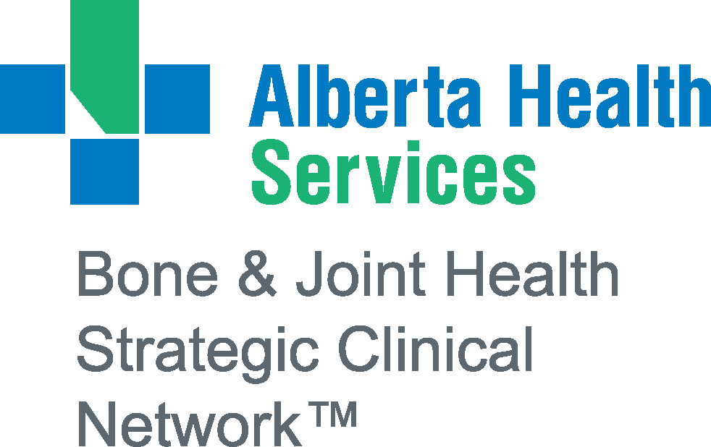
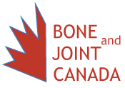
SPONSORS

Slide 32
Bibliography
(n.d.). Why Should I Get Tested. Retrieved from https://osteoporosis.ca/about-the-disease/diagnosis/why-should-i-get-tested/.
(2020). Bone Density Exam/Testing. Retrieved from https://www.nof.org/patients/diagnosis-information/bone-density-examtesting/.
Centre for Metabolic Bone Diseases, University of Sheffield. (2020). FRAX Fracture Risk Assessment Tool. Retrieved from https://www.sheffield.ac.uk/FRAX/tool.aspx?country=19.
(2016). Understanding Bone Density Results: Your T-score and Z-score Explained. Retrieved from https://americanbonehealth.org/bone-density/understanding-the-bone-density-t-score-and-z-score/.
National Osteoporosis Foundation. (2014). Healthy Bones for Life: Clinician’s Guide. (pp. 23-25).
National Osteoporosis Foundation. (2014). Healthy Bones for Life: Patient’s Guide. (pp. 19-20).
Osteoporosis Canada. (2014). Assessment of 10-Year Fracture Risk – Women and Men [PDF File].

