Slide 1

Medications to Improve Bone Health
Data-Driven. People-Led. Outcome-Focused.
Bone Health

Slide 2
Starter Activity
Please, find the Quiz on the first page of your Medications to Improve Bone Health - Workshop Guide
Complete the LEFT SIDE of the chart indicating how familiar you are with the topics that will be discussed today
We will return to this quiz at the end of the workshop

Slide 3
Agenda
1. Vitamin D and Calcium Supplements
2. Bisphosphonates
3. Denosumab
4. Hormone Therapy
5. SERMs
6. Teriparatide
Data-Driven. People-Led. Outcome-Focused.

Slide 4
Learning Objectives
I will be able to…
Briefly describe how each medication or therapy works
Describe how these medications are taken
Identify common side effects for each medication or therapy
Identify medications that increase my risk of having a fracture

Slide 5
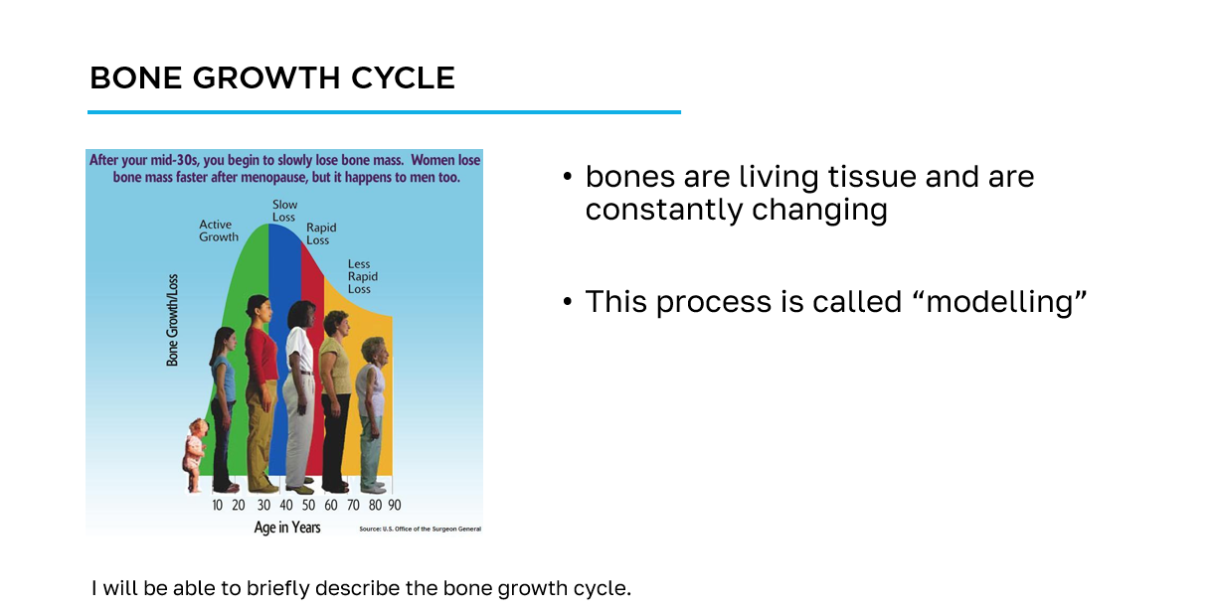
How to navigate the slides
slide title
key information
learning objective
slide image

Slide 6
Workshop Guide
As we progress through this workshop, please ensure to complete the appropriate sections of the Workshop Guide provided for you.
This will be your quick reference following this workshop to aid you on your bone health journey.

Slide 7
Section 1
Vitamin D and
Calcium Supplements

Slide 8
Why is Vitamin D so important?
Helps your body absorb and use calcium from your diet and/or supplements
Increases bone strength which reduces the risk of breaking a bone
Increases muscle strength which may reduce the risk of falling
I will be able to briefly describe how each medication or therapy works.
I will be able to describe how these medications are taken.

Slide 9
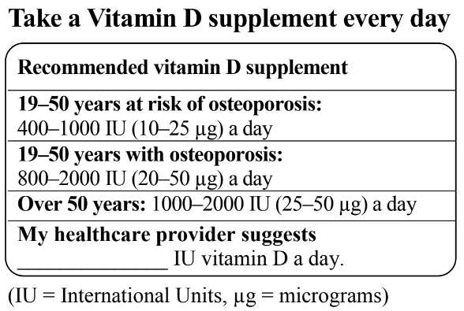
Recommended Daily Vitamin D Intake
Check the label of you supplement bottle for the type of vitamin D it contains
  vitamin D₃ is already converted to the active form of vitamin that your body uses.
Do not exceed more than 2000 IU of vitamin D each day from supplements unless your healthcare provider tells you to take more
I will be able to briefly describe how each medication or therapy works.
I will be able to describe how these medications are taken.

Slide 10
Vitamin D Sources
Choose foods with vitamin D such as milk, fortified soy beverage, halibut, salmon, sardines, trout, and eggs
Our skin makes vitamin D from sunlight
  Albertans and people who live in the north make little to no vitamin D from October to March!
Key Message:
Food and sunshine is NOT a reliable source of vitamin D
  a daily vitamin D supplement is recommended for all ages

Slide 11
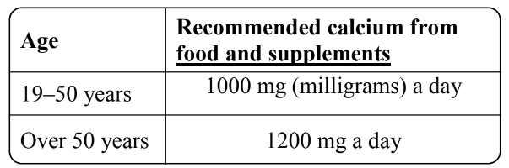
Why is Calcium Important?
Essential to helping the renewing and repairing process of bones stay balanced
Reduces the risk of breaking a bone
Recommended daily calcium intake
I will be able to briefly describe how each medication or therapy works.
I will be able to describe how these medications are taken.

Slide 12
Calcium Supplements
You may need a calcium supplement if
  you do not get enough calcium from food every day
  you do not include any dairy in your diet
  your healthcare provider recommends that you take a calcium supplement
I will be able to briefly describe how each medication or therapy works.
I will be able to describe how these medications are taken.

Slide 13
Calcium Supplements
If choosing a supplement, you will need to consider the amount of ‘elemental’ calcium in your total amount of calcium not just what you see on the front of the bottle
The body can only absorb a certain amount of calcium at one time (about 500 mg of elemental calcium)
I will be able to briefly describe how each medication or therapy works.
I will be able to describe how these medications are taken.

Slide 14
Calcium Supplements
Talk to your healthcare provider if you think you need a calcium supplement, and which type might be right for you (e.g. choosing between calcium citrate or phosphate)
Side effects: constipation, mild stomach upset
Cautions: calcium can interact with a number of nutrients and other medications
  Discuss with your pharmacist or other healthcare professional when you should be taking your supplement.
I will be able to briefly describe how each medication or therapy works.
I will be able to describe how these medications are taken.

Slide 15
Section 2
Bisphosphonates

Slide 16
What are Bisphosphonates?
Bisphosphonates are a group of medications that help slow bone loss
This is done by slowing down the body’s rate of bone removal
Common bisphosphonate medications:
  Alendronate (Fosamax)
  Risedronate (Actonel)
  Zolendronate (Alclasta)
I will be able to briefly describe how each medication or therapy works.
I will be able to describe how these medications are taken.

Slide 17
Safety Precautions for Bisphosphonates
There are quite a few drug interactions and safety precautions to keep in mind when taking bisphosphonates
  it is important to talk to your doctor or pharmacist if you have any questions when taking this medication
For example:
  Taking the medication with food can completely negate their benefit
  Taking the medication and not staying upright can be extremely dangerous to patients by causing damage to their esophagus
I will be able to briefly describe how each medication or therapy works.
I will be able to describe how these medications are taken.

Slide 18
What are side-effects of bisphosphonates?
Common side-effects include:
  stomach pain, heartburn, nausea, pain in bones and muscles
    usually get better with time
Less common side-effects:
  low calcium levels (numbness, tingling, muscle spasms)
    discuss your calcium intake with your doctor
  Serious side effects include the medication being caught in the throat if not taken with water. This can lead to damage and bleeding.
I will be able to identify common side effects for each medication or therapy.
I will be able to identify medications that increase my risk of having a fracture.

Slide 19
Section 3
Denosumab

Slide 20
What is Denosumab?
Denosumab (Prolia) is an injectable medication that helps to slow bone loss
  This is accomplished by slowing down the cells in your body responsible for removing bone, slowing or even reversing this process
It reduces the risk of fractures of the spine, hip and other sites in postmenopausal women
I will be able to briefly describe how each medication or therapy works.
I will be able to describe how these medications are taken.

Slide 21
What are side-effects of denosumab?
Common side-effects include:
  pain in muscles or joints, rash
    pain in muscles and joints usually gets better with time, talk to your doctor if it interferes with your ability to do regular activities
    if a rash develops, see your doctor
Less common side-effects:
  low calcium levels (numbness, tingling, muscle spasms), increased risk of infection
    discuss your calcium intake with your doctor
    let your doctor know if you notice any signs of infection (fever, feeling unwell)
I will be able to briefly describe how each medication or therapy works.
I will be able to describe how these medications are taken.

Slide 22
Section 4
Hormone Therapy

Slide 23
What is Estrogen Therapy?
Commonly used to relieve the symptoms of menopause
It is an effective treatment to help reduce the risk of osteoporotic fractures
Treatment can consist of estrogen alone or estrogen and progesterone in combination
Can reduce the risk of spine and hip fractures as well as other osteoporotic fractures
I will be able to briefly describe how each medication or therapy works.
I will be able to describe how these medications are taken.

Slide 24
What is Estrogen Therapy?
Estrogen helps to build and maintain bone density
The estrogen levels in menopausal women decrease leading to bone density loss
  Estrogen therapy supplements these very low hormone levels
Used to treat osteoporosis only in women who also suffer from menopausal symptoms
I will be able to briefly describe how each medication or therapy works.
I will be able to describe how these medications are taken.

Slide 25
Are there any side-effects?
May increase the risk of heart attack, stroke, blood clots and breast cancer
  other options should be explored first unless the woman is also suffering from significant menopausal symptoms
Side-effects can include:
  depression, headaches, breast tenderness, premenstrual syndrome (PMS), weight gain
I will be able to identify common side effects for each medication or therapy.
I will be able to identify medications that increase my risk of having a fracture.

Slide 26
What about Testosterone Therapy?
Used to treat hypogonadism in men
There is no evidence that testosterone can reduce fractures in men, even in men with low testosterone levels
  Testosterone has been shown to increase bone mass density
I will be able to briefly describe how each medication or therapy works.
I will be able to describe how these medications are taken.

Slide 27
Section 5
SERMs

Slide 28
What are SERMs?
SERMs are a family of medication called Selective Estrogen Receptor Modulators
  The most common is Raloxifene (Evista)
Although non-hormonal, they act like the hormone estrogen in some parts of the body, such as the bones
  In other parts, like the uterus and breasts, they block the effects of estrogen
Reduces the risk of spine fractures, but does not reduce the risk of fractures in other bones
I will be able to briefly describe how each medication or therapy works.
I will be able to describe how these medications are taken.

Slide 29
What are side-effects of SERMs?
Common side-effects include:
  worsening of post-menopausal symptoms (hot flashes)
  has been shown to increase the risk of blood clots
I will be able to identify common side effects for each medication or therapy.
I will be able to identify medications that increase my risk of having a fracture.

Slide 30
Section 5
Teriparatide

Slide 31
What is Teriparatide?
Teriparatide (Forteo) is a bone formation agent that targets the body’s bone-building cells and stimulates them to start building new bone
It is the only bone building medication available in Canada
Teriparatide can be used in postmenopausal women with osteoporosis
I will be able to briefly describe how each medication or therapy works.
I will be able to describe how these medications are taken.

Slide 32
What are side-effects of Teriparatide?
Common side-effects include:
  leg cramps, aches and pains
  dizziness
  nausea
People with bone cancer or a bone disease called Paget’s disease should not take this medication
I will be able to identify common side effects for each medication or therapy.
I will be able to identify medications that increase my risk of having a fracture.

Slide 33
Cool-down Activity
Review your “Medications to Improve Bone Health” Quiz from the starter activity in your Medications to Improve Bone Health - Workshop Guide
Complete the RIGHT SIDE of the chart to identify what you have learned during the workshop
With the person next to you, discuss:
  what you learned in the workshop
  what you found surprising in the workshop
  what do you want to learn more about
  what you will do next with this new knowledge

Slide 34
Additional Resources
Osteoporosis Canada
osteoporosis.ca
Dr. David Hanley Osteoporosis Centre
osteoporosiscalgary.com
National Osteoporosis Foundation
nof.org

Slide 35




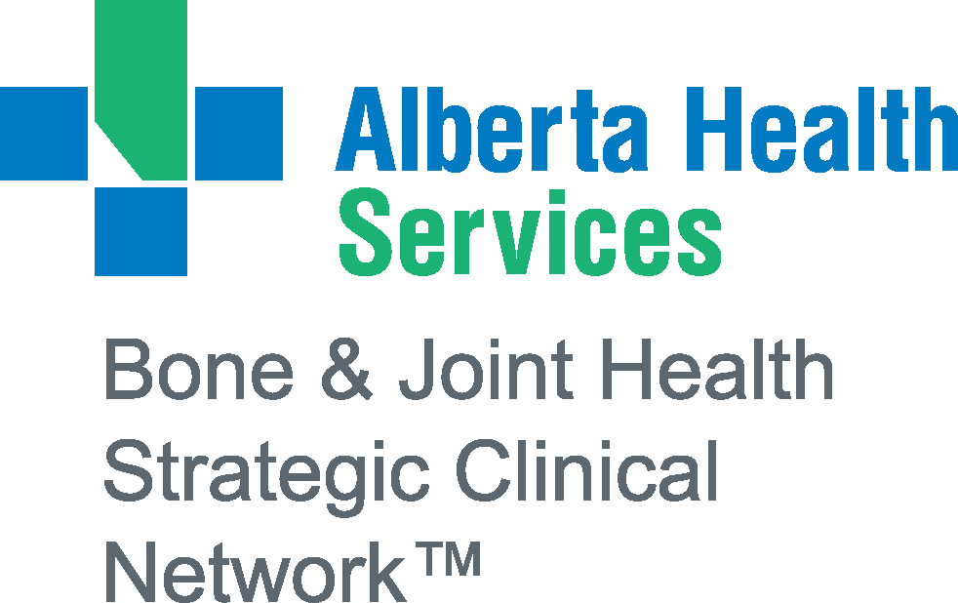
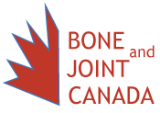
SPONSORS

Slide 36
Bibliography
(n.d.). Calcium. Retrieved from https://osteoporosis.ca/bone-health-osteoporosis/calcium-and-vitamin-d/.
Alberta Rheumatology. (n.d). Bisphosphonates [PDF].
Alberta Rheumatology. (n.d). Denosumab [PDF].
Alberta Health Services. (2019). Intravenous Bisphosphonate Therapy - General Information [PDF].
Alberta Health Services. (2018). Bisphosphonate Therapy - General Information [PDF].
Alberta Health Services. (2018). Eating Well to Prevent and Treat Osteoporosis.
Alberta Health Services. (2018). Healthy Bones.
Alberta Health Services. (2018). Osteoporosis Therapy - Denosumab (Prolia) [PDF].

Slide 37
Bibliography
(2016). Osteoporosis FAQs. Retrieved from https://https://www.osteoporosiscalgary.com/for-patients/osteoporosis-faqs.html.
Alberta Health Services. (2013). Osteoporosis/Bone Health Education Program. (pp. 105).

