Slide 1

Aerobic Exercise
Data-Driven. People-Led. Outcome-Focused.
Bone Health

Slide 2
Starter Activity
Please, complete the Get Active Questionnaire handout.
We will return to this questionnaire at the end of the workshop.
I will be able to identify what I am doing well and what I can improve on in terms of exercise for bone health

Slide 3
Agenda
1. Exercise Guidelines
2. SMART Goal Setting
Data-Driven. People-Led. Outcome-Focused.

Slide 4
Learning Objectives
I will be able to…
Assess my personal activity level in relation to both the Canadian Physical Activity Guidelines and the Osteoporosis Canada recommendations for bone health
Identify how much aerobic exercise is needed for health benefits
Identify the difference between weight-bearing and non-weight-bearing aerobic exercise and why this is important for those with osteoporosis
Create a plan to continue or add aerobic exercise into my weekly routine

Slide 5
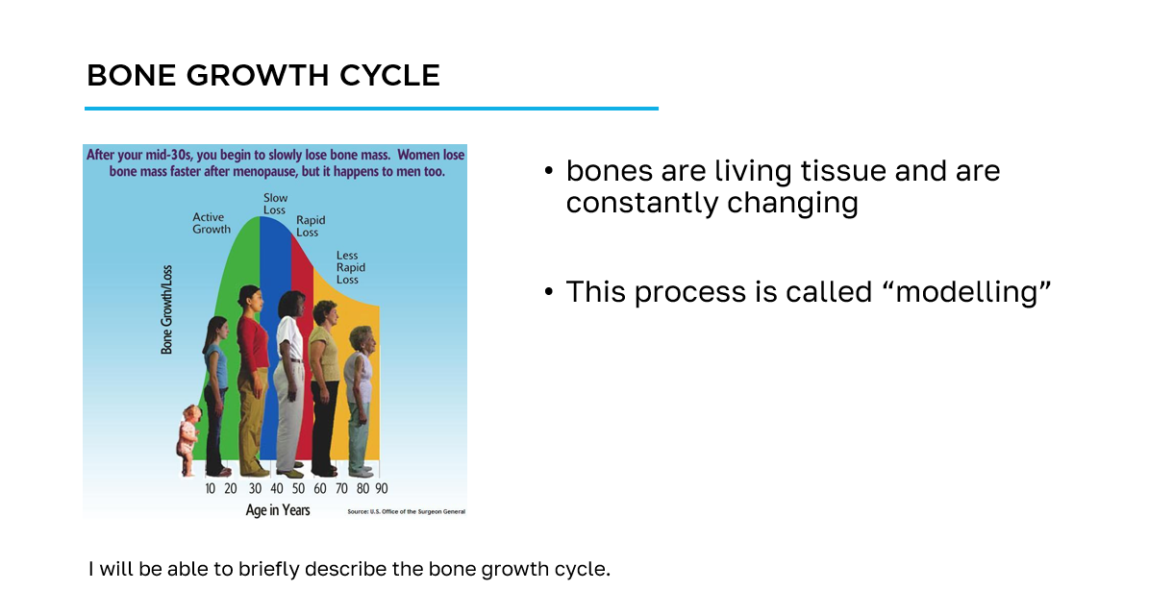
How to navigate the slides
slide title
key information
learning objective
slide image

Slide 6
Workshop Guide
As we progress through this workshop, please ensure to complete the appropriate sections of the Workshop Guide provided for you.
This will be your quick reference following this workshop to aid you on your bone health journey.

Slide 7
Section 1
Exercise Guidelines

Slide 8
Exercise for Bone Health
Osteoporosis Canada recommends:
at least 150 minutes of moderate-to-vigorous intensity aerobic physical activity per week, in bouts of 10 minutes or more - weight-bearing is better
muscle and bone strengthening activities using major muscle groups, at least 2 days per week
physical activities to enhance balance and prevent falls daily
practice spine sparing strategies and good posture daily
I will be able to assess my personal activity level in relation to both the Canadian Physical Activity Guidelines and the Osteoporosis Canada recommendations for bone health.

Slide 9
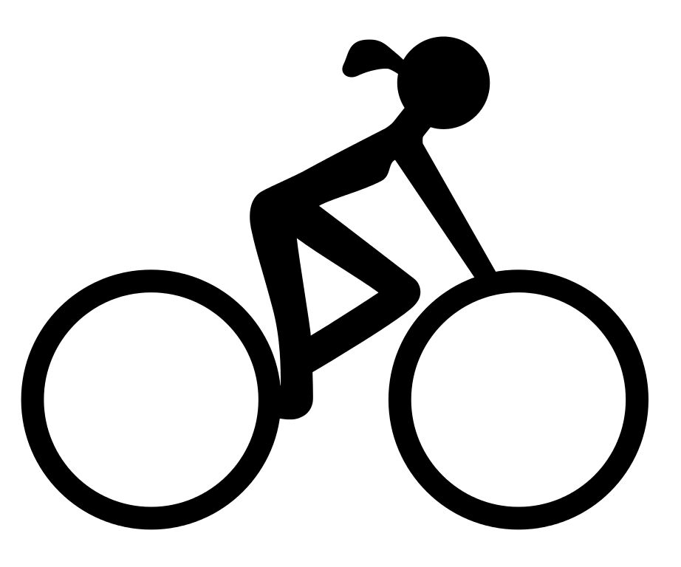

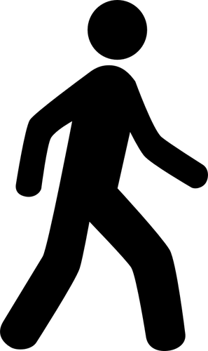

What is Aerobic Exercise?
aka “cardio”
physical activity that is rhythmic in nature, uses large muscle groups and results in an increase in breathing and heart rate
examples:
  walking
  cycling
  dancing
  swimming
  others?
I will be able to identify how much aerobic exercise is needed for health benefits.

Slide 10
How much aerobic exercise do I need?
With the person beside you, discuss the following questions:
How much aerobic exercise do you complete per week?
What motivates you to participate in aerobic exercise?
What are some barriers that prevent you from participating in aerobic exercise?
Record your ideas in your Workshop Guide.
I will be able to identify how much aerobic exercise is needed for health benefits.

Slide 11
Canadian Physical Activity Guidelines
To achieve health benefits, adults aged 18-64 should:
accumulate at least 150 minutes of moderate-to-vigorous intensity aerobic physical activity per week, in bouts of 10 minutes or more
perform muscle and bone strengthening activities using major muscle groups, at least 2 days per week
65 years and older:
as above + physical activities to enhance balance and prevent falls
I will be able to assess my personal activity level in relation to both the Canadian Physical Activity Guidelines and the Osteoporosis Canada recommendations for bone health.

Slide 12
Weight-bearing Aerobic Exercise
Weight-bearing aerobic exercise is recommended for people with osteoporosis
exercise on your feet and against gravity
weight-bearing exercise helps build bone
  Examples include walking, hiking, dancing
non weight-bearing exercise
  Examples include swimming, cycling, rowing
I will be able to identify the difference between weight-bearing and non weight-bearing aerobic exercise and why this is important for those with osteoporosis.

Slide 13
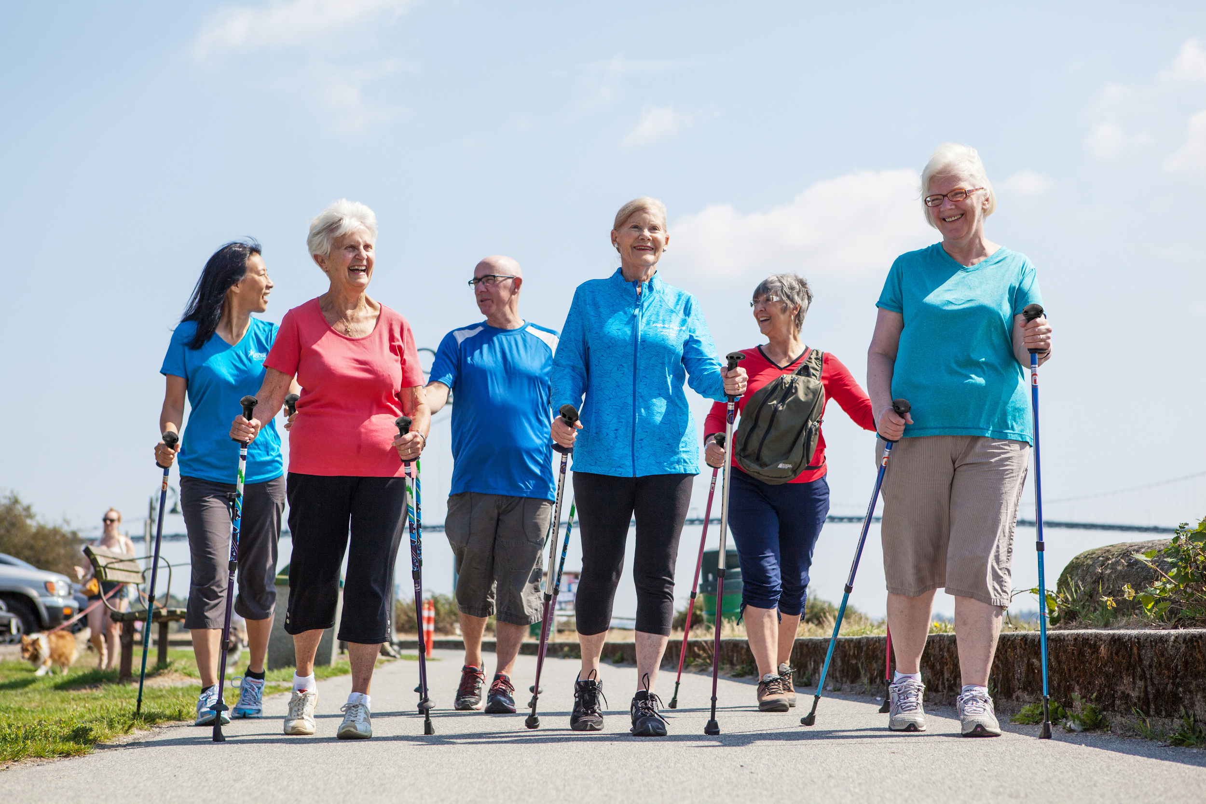
Nordic Pole Walking
Great form of weight-bearing aerobic exercise for those with osteoporosis
improves walking confidence
helps with balance when walking outdoors
promotes an upright walking posture
full body workout - uses upper body, lower body and core muscles
instructional videos at www.urbanpoling.com
It’s fun!
I will be able to identify the difference between weight-bearing and non weight-bearing aerobic exercise and why this is important for those with osteoporosis.

Slide 14

Benefits of Aerobic Exercise
Physical Health
  ↓ risk of developing many chronic health conditions
    heart disease, type 2 diabetes, high blood pressure, etc.
  ↑ management of chronic health conditions
    ↓ blood pressure, ↓ blood sugar, ↓ pain and ↑ function in those with arthritis, etc.
I will be able to Identify the difference between weight-bearing and non weight-bearing aerobic exercise and why this is important for those with osteoporosis.

Slide 15
Benefits of Aerobic Exercise
Fitness
  ↑ energy and stamina, ↓ fatigue
  maintenance of independence with ageing
Mental Health
  aerobic exercise is a known stress reliever and mood booster
I will be able to Identify the difference between weight-bearing and non weight-bearing aerobic exercise and why this is important for those with osteoporosis.

Slide 16
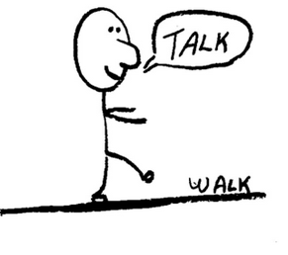
Monitoring Intensity - How hard?
moderate-vigorous intensity
measure by:
Rating of Perceived Exertion (scale of 0-10) - aim for 3-6
Talk test - you should be able to talk, but you shouldn’t be able to sing
Heart rate - can be inaccurate/difficult to measure, some medications can affect heart rate
Start slowly!
I will be able to identify how much aerobic exercise is needed for health benefits.

Slide 17
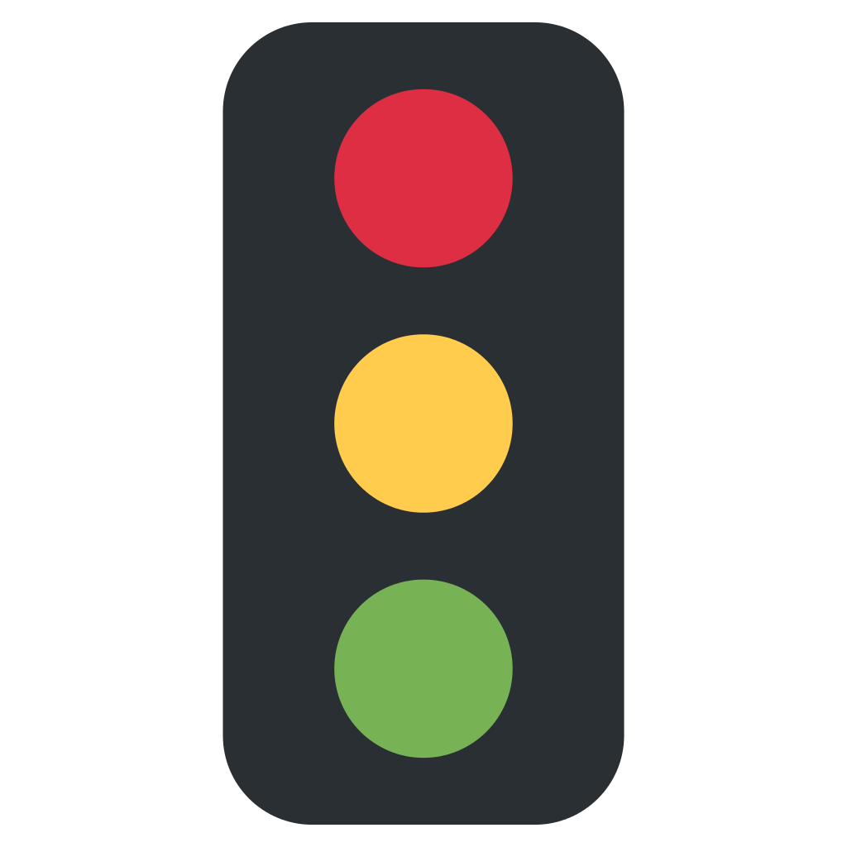
Keeping Safe
KEEP GOING
breathing faster, sweating, feels a bit challenging
SLOW DOWN
out of breath, difficult to talk
STOP
dizziness, significant shortness of breath, chest pain, etc.
I will be able to identify how much aerobic exercise is needed for health benefits.

Slide 18
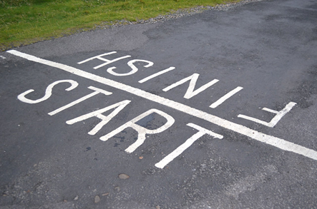
Getting Started
FITT Principle
Frequency - how often?
Intensity - how hard?
Time - how long?
Type - what?
Remember…
Set SMART goals
Start slowly
Establish the routine first, address intensity last
Focus on alignment/posture

Slide 19
Before You Start Exercising
For almost everyone the benefits of exercise far outweigh the risks!
complete a Get Active Questionnaire before you start a new exercise program and...
if you have any questions or concerns check with your doctor, a physiotherapist, a qualified exercise professional (Canadian Society for Exercise Physiology) or a BoneFitTM trained professional

Slide 20
Section 2
SMART Goal Setting

Slide 21
Planning and Goal Setting
In your Aerobic Exercise - Workshop Guide, consider the following:
This week…
decide how you want to continue with aerobic exercise
identify how you will take action to benefit from the information you have learned
identify goals that will help you stay motivated
I will be able to create a plan to continue or add aerobic exercise into my weekly routine.

Slide 22
How do I set goals?
Setting SMART goals helps you make clear, successful changes
Specific How will I do it? What, how much, when, how often?
Measurable How will I measure it? What will it look like to achieve my goal?
Achievable Can I do it? Can I keep doing it? Start small and build momentum.
Realistic Is it within reach? Does my goal fit into your everyday life?
Time-oriented When will I meet my goal?
I will be able to create a plan to continue or add aerobic exercise into my weekly routine.

Slide 23
Hints to Stay Motivated
schedule exercise into your week
use the words “I will”, not “ I will try…”
choose a goal that is meaningful to you
big goals need to be broken down into smaller steps
  but always keep your big goals in mind
reach out for support - recruit a “cheer team”
I will be able to create a plan to continue or add aerobic exercise into my weekly routine.

Slide 24
Cool-down Activity
Review your Get Active Questionnaire from the Starter Activity. In your Workshop Guide, consider
  what changes do you need to make to your daily routine?
  how can you make these changes?
  which areas should you focus on first?
Create a SMART goal for improving your exercise routine that you can work towards over the next week
I will be able to create a plan to continue or add aerobic exercise into my weekly routine.

Slide 25
Additional Resources
Osteoporosis Canada
osteoporosis.ca
Dr. David Hanley Osteoporosis Centre
osteoporosiscalgary.com
National Osteoporosis Foundation
nof.org

Slide 26





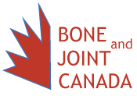
SPONSORS

Slide 27
Bibliography
Osteoporosis Canada. (2018). Too Fit to Fracture: Managing Osteoporosis through Exercise.
Alberta Health Services. (2013). Osteoporosis/Bone Health Education Program.

